Slide 1
An efficient algorithm to compute the minimum free energy of interacting nucleic acid strands
Ahmed Shalaby
3rd year PhD
Supervisor: Damien Woods

Slide 2
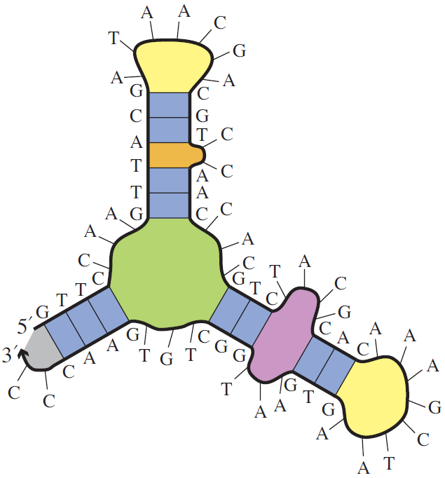
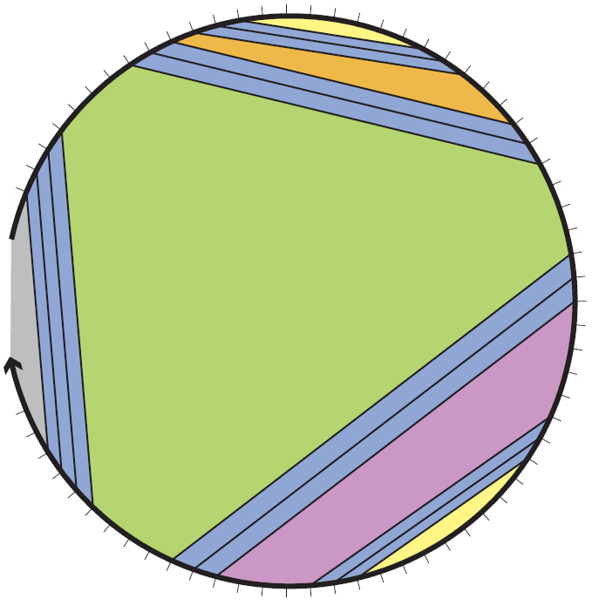
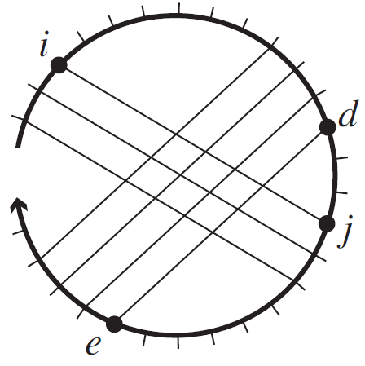
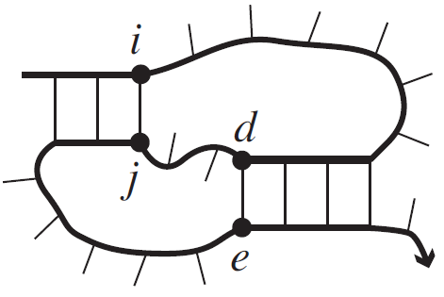
Secondary structure
Dirks et al. 2007
pseudoknot-free
$$U$$
A
T
T
C
Dirks et al. 2007
G
G
Single stranded DNA/RNA
Secondary structure
Polymer graph representation
$$NP−Complete$$
pseudoknotted
Dirks et al. 2007
Dirks et al. 2007

Slide 4
Secondary structure
A
A
G
U
U
C
C
A
A
A
G
U
U
C
C
A
A
A
G
U
U
C
C
A
A
A
G
U
U
C
C
A
. . .
A
A
G
U
U
C
C
A
$$Ω$$
. . .
Which secondary structure is more favourable?

Slide 5
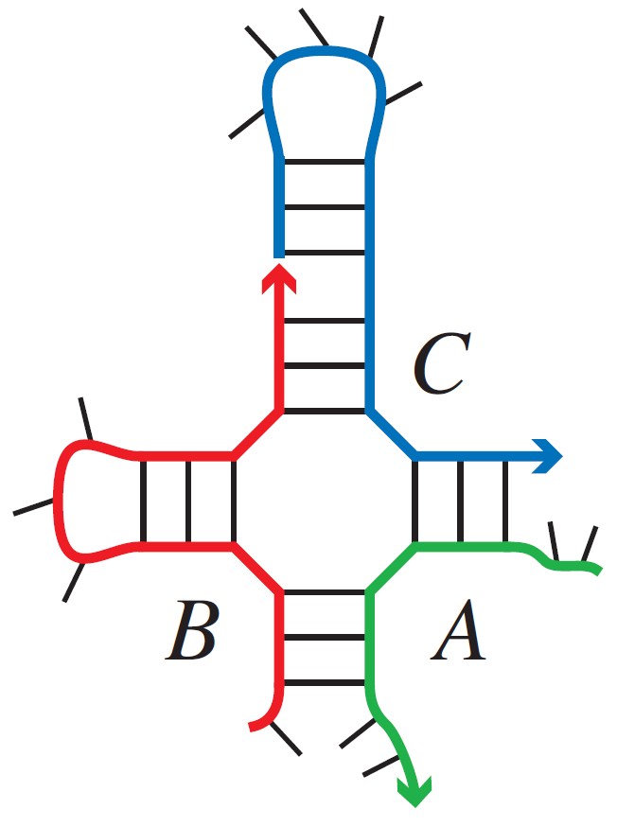
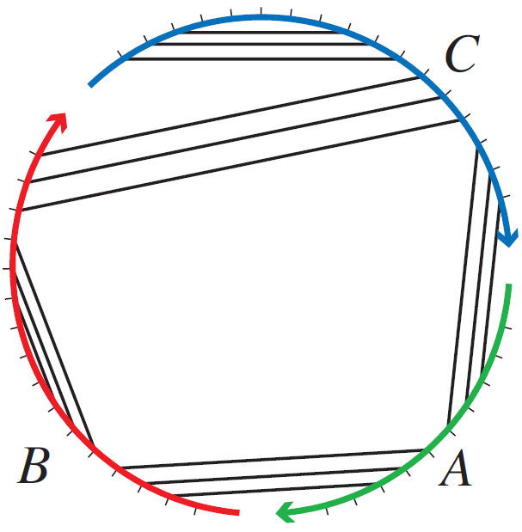
Energy models, Minimum Free Energy and Partition Function
Single stranded system
Multi stranded system of $c$ strands
Dirks et al. 2007
$$ΔG\left(S\right)$$
Energy model
Capture the free energy
of secondary structure
Dirks et al. 2007
Boltzmann weighted sum
Free energy
$$Q=\sum_{S∈Ω}{e^{−ΔG\left(S\right)/k_{B}T}}$$
$$⇒$$
$$Pr⁡[S]=\frac{e^{−ΔG\left(S\right)/k_{B}T}}{Q}$$
$$MFE= \min_{S∈Ω}{ΔG\left(S\right)}$$
Minimum Free Energy
Partition Function
System secondary structures

Slide 6
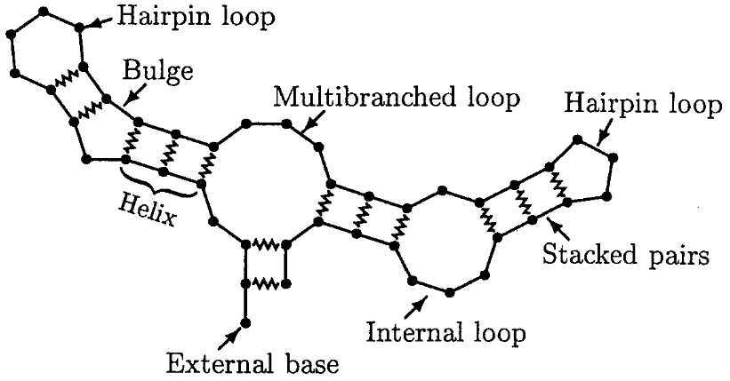
Energy model: Nearest neighbour model
Dirks et al. 2007
$$l_{1}$$
Lyngsø and Pedersen 2000
$$D$$
$$l_{2}$$
$$l_{3}$$
$$l_{4}$$
$$l_{6}$$
$$l_{k}$$
$$l_{9}$$
c = 3 strands
unique strands
$$ΔG\left(S\right)=ΔG\left(l_{1}\right)+ΔG\left(l_{2}\right)+…+ΔG(l_{k})$$
$$ΔG\left(S\right)=\sum_{l∈S}{ΔG(l)}+(c−1) ΔG^{assoc}$$
$$ΔG\left(S\right)=\sum_{l ∈ S}{ΔG(l)}$$
$$\min_{S∈Ω}{ΔG(S)}$$
$Ω:$ the set of all secondary structures

Slide 7
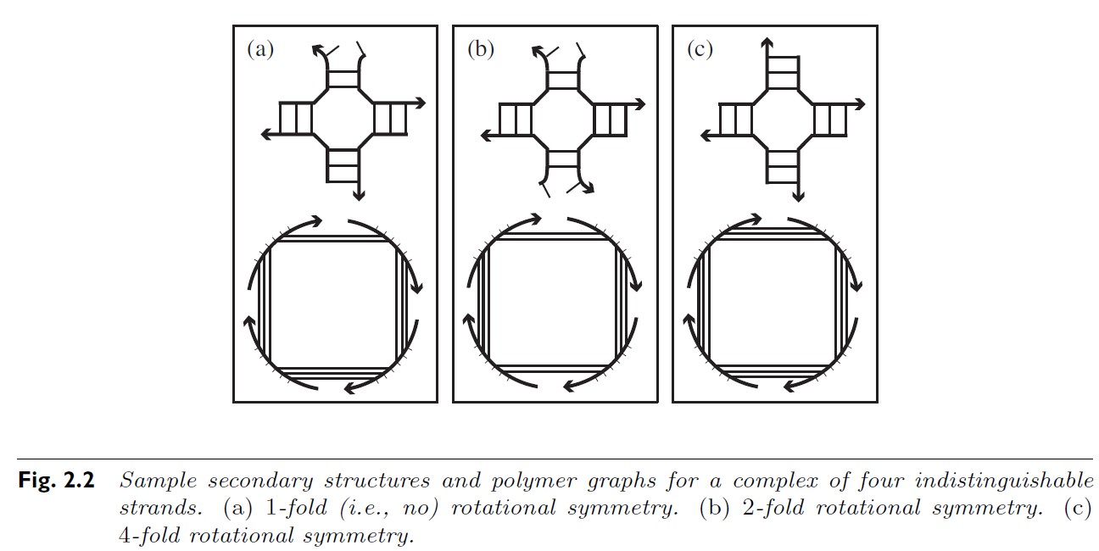
Energy model: Nearest neighbour model (allowing repeated strands)
$$−$$
$$+$$
$$+$$
Free energy
Loop energy
Entropic association cost
Symmetry penalty
$$ΔG\left(S\right)= \sum_{l∈S}{ΔG\left(l\right)}+\left(c−1\right)∗∆G^{assoc}+k_{B}T∗logR$$
Dirks et al. 2007
c$=4$ strands
$$\min_{S∈Ω}{ΔG(S)}$$
1
2
4
$Ω:$ the set of all connected structures
$R:$ degree of rotational symmetry

Slide 8
Computational complexity of Minimum Free Energy algorithms
Input Type | MFE
Single Strand | $$O(N^{4})$$
Multiple unique Strands, Bounded $(≤c)$ | $$O\left(N^{4}\left(c−1\right)!\right)$$
Multiple Strands allowing repeats, Bounded $(≤c)$ | $$?$$
Multiple Strands, Unbounded | $$NP−Complete$$
Nussinov et al. 1980
Dirkis er al. 2007
Condon et al. 2021
$N$bases, $c$ strands
Open problem for $≈20$ years

Slide 9
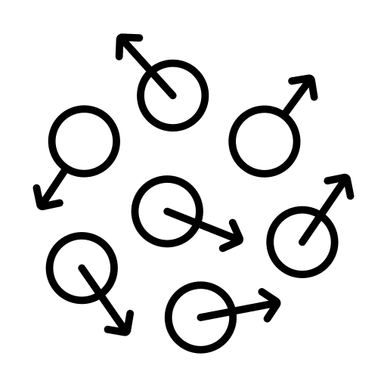
Why symmetry makes that difference?
Entropy

Slide 10
$$ΔG$$
Free energy
Enthalpy
H
Entropy
S

Slide 11
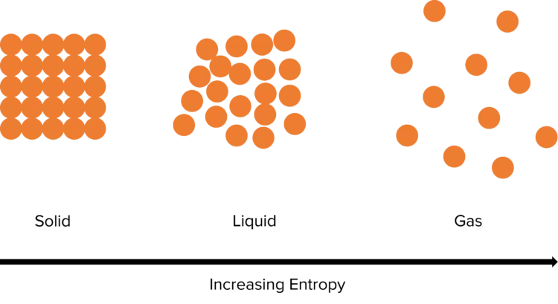

Slide 12
$$S=k_{B}\log{Π}$$
$$N$$
The total number of states of the $N$ magnets is $Π=2^{N}$
$$S=k_{B}N log 2$$
$$\frac{N}{2}$$
$$\frac{N}{2}$$
$$Π=2^{N/2}$$
$S=$ $k_{B}\frac{N}{2} log 2$

Slide 13
Free energy
Loop energy
Entropic association cost
Symmetry penalty
$$ΔG\left(S\right)= \sum_{l∈S}{ΔG\left(l\right)}+\left(c−1\right)∗∆G^{assoc}+k_{B}T∗logR$$

Slide 14
Why is this difficult?

Slide 15
Why symmetry makes it difficult?
Input Type | MFE
Single Strand | $$O(N^{4})$$
Multiple unique Strands, Bounded $(≤c)$ | $$O\left(N^{4}\left(c−1\right)!\right)$$
Multiple Strands, Bounded $(≤c)$ | $$?$$
Dynamic
programming
algorithms
$N$bases, $c$ strands
All of these are dynamic programming algorithms
Subproblems
Big problem

Slide 16
All of these are dynamic programming algorithms
Subproblems
Big problem
Local point of view
?
Global property

Slide 17
Our solution

Slide 19
$$S_{x}$$
Symmetric
$$ΔG′\left(S\right)$$
$$X$$
$S_{x}$ and $S_{y}$
Admissible cut
$${ΔG′(S}_{y})≤ΔG′(S_{x})$$
$$S_{z}$$
Asymmetric
$${ΔG′(S}_{y})≤ΔG\left(S_{z}\right)≤ΔG′(S_{x})$$
$$S_{y}$$
Symmetric

Slide 20
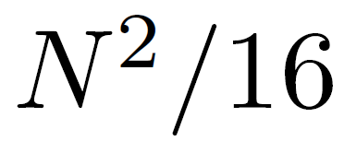
$$S_{x}$$
Upper bound
Symmetric
$$+$$
$$X$$
$$S_{z}$$
$S_{x}$ and $S_{y}$
Admissible cut
Asymmetric
Adjusting the backtracking algorithm to go through energy levels sequentially starting from the MFE level.
$$S_{y}$$
Symmetric

Slide 21
$$Ω$$
$$ΔG′\left(S\right)$$
$$Polynomial$$

Slide 22
$$Ω$$
$$ΔG′\left(S\right)$$
$$Polynomial$$

Slide 23
Computational complexity of Minimum Free Energy algorithms
Input Type | MFE
Single Strand | $$O(N^{4})$$
Multiple unique Strands, Bounded $(≤c)$ | $$O\left(N^{4}\left(c−1\right)!\right)$$
Multiple Strands, Bounded $(≤c)$ | $$O\left(N^{4}\left(c−1\right)!\right)$$
Multiple Strands, Unbounded | $$NP−Complete$$
$N$bases, $c$ strands

Slide 24
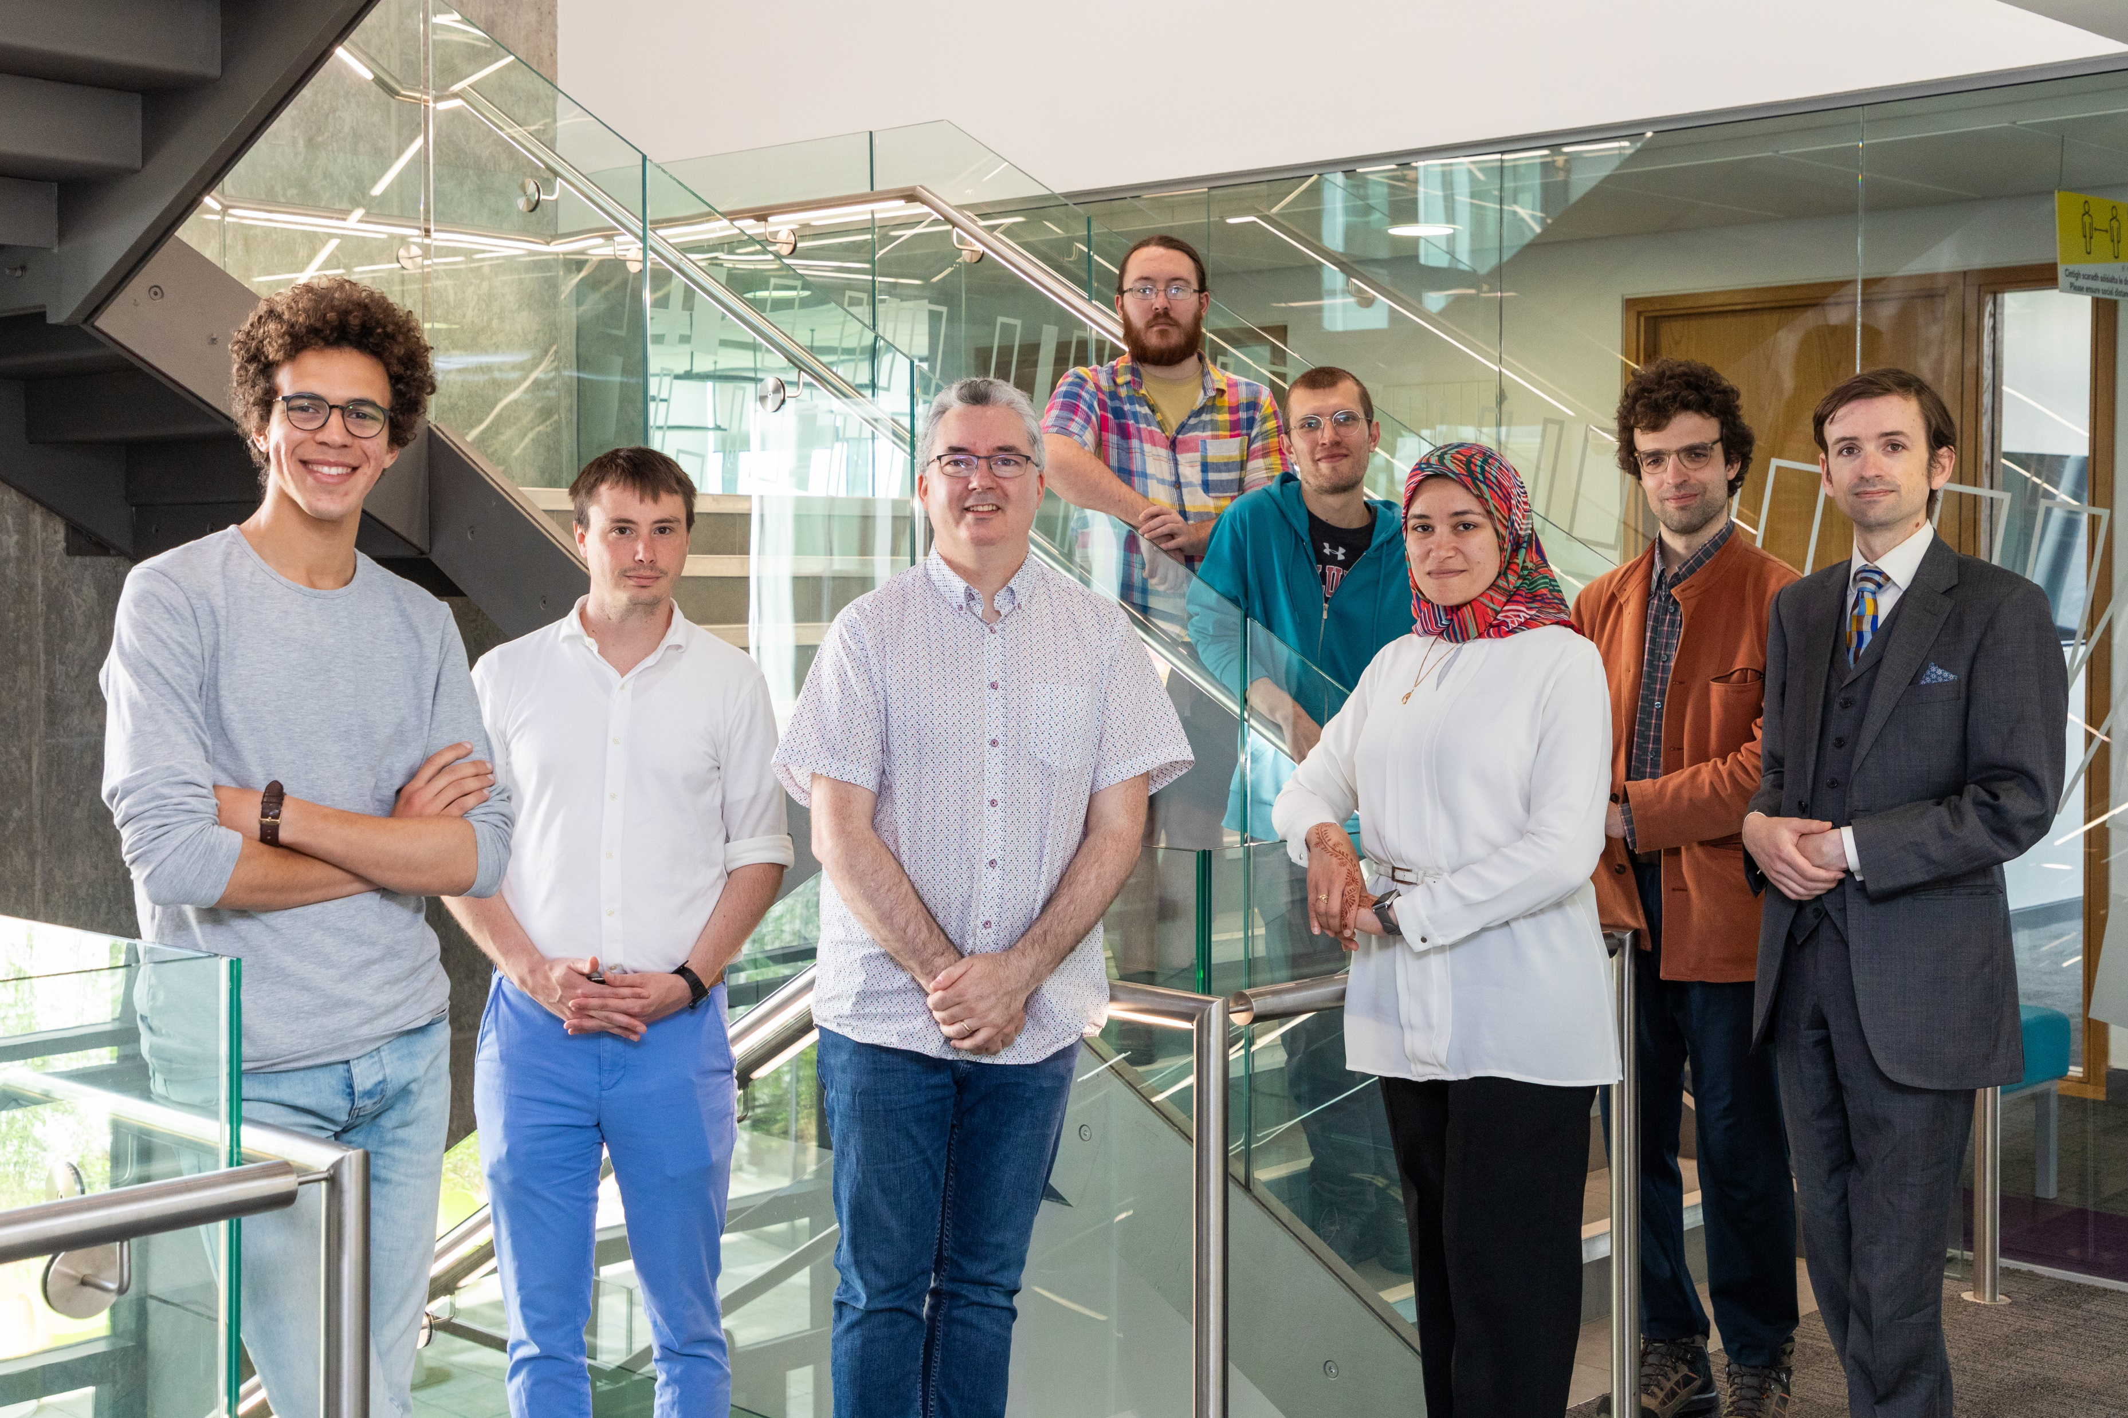
Thanks
dna.hamilton.ie/shalaby
We're hiring!

