Slide 1
Thermodynamics of a multistranded one-dimension Scaffolded DNA Computer
Ahmed Shalaby
1st year PhD
Computer Science Department
Supervisor: Damien Woods

Slide 2
Agenda
What is 1D Scaffolded DNA Computer?
What is the thermodynamic aspects we are interested in?
Minimum free energy.
Partition function.
How to compute Partition function efficiently?
SDC kinetic simulation and experimental results.

Slide 3
1
1
1
1
2
2
2
2
Free persons
With colored gloves
...
...
...
...
$$k_{1}$$
$$k_{2}$$
$$k_{3}$$
$$k_{N}$$
. . .
1
2
3
N
How many different configurations we will have ?
(Exponential in the # of chairs)

Slide 4
Ahmed
Cai
Ismail
Damien
$$X$$
1
2
3
4
5
$E\left(X\right)=sit\left(Ahmed\right)+sit\left(Cai\right)+sit\left(Ismail\right)+sit\left(Damien\right)+4 ∗sit_convincing_cost+handshake\left(Cai,Ismail\right)$.
+
+
+
+
-
+
E$\left(X\right)=\sum_{p∈X}{sit\left(p\right)+l∗sit_convincing_cost+\sum_{p_{i},p_{i+1}∈X}{handshake\left(p_{i},p_{i+1}\right).}}$
configuration $X^{ }$ of size $l$
We further assume the following:
$|sit(p)|>|sit_convincing_cost|$. (you always gain by convincing a person to sit)

Slide 5
$$Ω$$
The Maximum Energy $M$
$$0$$
$$4$$
$$M≔ \max_{X∈Ω}{\{E\left(X\right)\}}$$
A
C
$$2$$
The Partition function $Q$
B
D
$$4$$
$$Q≔ \sum_{X∈Ω}{e^{\frac{E(X)}{c}}}$$
$$2$$
1
2
Where $c$ is some specific constant
$$5$$
$sit\left(A\right)=sit(B)=3$
$sit\left(C\right)=sit(D)=3$
$handshake\left(B,C\right)$ = 1
$sit_convincing_cost$ = -1
$$1$$
Why are we interested in this ?
$$4$$
$$1$$

Slide 6
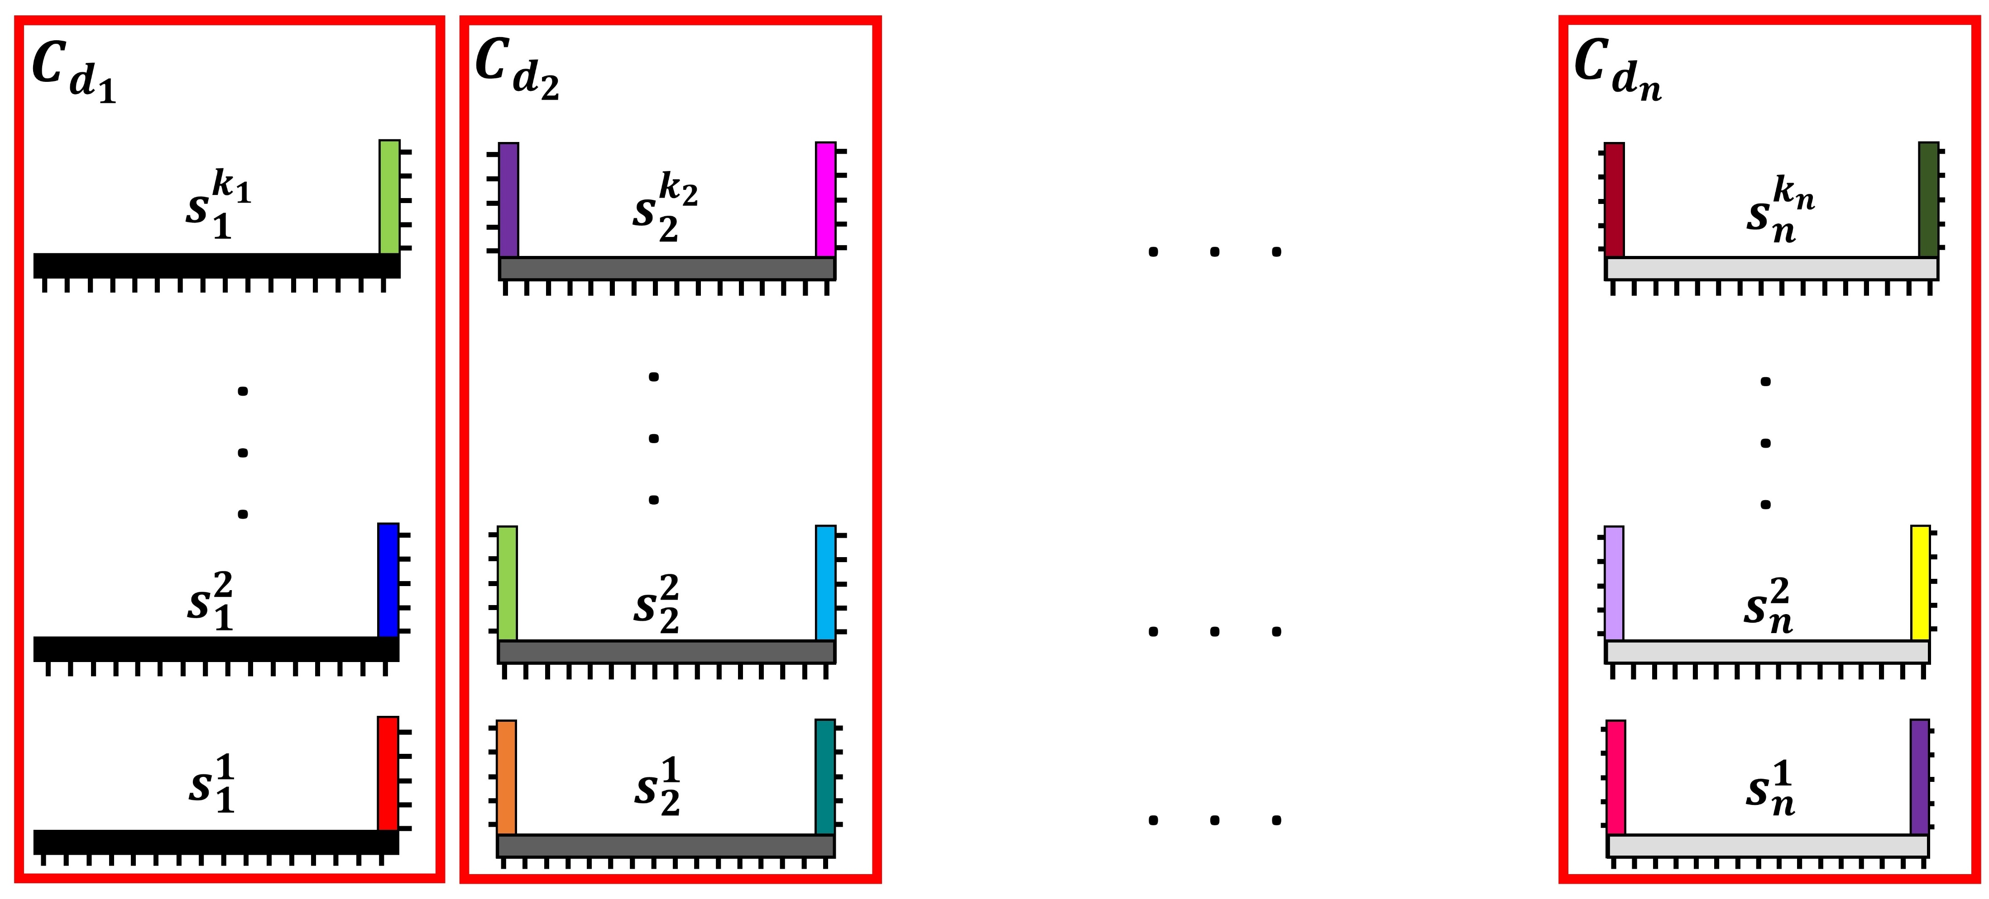
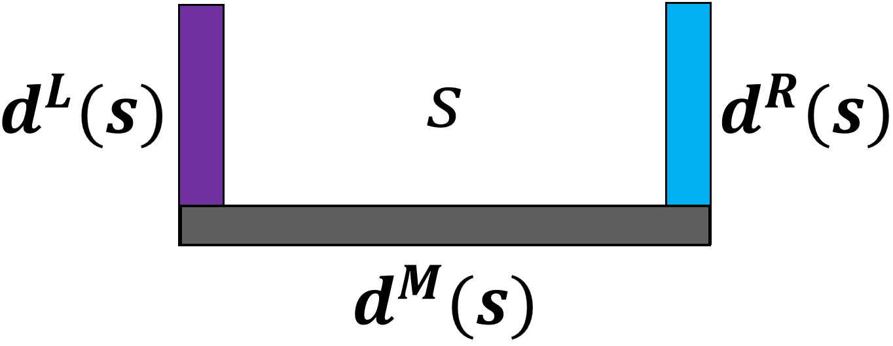
This is 1D Scaffolded DNA Computer
1
1
1
1
2
2
2
2
...
...
...
...
$$k_{1}$$
$$k_{2}$$
$$k_{3}$$
$$k_{N}$$
. . .
A
T
A
G
C
T
1
2
3
N
The Scaffold

Slide 7
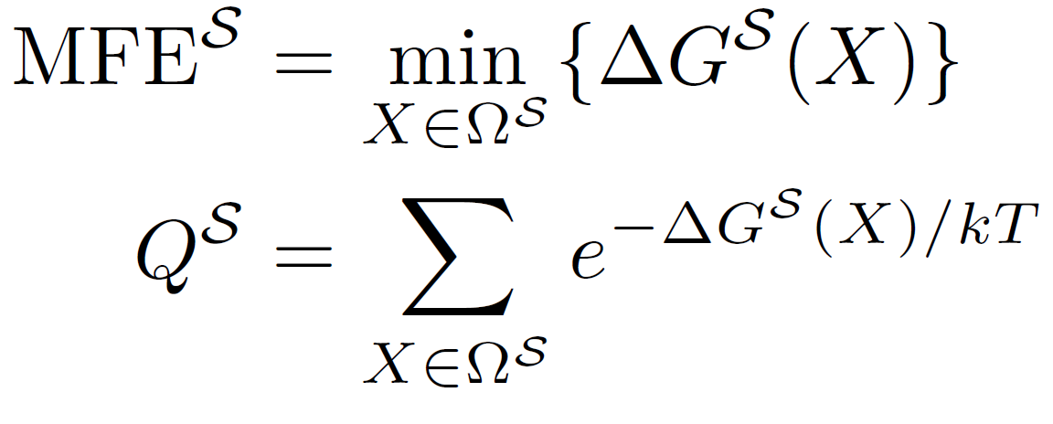
1D Scaffolded DNA Computer Energy model and thermodynamic features
For any configuration $X^{ }$ of size $l$:
DNA
$$X$$
Chair
E$\left(X\right)=\sum_{p∈X}{sit\left(p\right)+l∗sitcost+\sum_{p_{i},p_{i+1}∈X}{handshake\left(p_{i},p_{i+1}\right).}}$
NP-Hard in base level case
$T$ is the temperature in (kelvin) and $k$ is Boltzmann constant.
Intuitively, the MFE is the energy of the most favored configuration(s) of the system.
The partition function is a Boltzmann-weighted sum of the energies of every configuration of the system and typically used as a normalization factor to calculate the probability of any configuration $X$ at equilibrium: $p(X) = (e^{−ΔG^{𝒮}(X)/kT})/Q^{𝒮}$.

Slide 8
What is interesting in Scaffolded DNA Computer (SDC) ?
DNA strand displacement
computationally expressive:
simulate finite state machines in 1D.
Boolean circuits in 2D.
amenable to DNA storage applications.
The SDC has been implemented experimentally in 1D, showcasing a total of 10 programs that solve problems such as
Bit-copy
Addition of two 4-bit numbers
Parity of an 8-bit input (is the number of 1s odd?)
Graph Reachability (is there a path in an input graph from a source node s to a target node t)
Initial designs and results in 2D include Addition of two 7-bit numbers and a simple Bit-Copy program.
1
2
3
4
1
2
4
1
2
3
4
3

Slide 9
$$Ω$$
Is there recursive way to build these classes from themselves?
$${Ω }_{C}$$
$${Ω }_{D}$$
$${Ω }_{ε}$$
D
C
A
C
$${Ω }_{A}$$
A
A
C
A
D
B
D
C
B
D
$${Ω }_{B}$$
B
1
2
B

Slide 10
0
1
$$k_{1}$$
. . .
1
1
$$k_{2}$$
...
2
1
$$k_{1}$$
1
$$k_{1}$$
...
...

Slide 11
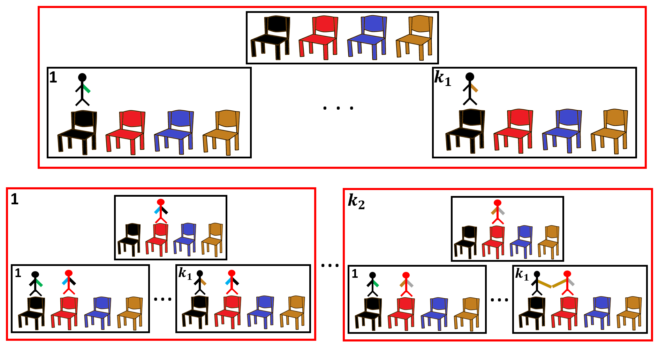
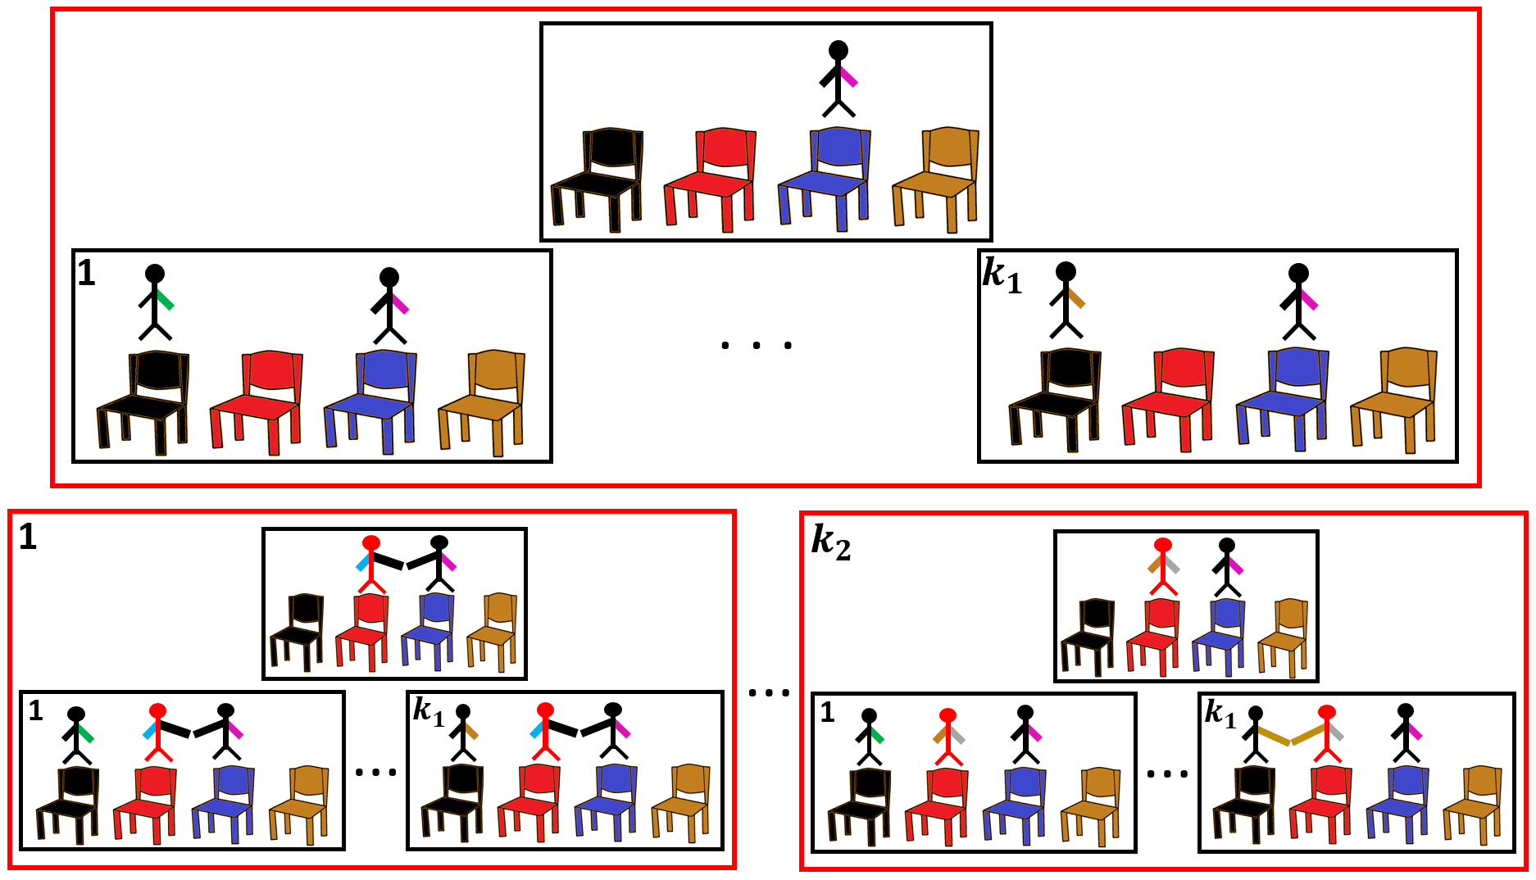
0
Layer = chair
1
$$Ω_{ϵ}$$
Cai
$$Ω_{Cai}$$
There is a 1-1 correspondence between each class of higher layers and a sub-class of any class in current layer.
$$Ω_{Damien}$$
Damien
2
Damien
Damien
$$Ω_{p}$$
$$Ω_{ϵ→Ahmed}$$
$$Ω_{Cai→Ahmed}$$
$$Ω_{p→p′}$$
3
. . .
. . .
1
$$k_{3}$$
$$Ω_{Damien→Ahmed}$$
a sub-class of the class $Ω_{p′}$ where $p$ is the nearest neighbour to $p’$.
$$Ω_{Ahmed}$$

Slide 12
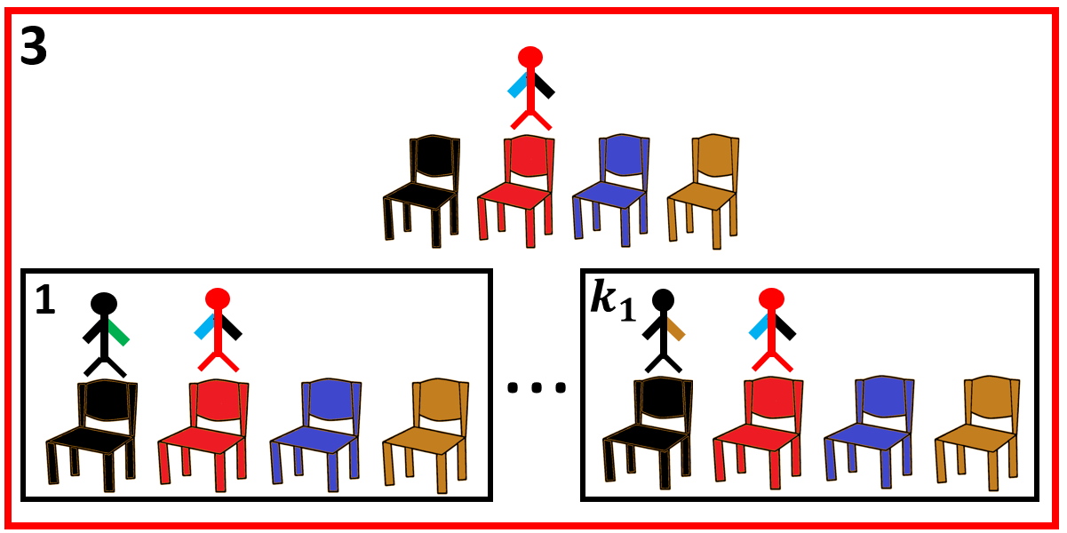
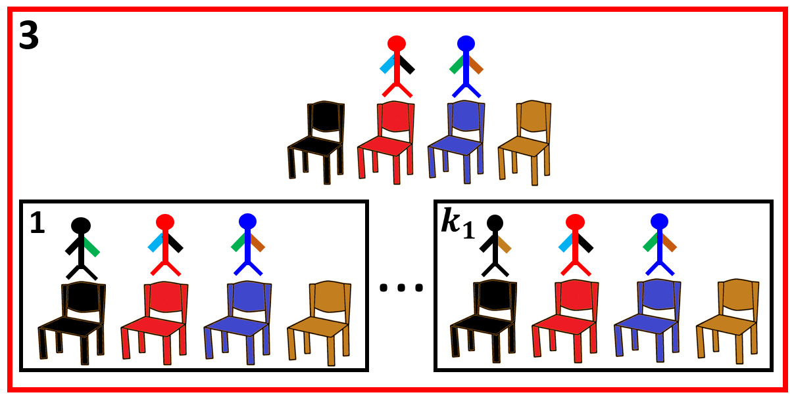
Can we use this inductive construction process to propagate information through this hierarchy ?
1 - Propagate information from exactly the previous layer (Direct neighbour handshaking possibility).
$$Ω_{Damien}$$
$$Ω_{Damien→Ahmed}$$
$$Damien$$
$$Damien$$
$$Ahmed$$
$$Damien$$
$$Damien$$
$$Damien$$
$$Ahmed$$
$$Damien$$
$$Ahmed$$
Information given:$Q\left(Ω_{Damien}\right)$
Information needed: $Q\left(Ω_{Damien→Ahmed}\right)$
$$Q\left(Ω_{Damien→Ahmed}\right)= . . . ={ e}^{\frac{sit\left(Ahmed\right) + Sit_Cost}{c}}∗{ e}^{\frac{handshake\left(Damien,Ahmed\right) }{c}} ∗Q\left(Ω_{Damien}\right)$$

Slide 13
2 - Propagate information from the rest (No handshaking possibility).
$$Ω_{Cai→Ahmed}$$
$$Ω_{Cai}$$
$$Cai$$
$$Ahmed$$
$X$’
$$Cai$$
$$X$$
Information given:$Q\left(Ω_{Cai}\right)$
Information needed: $Q\left(Ω_{Cai→Ahmed}\right)$
$$Q\left(Ω_{Cai→Ahmed}\right) = . . . = e^{\frac{sit\left(Ahmed\right)+sit_cost}{c}}∗Q\left(Ω_{Cai}\right)$$

Slide 14
$$Q =1+\sum_{p}{Q(Ω_{p})}$$
$$Q\left(Ω_{p}\right)=e^{\frac{sit\left(p\right)+sit_cost}{c}}∗\left[\left(\sum_{\begin{aligned}p^{′}is \\ direct neighbour\end{aligned}}{{ e}^{\frac{handshake\left(p^{′},p\right) }{c}}} ∗Q\left(Ω_{p′}\right)\right)+1+\sum_{\begin{aligned}p^{′}is not \\ direct neighbour\end{aligned}}{Q\left(Ω_{p′}\right)}\right]$$

Slide 15
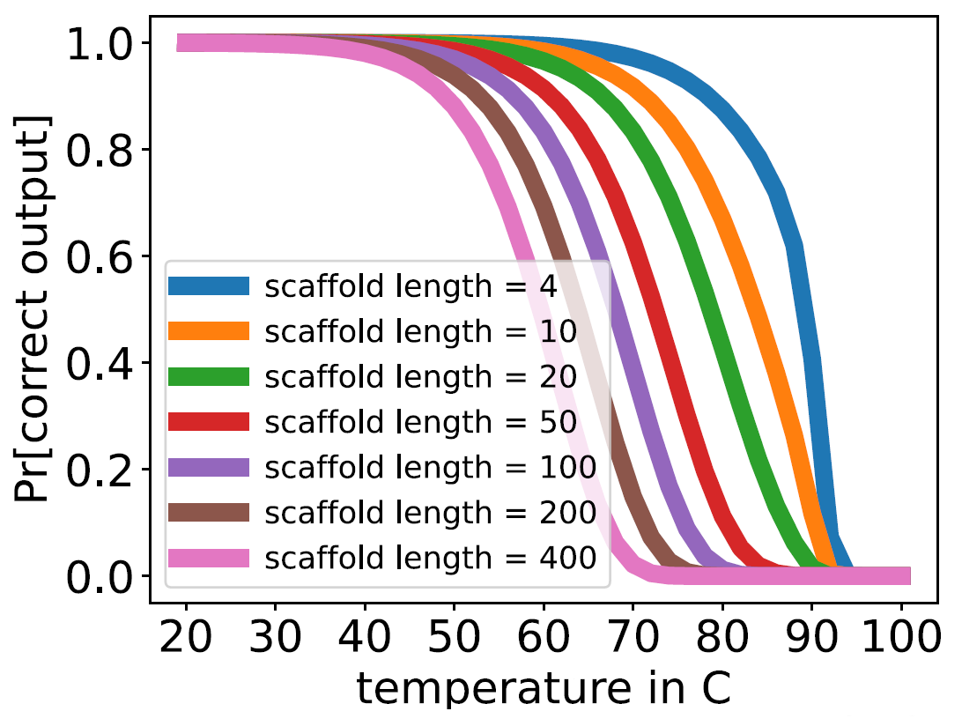
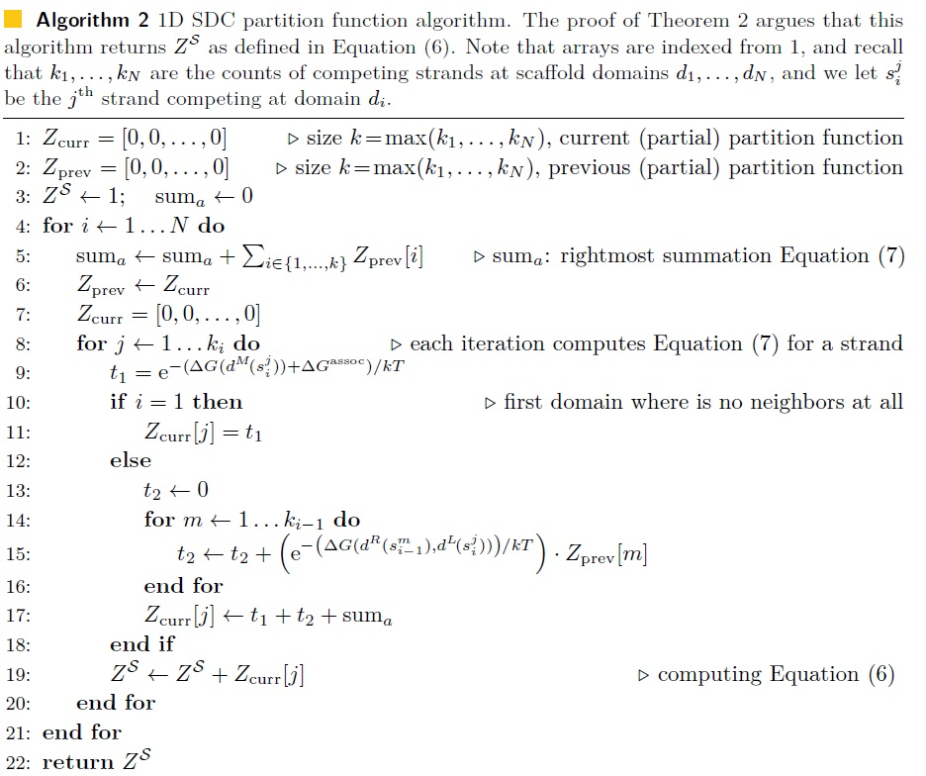

Slide 16
Thanks

