Slide 1
Thermodynamics of a multistranded one-dimension Scaffolded DNA Computer
The Curse of Hamilton’s Chairs
Ahmed Shalaby
2nd year PhD
Supervisor: Damien Woods

Slide 2
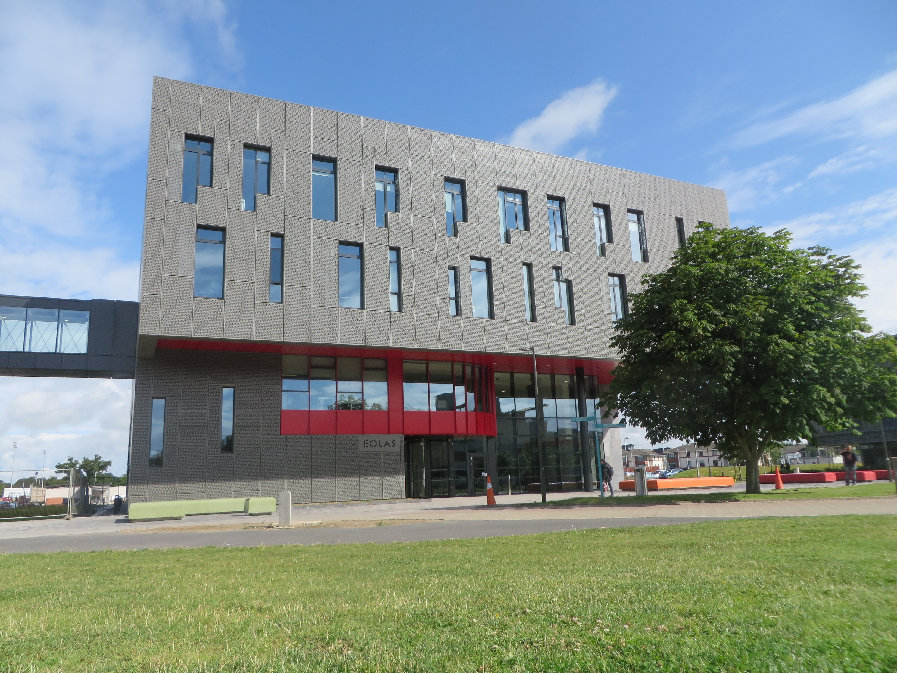
Let’s discover the rules of the game

Slide 3
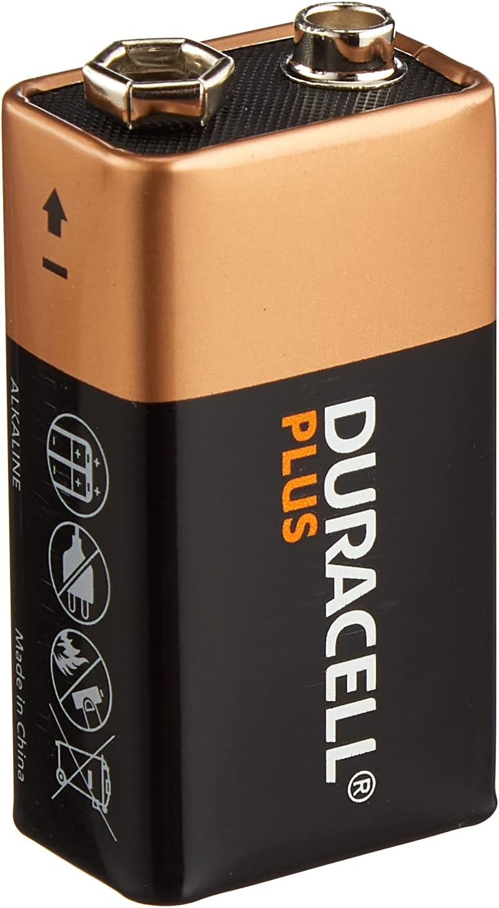
1
1
1
1
2
2
2
2
...
...
...
...
Damien
PhD students
With colored clothes and gloves
$$k_{1}$$
$$k_{2}$$
$$k_{3}$$
$$k_{N}$$
. . .
Hamilton
1
2
3
N
How many different configurations we will have ?
$${(K+1)}^{N}$$
(Exponential in the # of chairs)

Slide 4
Emma
Yc
Akash
$$X$$
Damien
1
2
3
4
5
Hamilton
$$E\left(X\right)=sit\left(Emma\right)+sit\left(Yc\right)+sit\left(Akash\right)+handshake\left(Emma,Yc\right)$$
$+ 3∗sit_convincing_cost$.
+
+
+
+
-
E$\left(X\right)=\sum_{p∈X}{sit\left(p\right)+\sum_{p_{i},p_{i+1}∈X}{handshake\left(p_{i},p_{i+1}\right)+l∗sit_convincing_cost.}}$
configuration $X^{ }$ of size $l$PhD students
We further assume the following:
$|sit(p)|>|sit_convincing_cost|$. (Damien always gains by convincing a PhD student to sit)

Slide 5
Built–in self improvement mechanism
PhD students' displacement system
Akash
Paddy
Paddy
Yc
Akash
Blake
Damien
1
2
3
4
Hamilton

Slide 6
$$Ω$$
$$0$$
The Maximum Energy $M$
$$M≔ \max_{X∈Ω}{\{E\left(X\right)\}}$$
$$4$$
A
C
$$2$$
B
D
$$4$$
Free energy
$$2$$
1
2
Configuration space
$sit\left(A\right)=sit(B)=3$
$sit\left(C\right)=sit(D)=3$
$handshake\left(B,C\right)$ = 1
$sit_convincing_cost$ = -1
$$5$$
The Partition function $Q$
$$1$$
$$Q≔ \sum_{X∈Ω}{e^{\frac{E(X)}{c}}}$$
$$4$$
$$1$$
Where $c$ is some specific constant

Slide 7
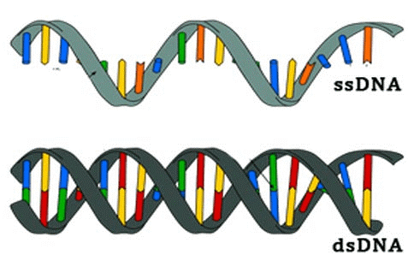
Why are we interested in this ?

Slide 8
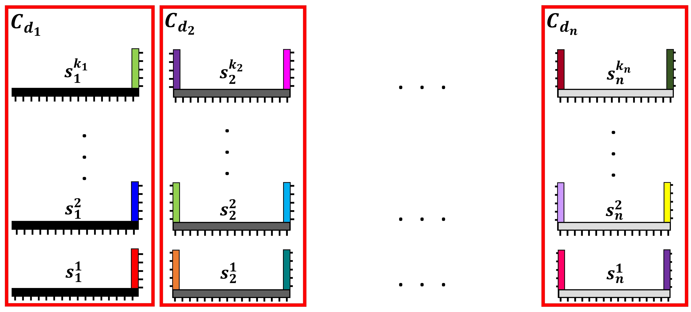
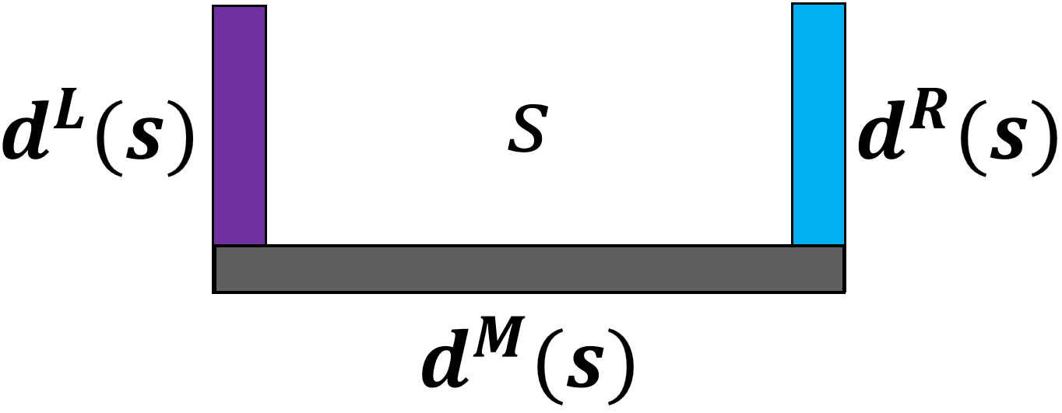
This is 1D Scaffolded DNA Computer
1
1
1
1
2
2
2
2
...
...
...
...
$$k_{1}$$
$$k_{2}$$
$$k_{3}$$
$$k_{N}$$
. . .
A
T
A
G
C
T
1
2
3
N
The Scaffold

Slide 9
Built–in algorithmic self correction mechanism
DNA strand displacement

Slide 10
1D Scaffolded DNA Computer Energy model and thermodynamic features
For any configuration $X^{ }$ of size $l$:
Chair
E$\left(X\right)=\sum_{p∈X}{sit\left(p\right)+l∗sitcost+\sum_{p_{i},p_{i+1}∈X}{handshake\left(p_{i},p_{i+1}\right).}}$
DNA
$$X$$
Free energy
Boltzmann weighted sum
$$Q=\sum_{S∈Ω}{e^{−ΔG\left(S\right)/k_{B}T}}$$
$$⇒$$
$$Pr⁡[S]=\frac{e^{−ΔG\left(S\right)/k_{B}T}}{Q}$$
$$MFE= \min_{S∈Ω}{ΔG\left(S\right)}$$
Minimum Free Energy
Partition Function
System secondary structures

Slide 11
Scaffolded DNA Computer example: Bit-Copy
0
1
0
0
0
0
0
0
Input 1
$$1$$
$$2$$
$$3$$
$$4$$
1
1
1
1
1
1
Compute
$$1$$
$$2$$
$$3$$
$$4$$
$$2$$
$$4$$
Input domain
Input 0
$$1$$
$$3$$
GOAL
$$Pr⁡[$$
$$]$$
$$≫\sum_{c }{Pr⁡[}$$
$$]$$
$$c :is another configuration$$
…
At equilibrium
$$MFE$$
$$Pr[target] =\frac{e^{− ΔG\left(target\right) /k_{B}T}}{Q}$$

Slide 12
Computational complexity of Minimum Free Energy and the Partition Function
Input Type | MFE | Partition Function
Single Strand | $$O(n^{3})$$ | $$O(n^{3})$$
Multiple Strands, Bounded $(≤s)$ | $$?$$ | $$O\left(n^{3}\right)\left(s−1\right)!$$
Multiple Strands, Unbounded | $$NP−Complete$$ | $$?$$
$n$bases, $s$ strands
GOAL
At equilibrium
$$Pr⁡[$$
$$]$$
$$\sum_{c }{Pr⁡[}$$
$$≫$$
$$]$$
$$c :is another configuration$$
Efficiently

Slide 13
Is there recursive way to build these classes from themselves?
$$Ω$$
$${Ω }_{C}$$
$${Ω }_{D}$$
$${Ω }_{ε}$$
D
C
A
C
B
D
$${Ω }_{A}$$
A
C
A
D
A
1
2
$$\left|Ω\right|={(k+1)}^{N} =9$$
B
C
B
D
$${Ω }_{B}$$
B
$$Q=\sum_{p∈Ω}{e^{−ΔG\left(p\right)/k_{B}T}}$$

Slide 14
0
1
$$k_{1}$$
. . .
1
1
$$k_{2}$$
...
2
1
$$k_{1}$$
1
$$k_{1}$$
...
...

Slide 15
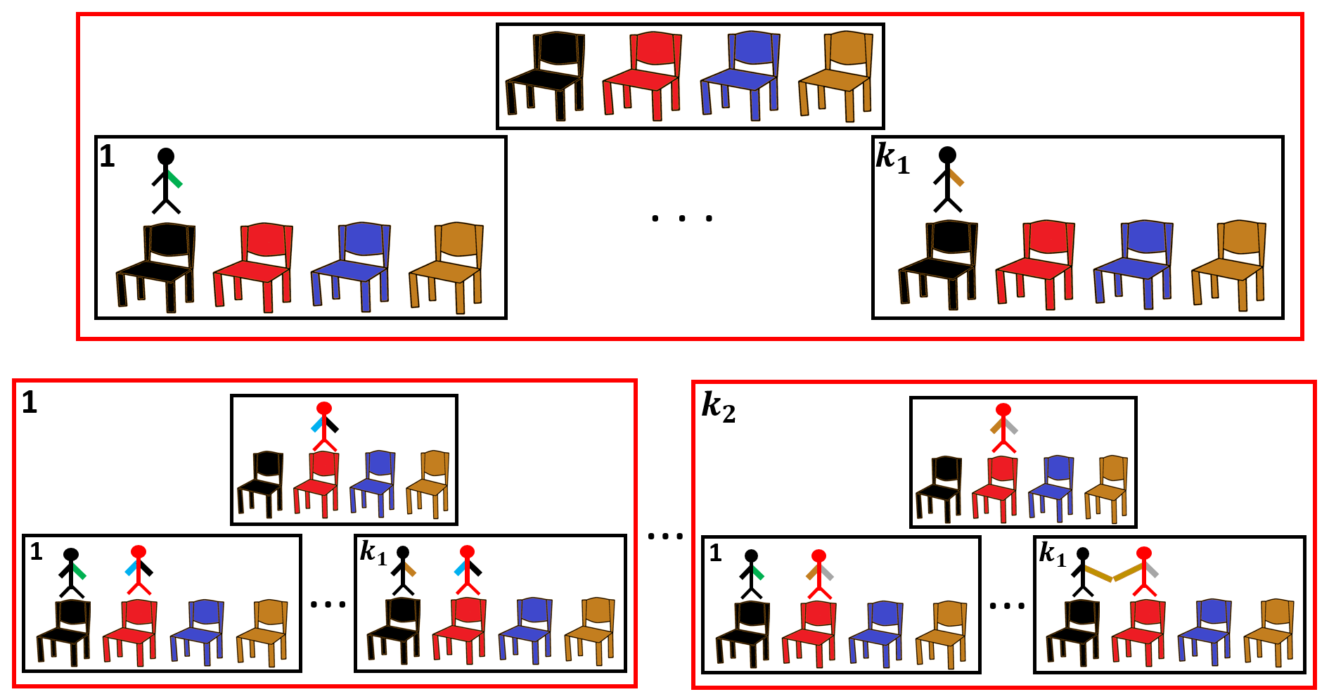
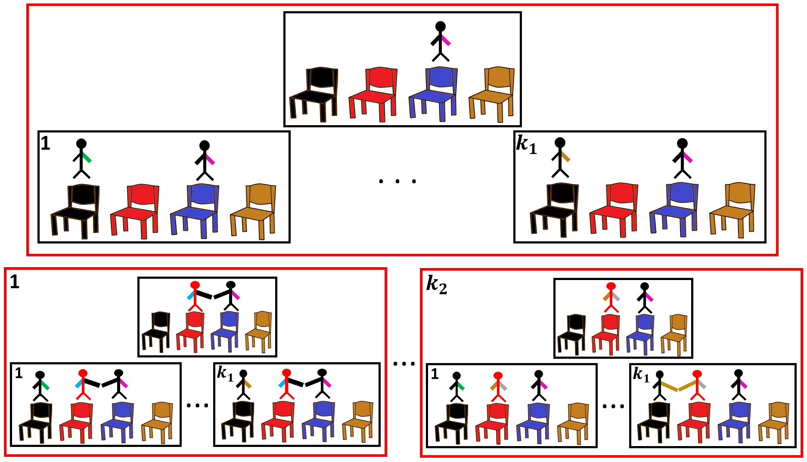
0
Layer = chair
There is a 1-1 correspondence between each class of higher layers and a sub-class of any class in the current layer.
1
Class
Cai
2
$$Ω_{Cai}$$
$$Ω_{Cai}$$
$$Ω_{Ahmed}$$
Ahmed
$$Ω_{Cai⟷Ahmed}$$
Class
3
. . .
. . .
$${⊂Ω}_{Ahmed}$$
1
$$k_{3}$$
Sub-class
Cai
$$Ω_{Cai⟷Ahmed}$$

Slide 16
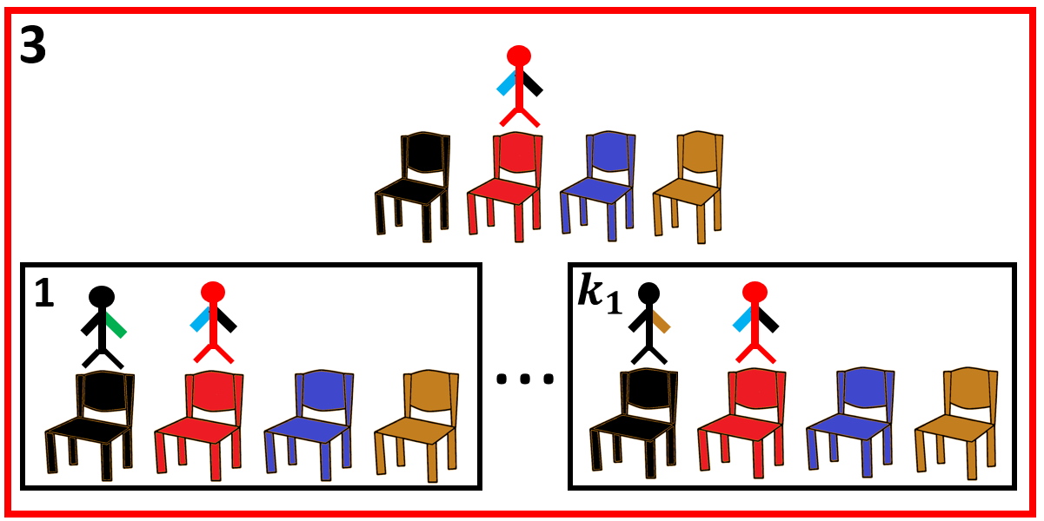
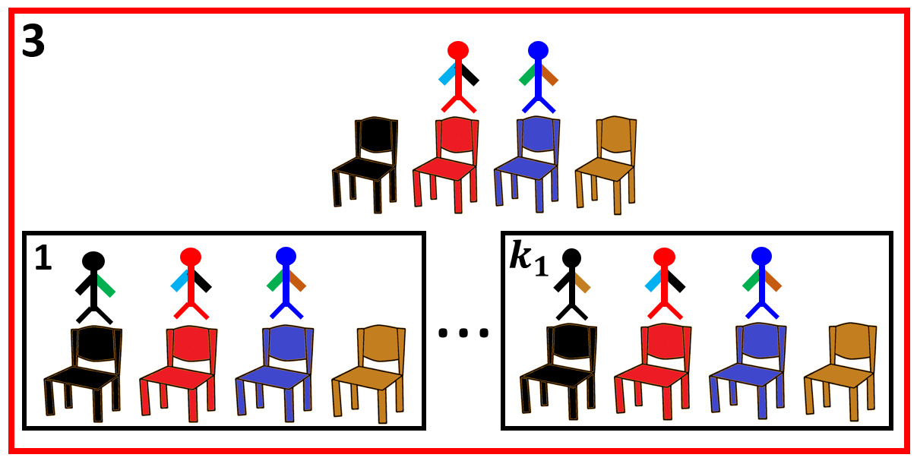
Can we use this inductive construction process to propagate information through this hierarchy ?
1 - Propagate information from exactly the previous layer (Direct neighbour handshaking possibility).
$$Ω_{Cai}$$
$$Ω_{Cai→Ahmed}$$
$$Cai$$
$$Cai$$
$$Ahmed$$
$$Cai$$
$$Cai$$
$$Cai$$
$$Ahmed$$
$$Cai$$
$$Ahmed$$
Information given:$Q\left(Ω_{Cai}\right)$
Information needed: $Q\left(Ω_{Cai⟷Ahmed}\right)$
$$Q\left(Ω_{Cai⟷Ahmed}\right)= . . . ={ e}^{\frac{sit\left(Ahmed\right) + Sit_Cost}{c}}∗{ e}^{\frac{handshake\left(Cai,Ahmed\right) }{c}} ∗Q\left(Ω_{Cai}\right)$$

Slide 17
2 - Propagate information from the rest (No handshaking possibility).
$$Ω_{Blake}$$
$$Ω_{Blake⟷Ahmed}$$
$$Blake$$
$$Ahmed$$
$$Blake$$
Information given:$Q\left(Ω_{Blake}\right)$
Information needed: $Q\left(Ω_{Blake→Ahmed}\right)$
$$Q\left(Ω_{Blake⟷Ahmed}\right) = . . . = e^{\frac{sit\left(Ahmed\right)+sit_cost}{c}}∗Q\left(Ω_{Blake}\right)$$

Slide 18
$$Q =1+\sum_{p}{Q(Ω_{p})}$$
$$Q\left(Ω_{p}\right)=e^{\frac{sit\left(p\right)+sit_cost}{c}}∗\left[\left(\sum_{\begin{aligned}p^{′}is \\ direct neighbour\end{aligned}}{{ e}^{\frac{handshake\left(p^{′},p\right) }{c}}} ∗Q\left(Ω_{p′}\right)\right)+1+\sum_{\begin{aligned}p^{′}is not \\ direct neighbour\end{aligned}}{Q\left(Ω_{p′}\right)}\right]$$

Slide 19
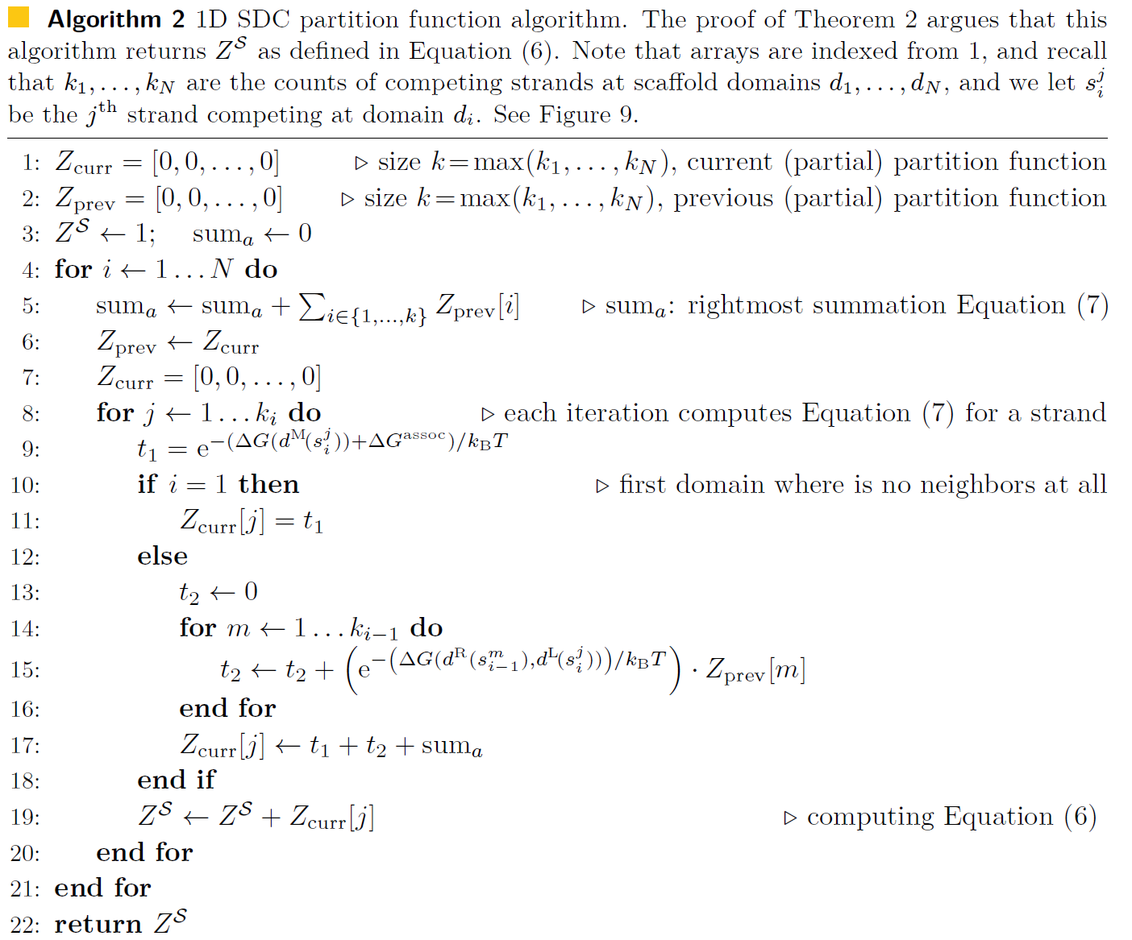
$$Q\left(Ω_{s}\right)=e^{\frac{−∆G(M(s))+∆G^{assoc}}{k_{B}T}}∗\left[\sum_{\begin{aligned}s^{′}∈{LD}_{s} \\ \end{aligned}}{\left({ e}^{\frac{−∆G\left(R\left(s^{′}\right), L\left(s\right)\right)}{k_{B}T}}∗Q\left(Ω_{s^{′}}\right)\right)}+1+\sum_{\begin{aligned}s^{′}≺s \\ s^{′}∉{LD}_{s}\end{aligned}}{Q\left(Ω_{p′}\right)}\right]$$
$$Q =1+\sum_{s∈T}{Q(Ω_{s})}$$

Slide 20
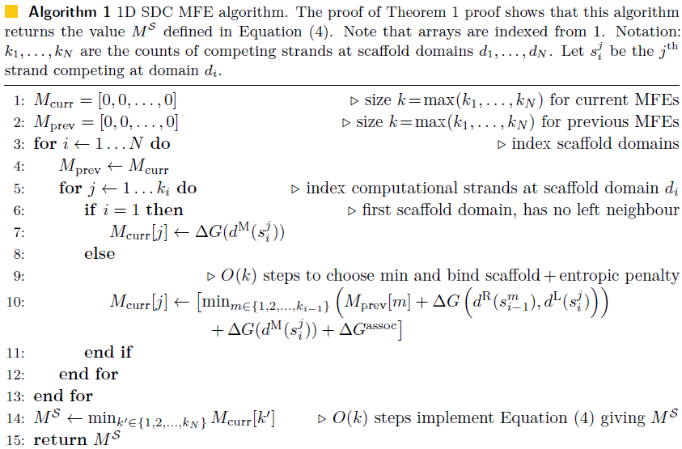

Slide 21
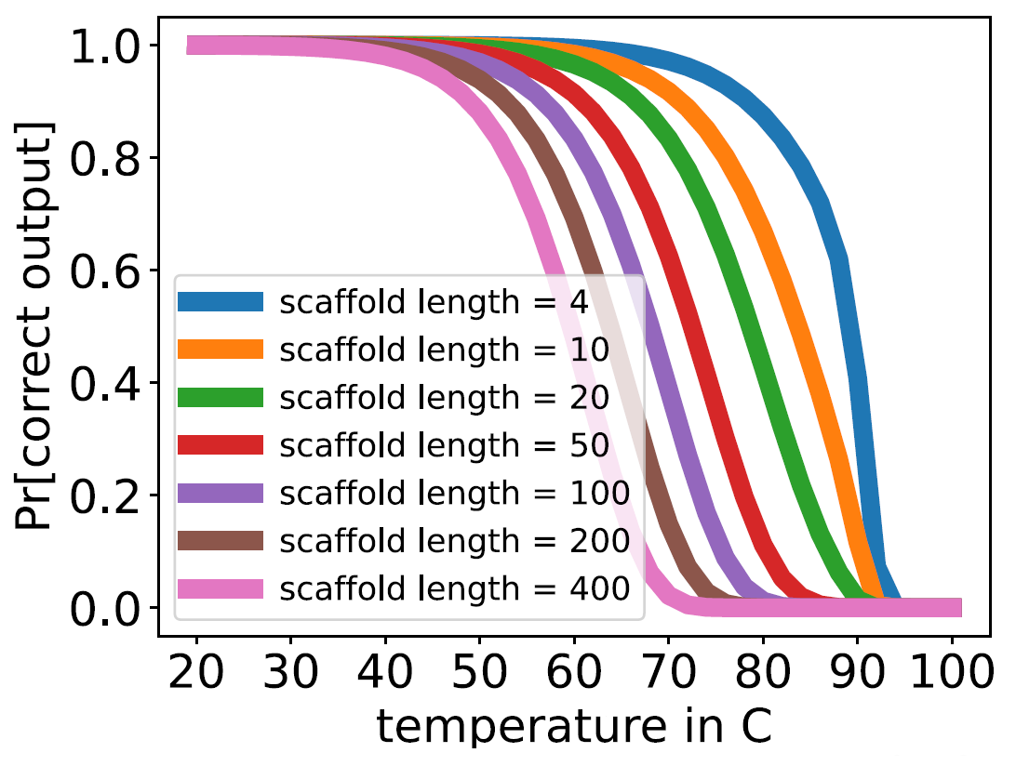
Benefits of Domain Based models !!
Previous: 1 simulation of length 13
Now: 280 simulations in 20 min [800 strands]

Slide 22
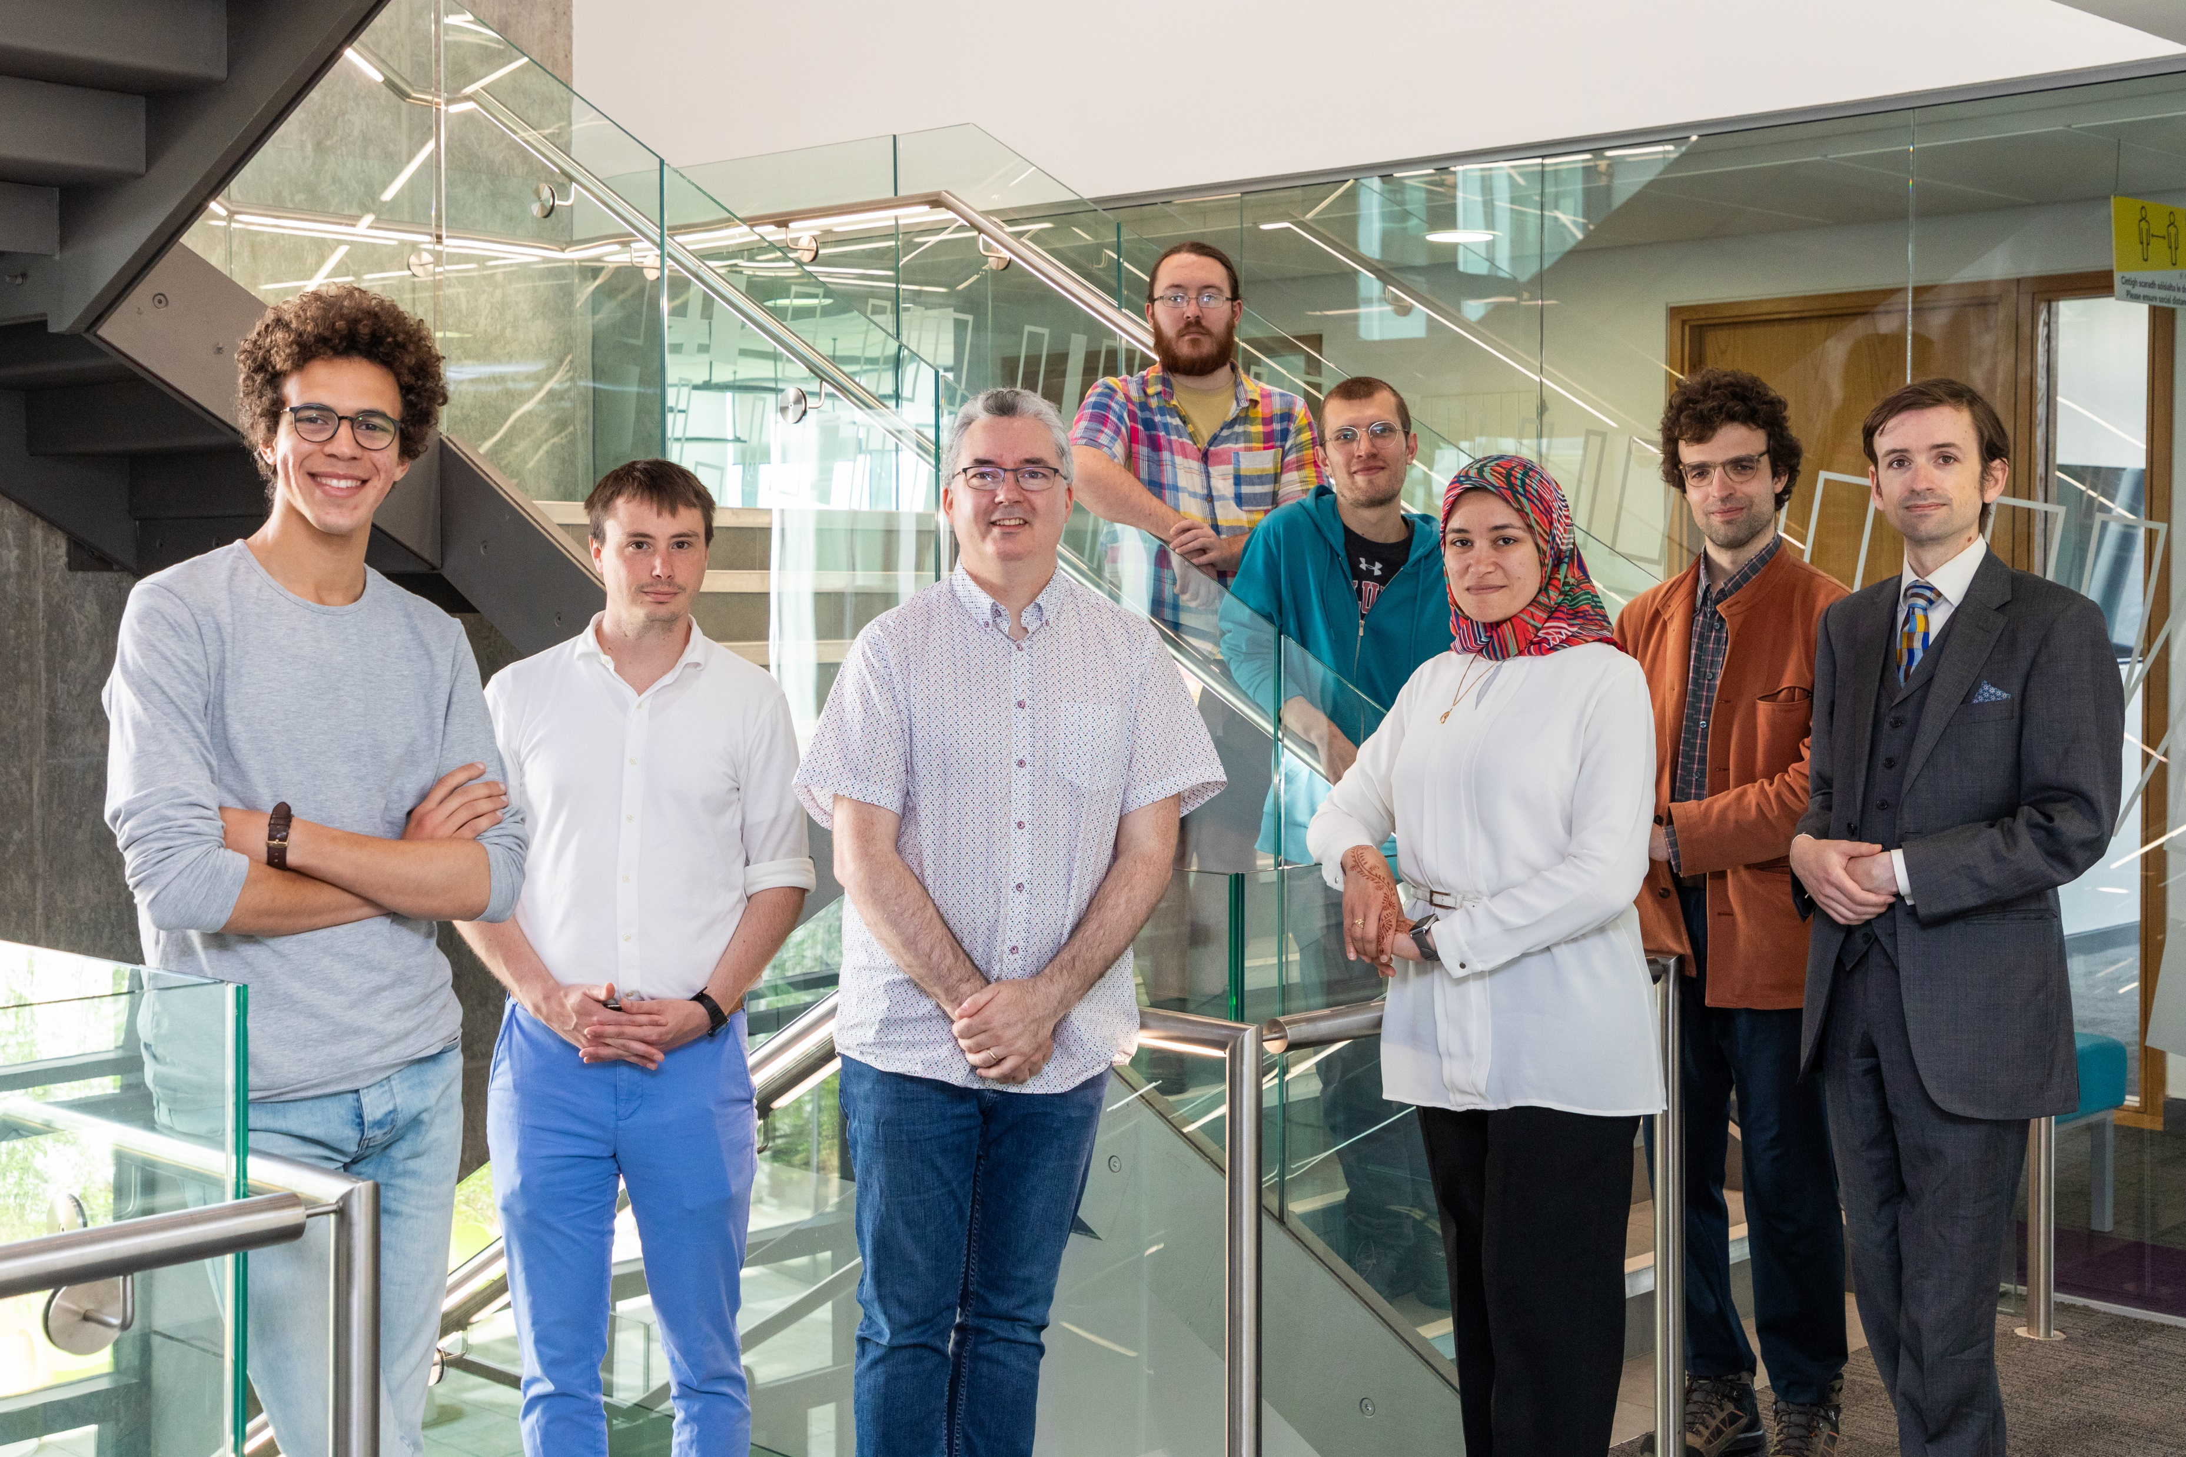
Thanks
dna.hamilton.ie
We're hiring!
Postdoc, PhD

