Slide 1





An efficient algorithm to compute the minimum free energy of interacting nucleic acid strands
Ahmed Shalaby, Damien Woods
Final year PhD

Slide 2


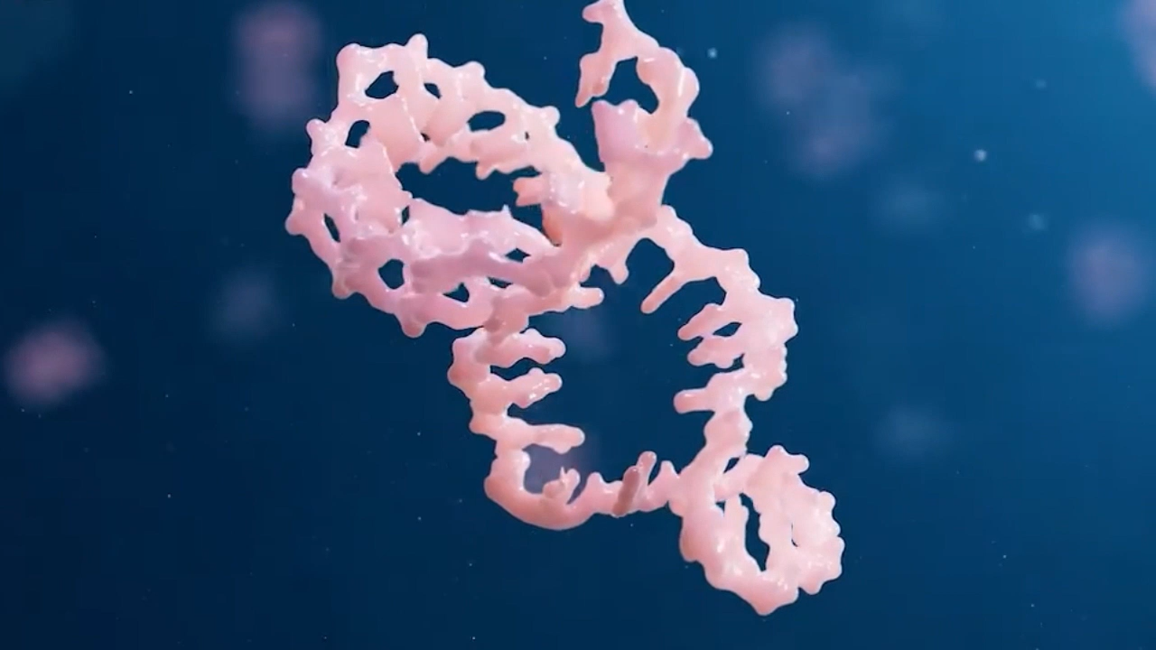
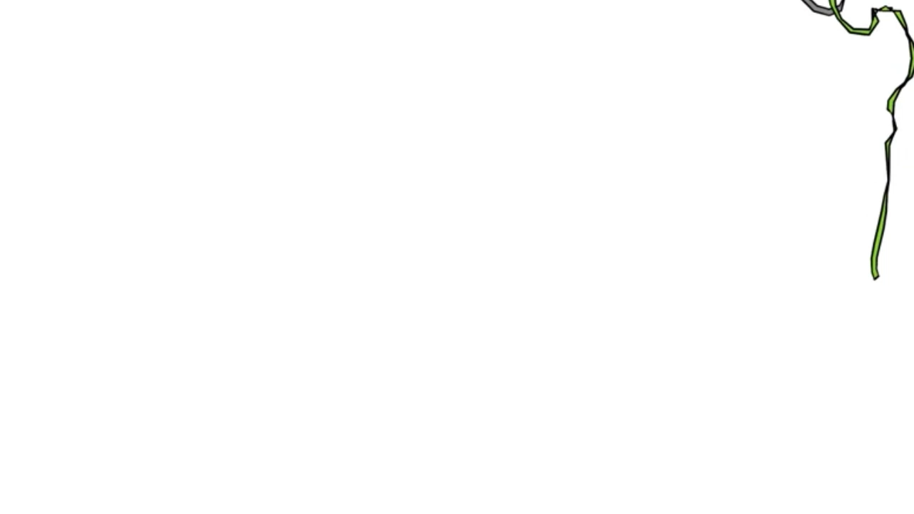

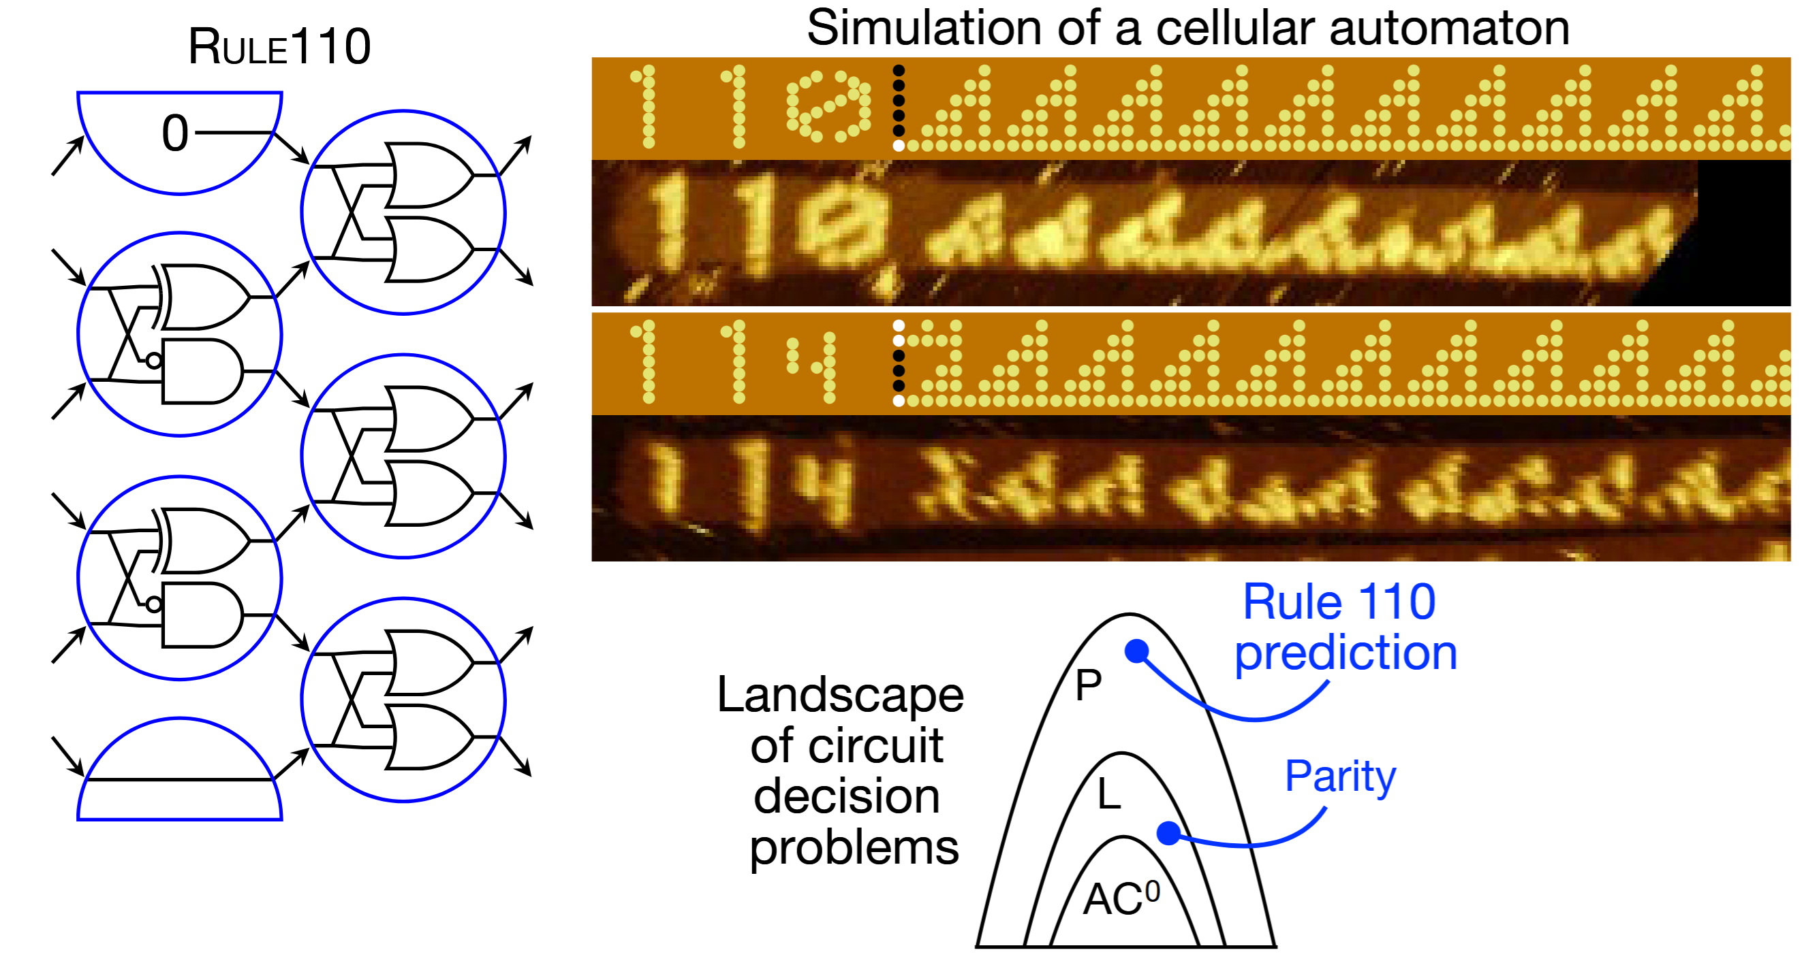
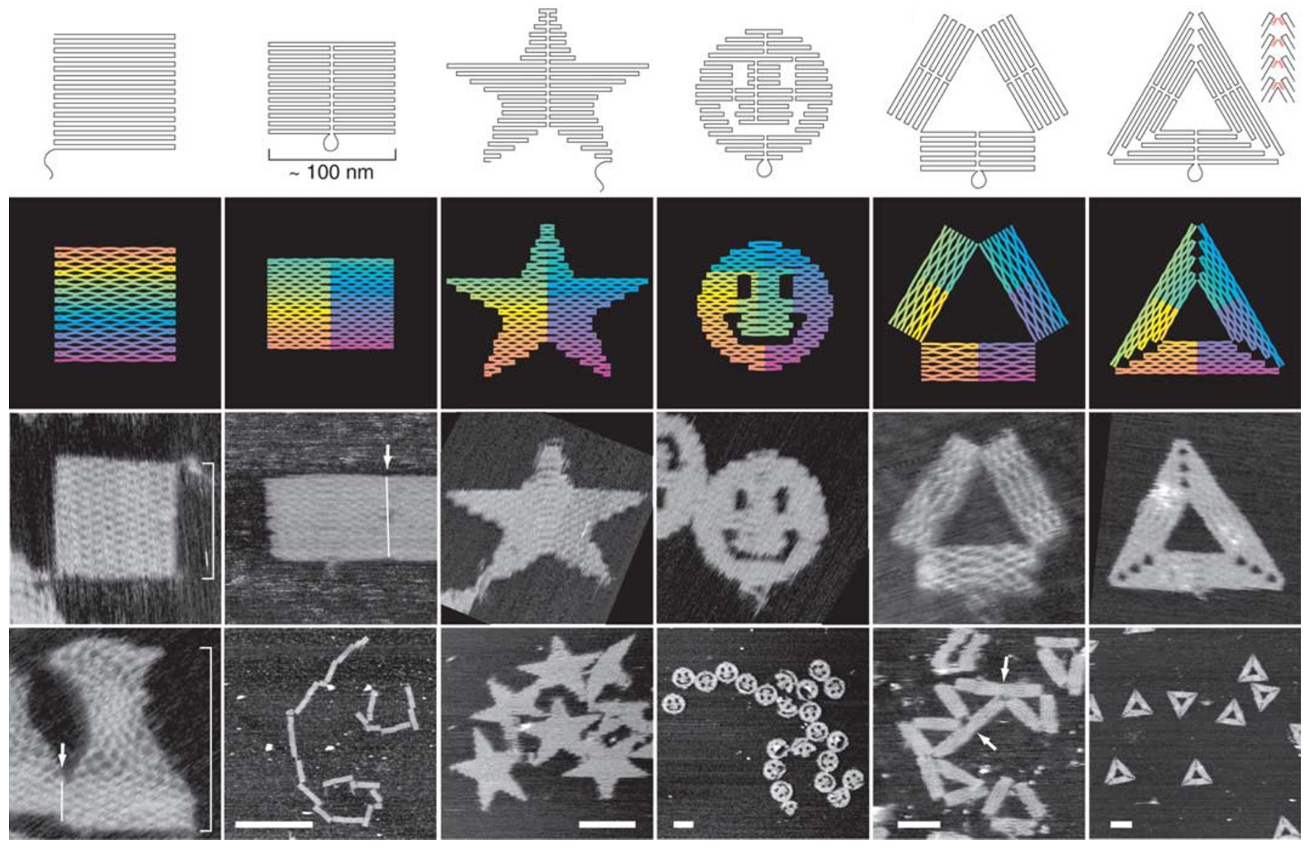

RNA/DNA folding problem
DNA Computing
Aptamers: Movie by WuXi AppTec
Movie by Shawn Douglas
Doty, Woods et al. 2017
Rothemund 2006

Slide 3
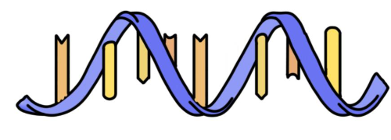
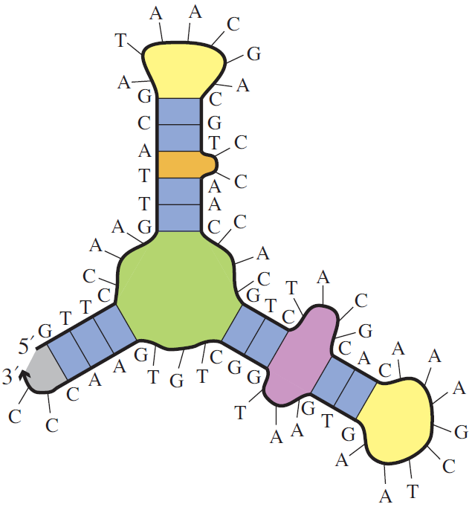
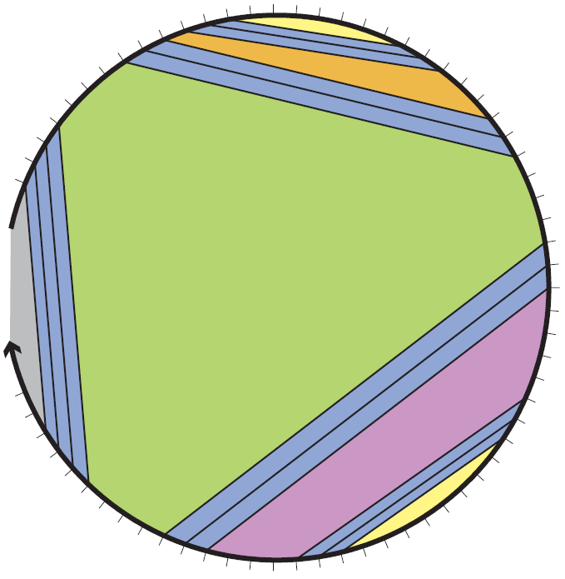






RNA/DNA secondary structure
A
T
T
Pseudoknot
G
C
G
Dirks et al. 2007
Secondary structure
Polymer graph representation
$$Ω:$$
exponential space of all secondary structures
Unfavorable
$$NP−Complete$$
$$ΔG\left(S\right)$$
$$MFE= \min_{S∈Ω}{ΔG\left(S\right)}$$
$$ΔG\left(S\right)$$
Energy model
Favorable

Slide 4
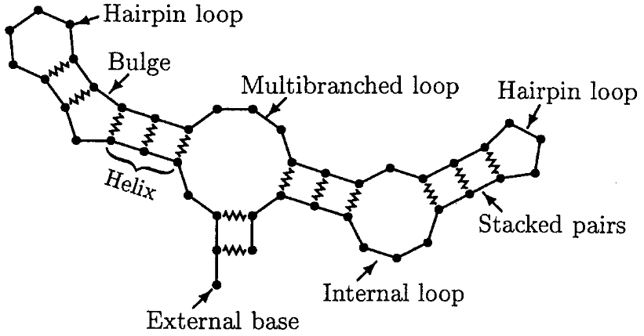



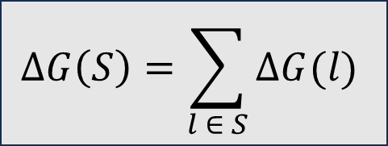





Energy model: Nearest neighbour model
$$l_{1}$$
Lyngsø and Pedersen 2000
$$l_{2}$$
$$l_{3}$$
$$l_{4}$$
$$l_{6}$$
$$l_{k}$$
$$l_{9}$$
$$ΔG\left(S\right)=ΔG\left(l_{1}\right)+ΔG\left(l_{2}\right)+…+ΔG(l_{k})$$
$$ΔG\left(S\right)=\sum_{l ∈ S}{ΔG(l)}$$

Slide 5
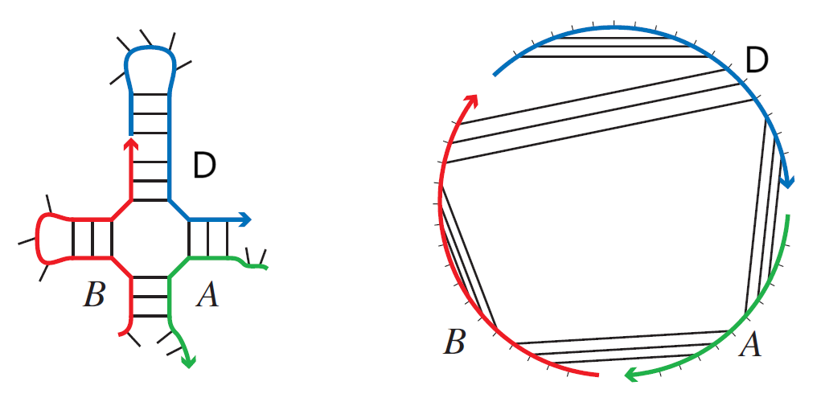
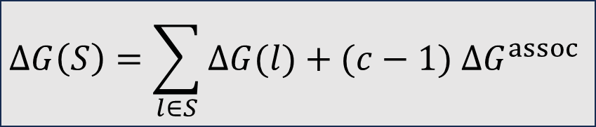
Energy model: Nearest neighbour model
Dirks et al. 2007
Dirks et al. 2007
unique strands
c = 3 strands
$$ΔG\left(S\right)=\sum_{l∈S}{ΔG(l)}+(c−1) ΔG^{assoc}$$

Slide 6
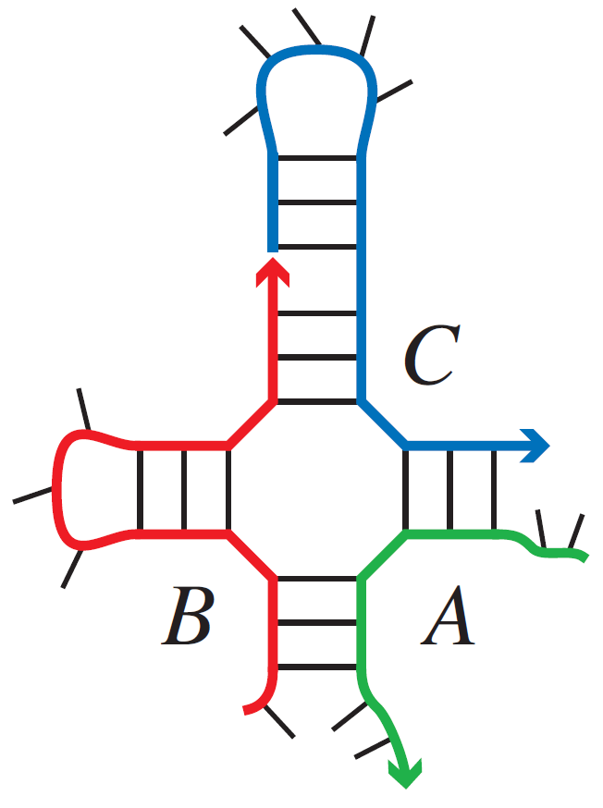
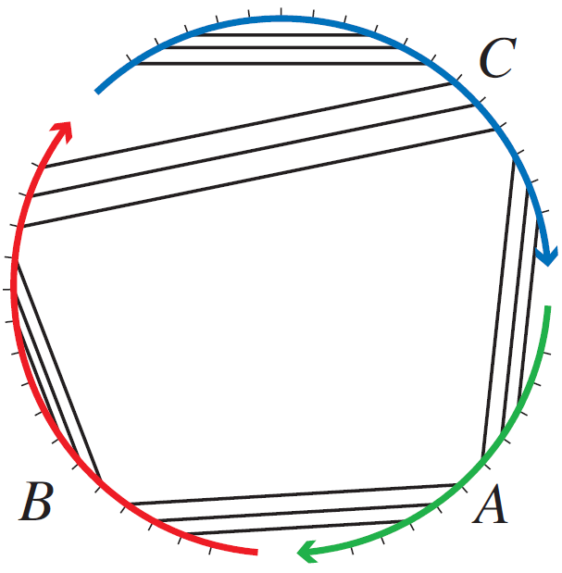
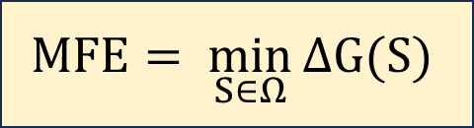
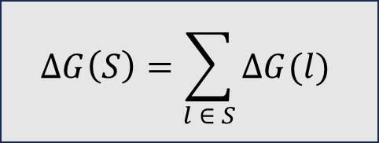

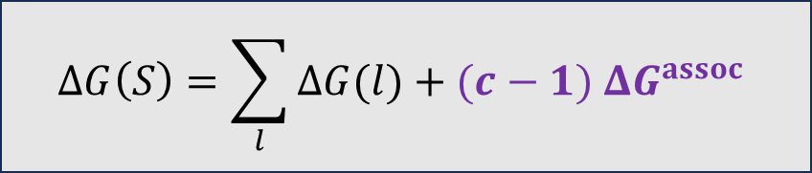

The Nearest Neighbour model for RNA/DNA
Single stranded system
Multi-stranded system of $c$ strands
Dirks et al. 2007
Dirks et al. 2007
$$c = 3$$
unique strands
$$ΔG\left(S\right)=\sum_{l}{ΔG(l)}+(c−1) ΔG^{assoc}$$
Hairpin loop
Bulge
Stack
Multiloop
Interior loop
Exterior loop
$$ΔG\left(S\right)=\sum_{l ∈ S}{ΔG(l)}$$
Initiation penalty
$$MFE= \min_{S∈Ω}{ΔG(S)}$$
$Ω:$ the set of all connected unpseudoknotted secondary structures
6

Slide 7








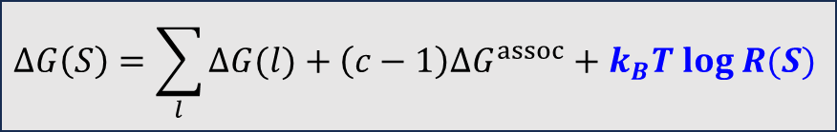



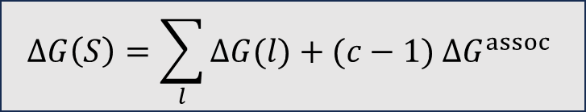





$$G$$
$$C$$
$$G$$
$$C$$
$$G$$
$$C$$
$$G$$
$$C$$
[ ]
$$=$$
[ ]
$$P$$
$$G$$
$$C$$
$$P$$
$$G$$
$$C$$
$$C$$
$$G$$
$$C$$
$$G$$
[ ]
$$G$$
$$C$$
$$=$$
[ ]
$$P$$
$$P$$
$$G$$
$$C$$
$$C$$
$$G$$
$$G$$
$$C$$
$$C$$
$$G$$
$$C$$
$$G$$
Entropic penalty
$$ΔG\left(S\right)=\sum_{l}{ΔG(l)}+(c−1) ΔG^{assoc}$$
$$ΔG\left(S\right)=\sum_{l}{ΔG(l)}+\left(c−1\right)ΔG^{assoc}+k_{B}T log R(S)$$
$R(S):$ degree of rotational symmetry of $S$

Slide 8
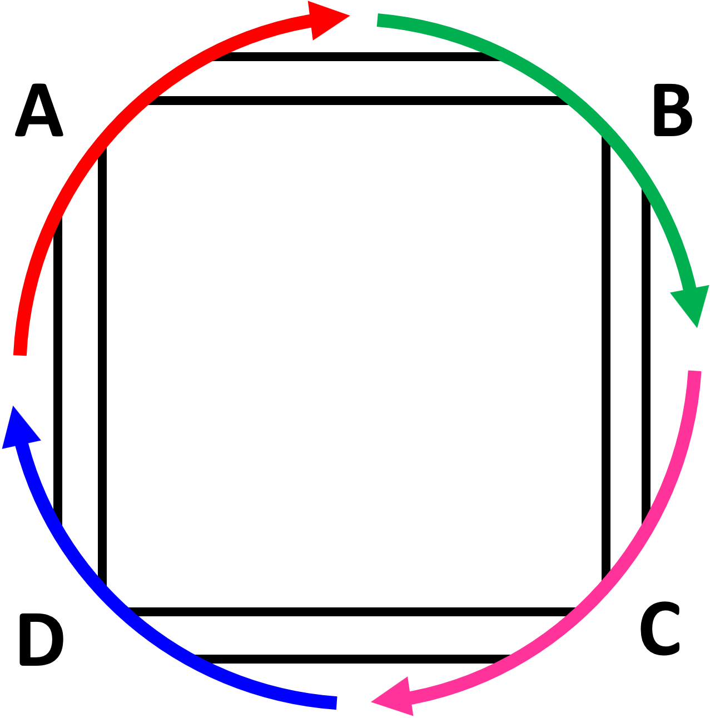
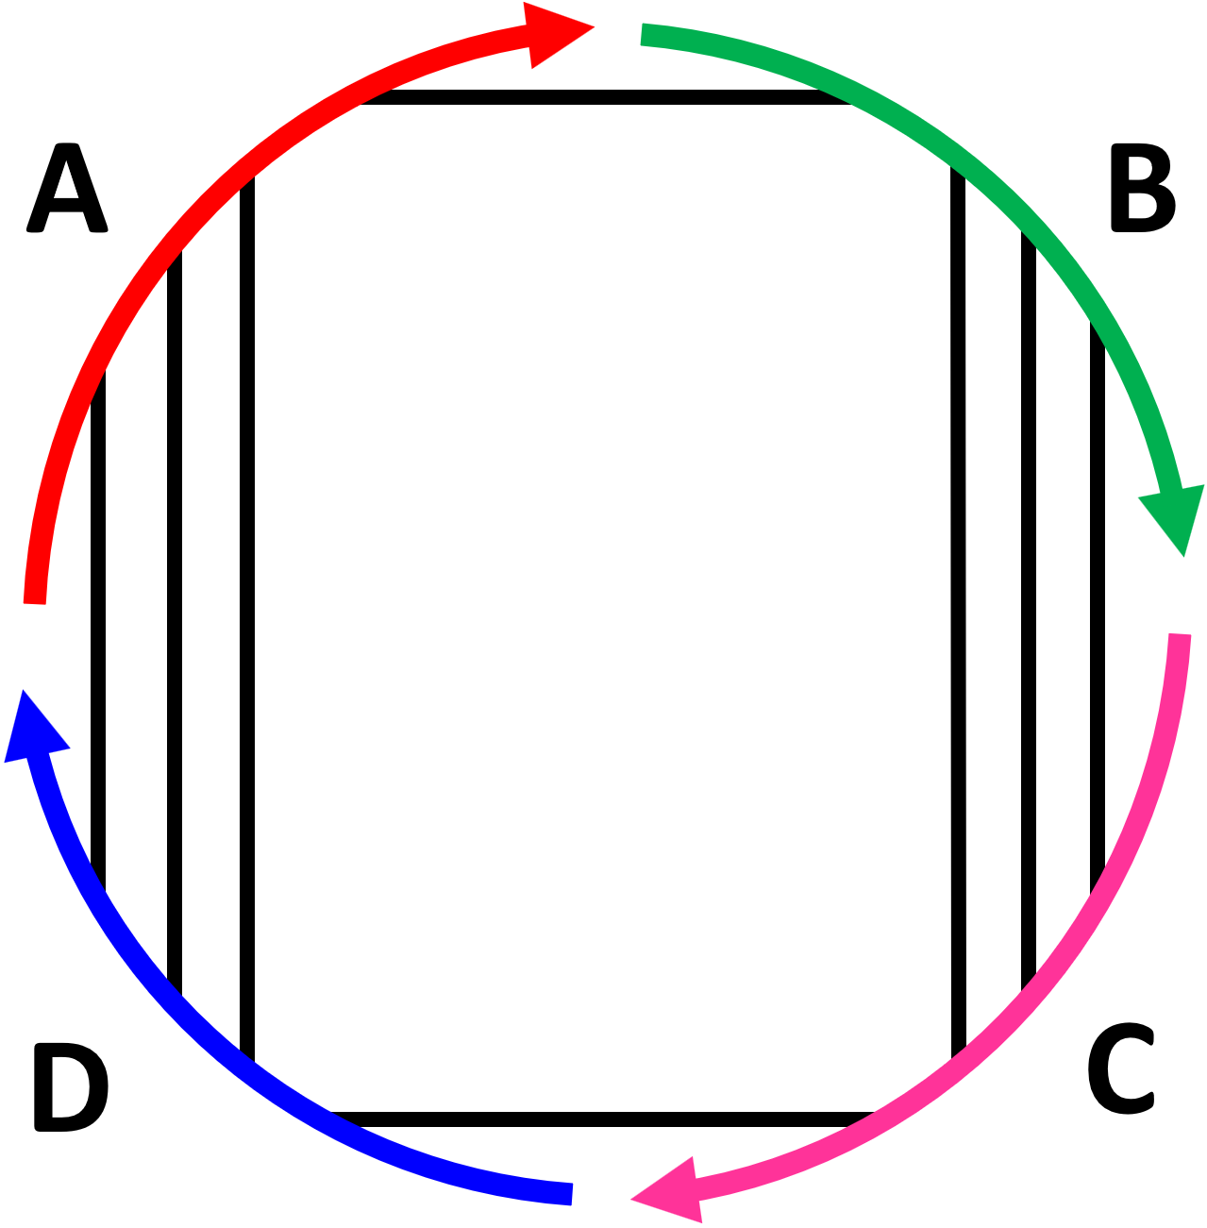
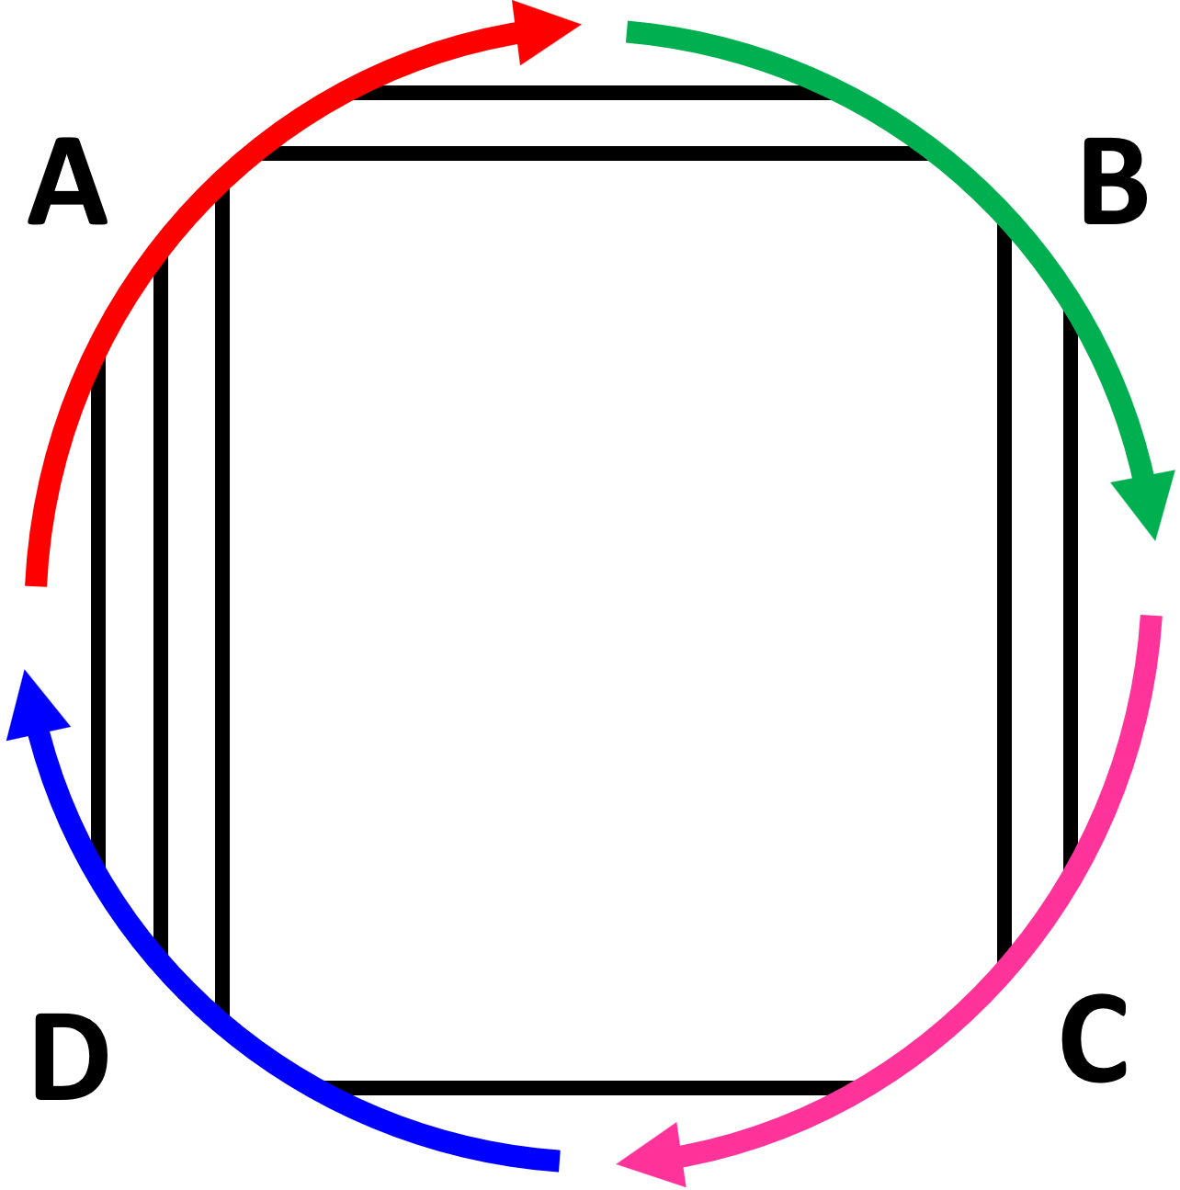
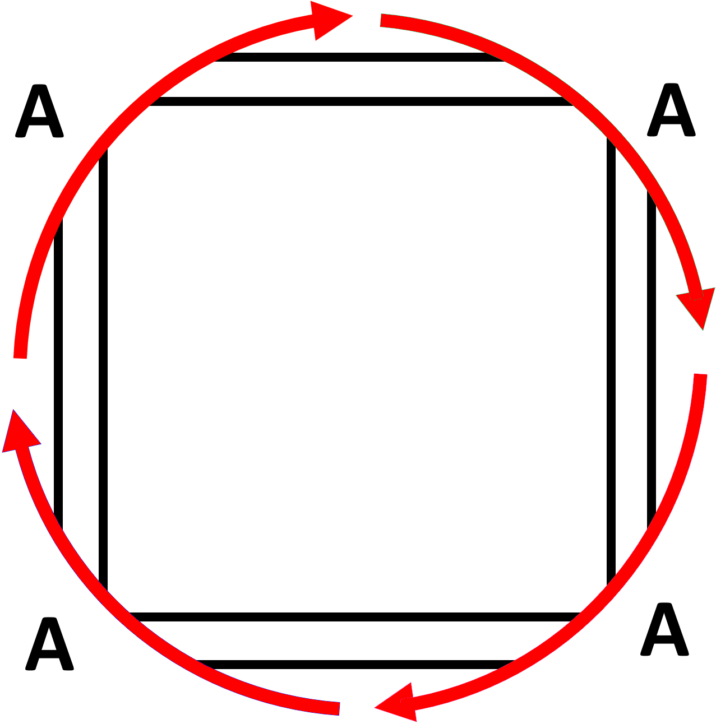
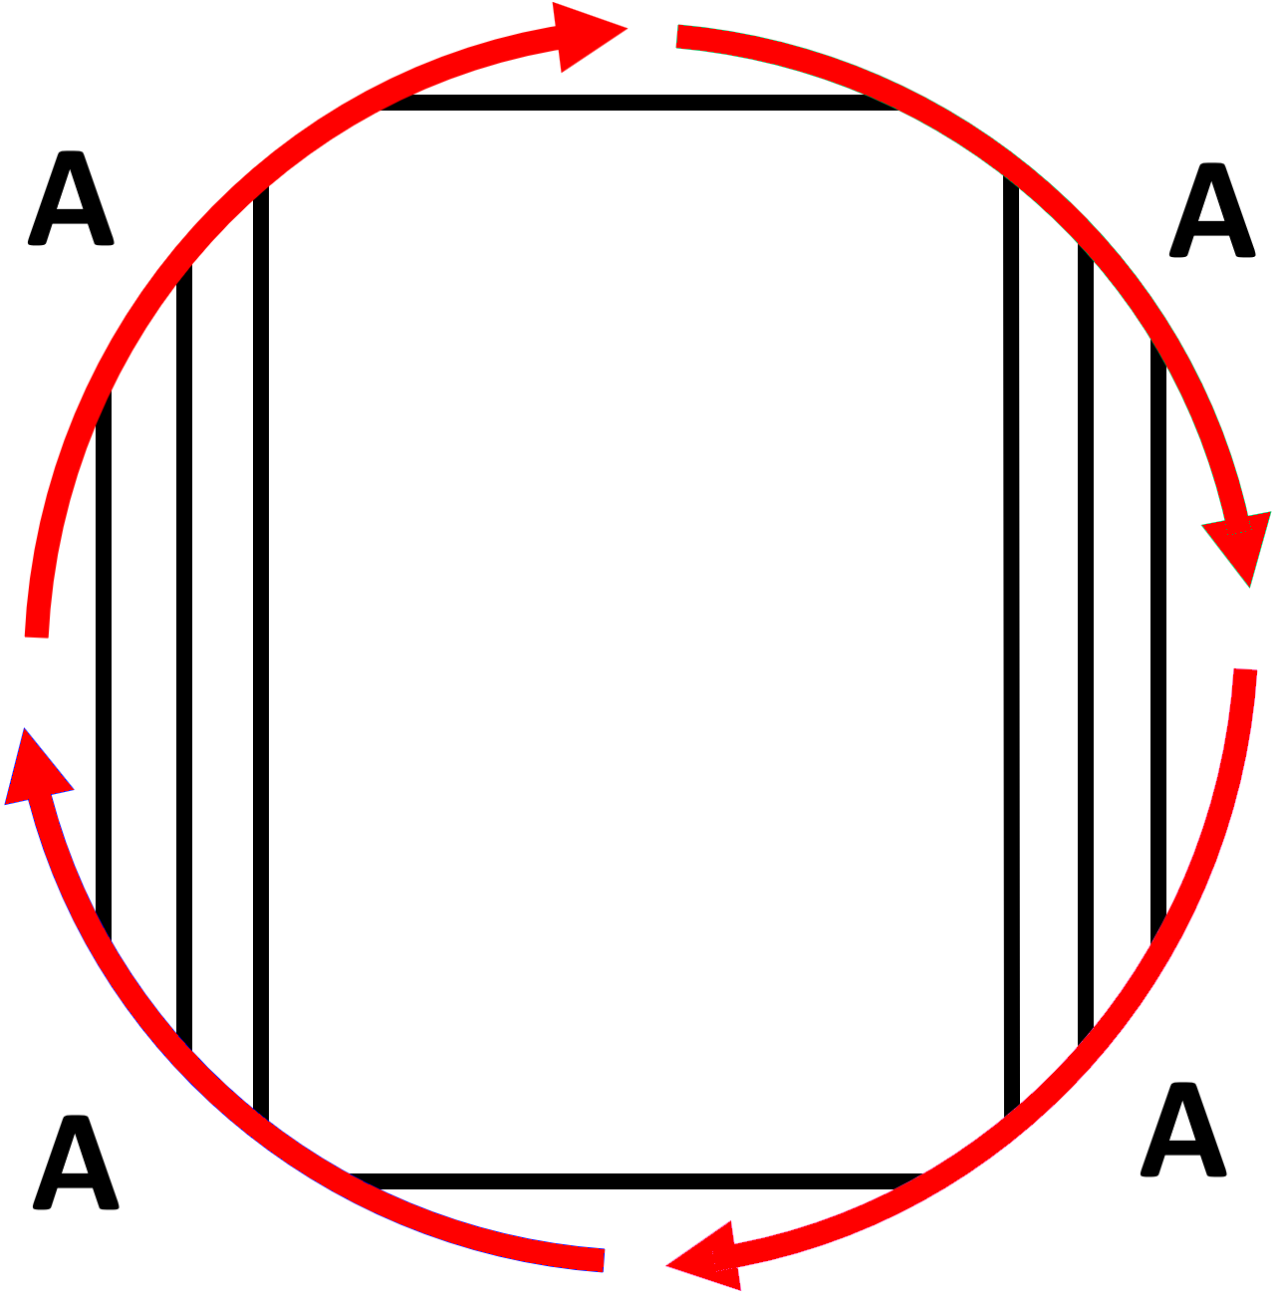
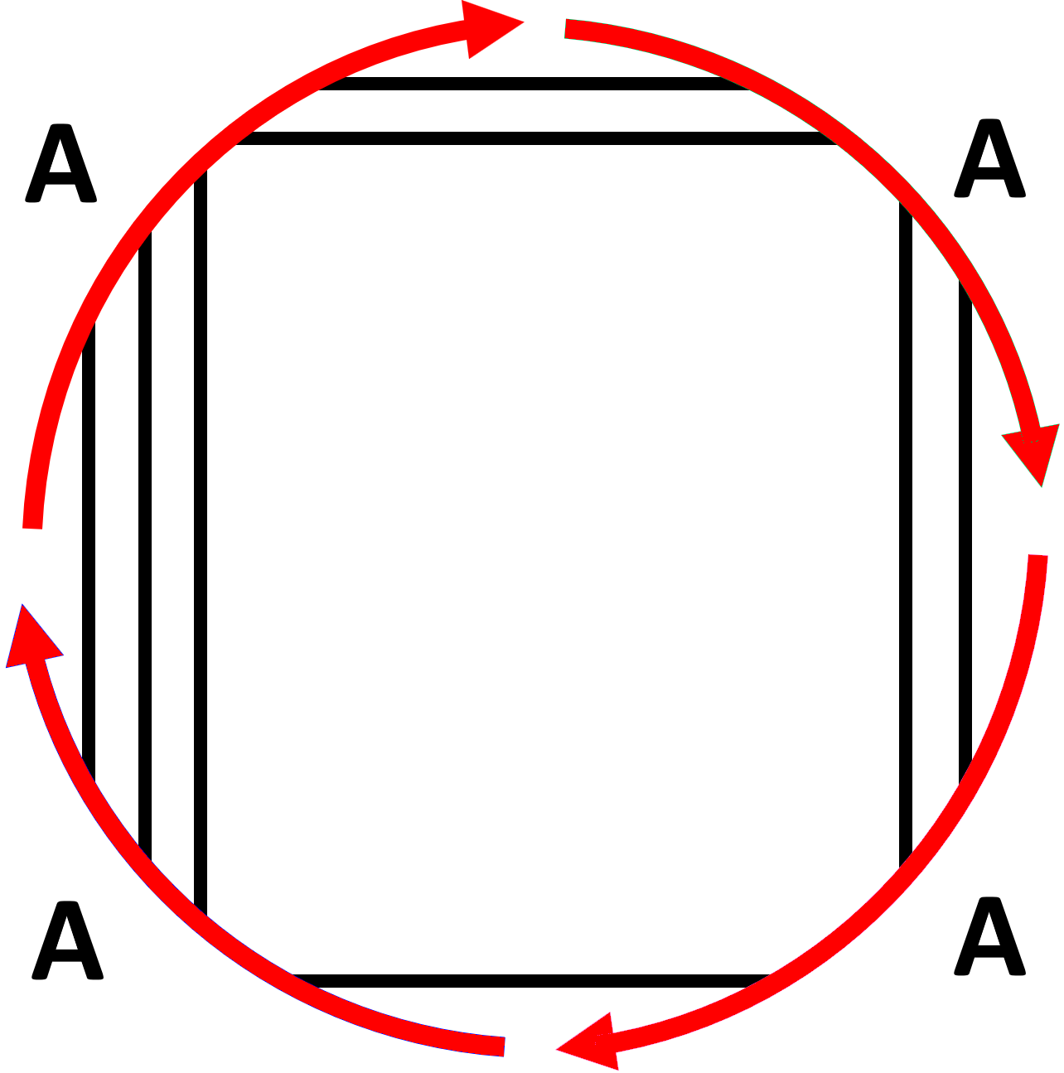


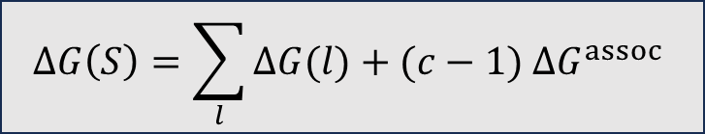







Unfavorable
Unfavorable
$$ΔG\left(S\right)$$
$$ΔG\left(S\right)$$
$k_{B}T log$ 4
$k_{B}T log$ 2
Energy level $l$
Favorable
Favorable
$$ΔG\left(S\right)=\sum_{l}{ΔG(l)}+(c−1) ΔG^{assoc}$$
$$ΔG\left(S\right)=\sum_{l}{ΔG(l)}+\left(c−1\right)ΔG^{assoc}+k_{B}T log R(S)$$
$R(S):$ degree of rotational symmetry of $S$
$$R=4$$
$$R=2$$
$$R=1$$

Slide 9
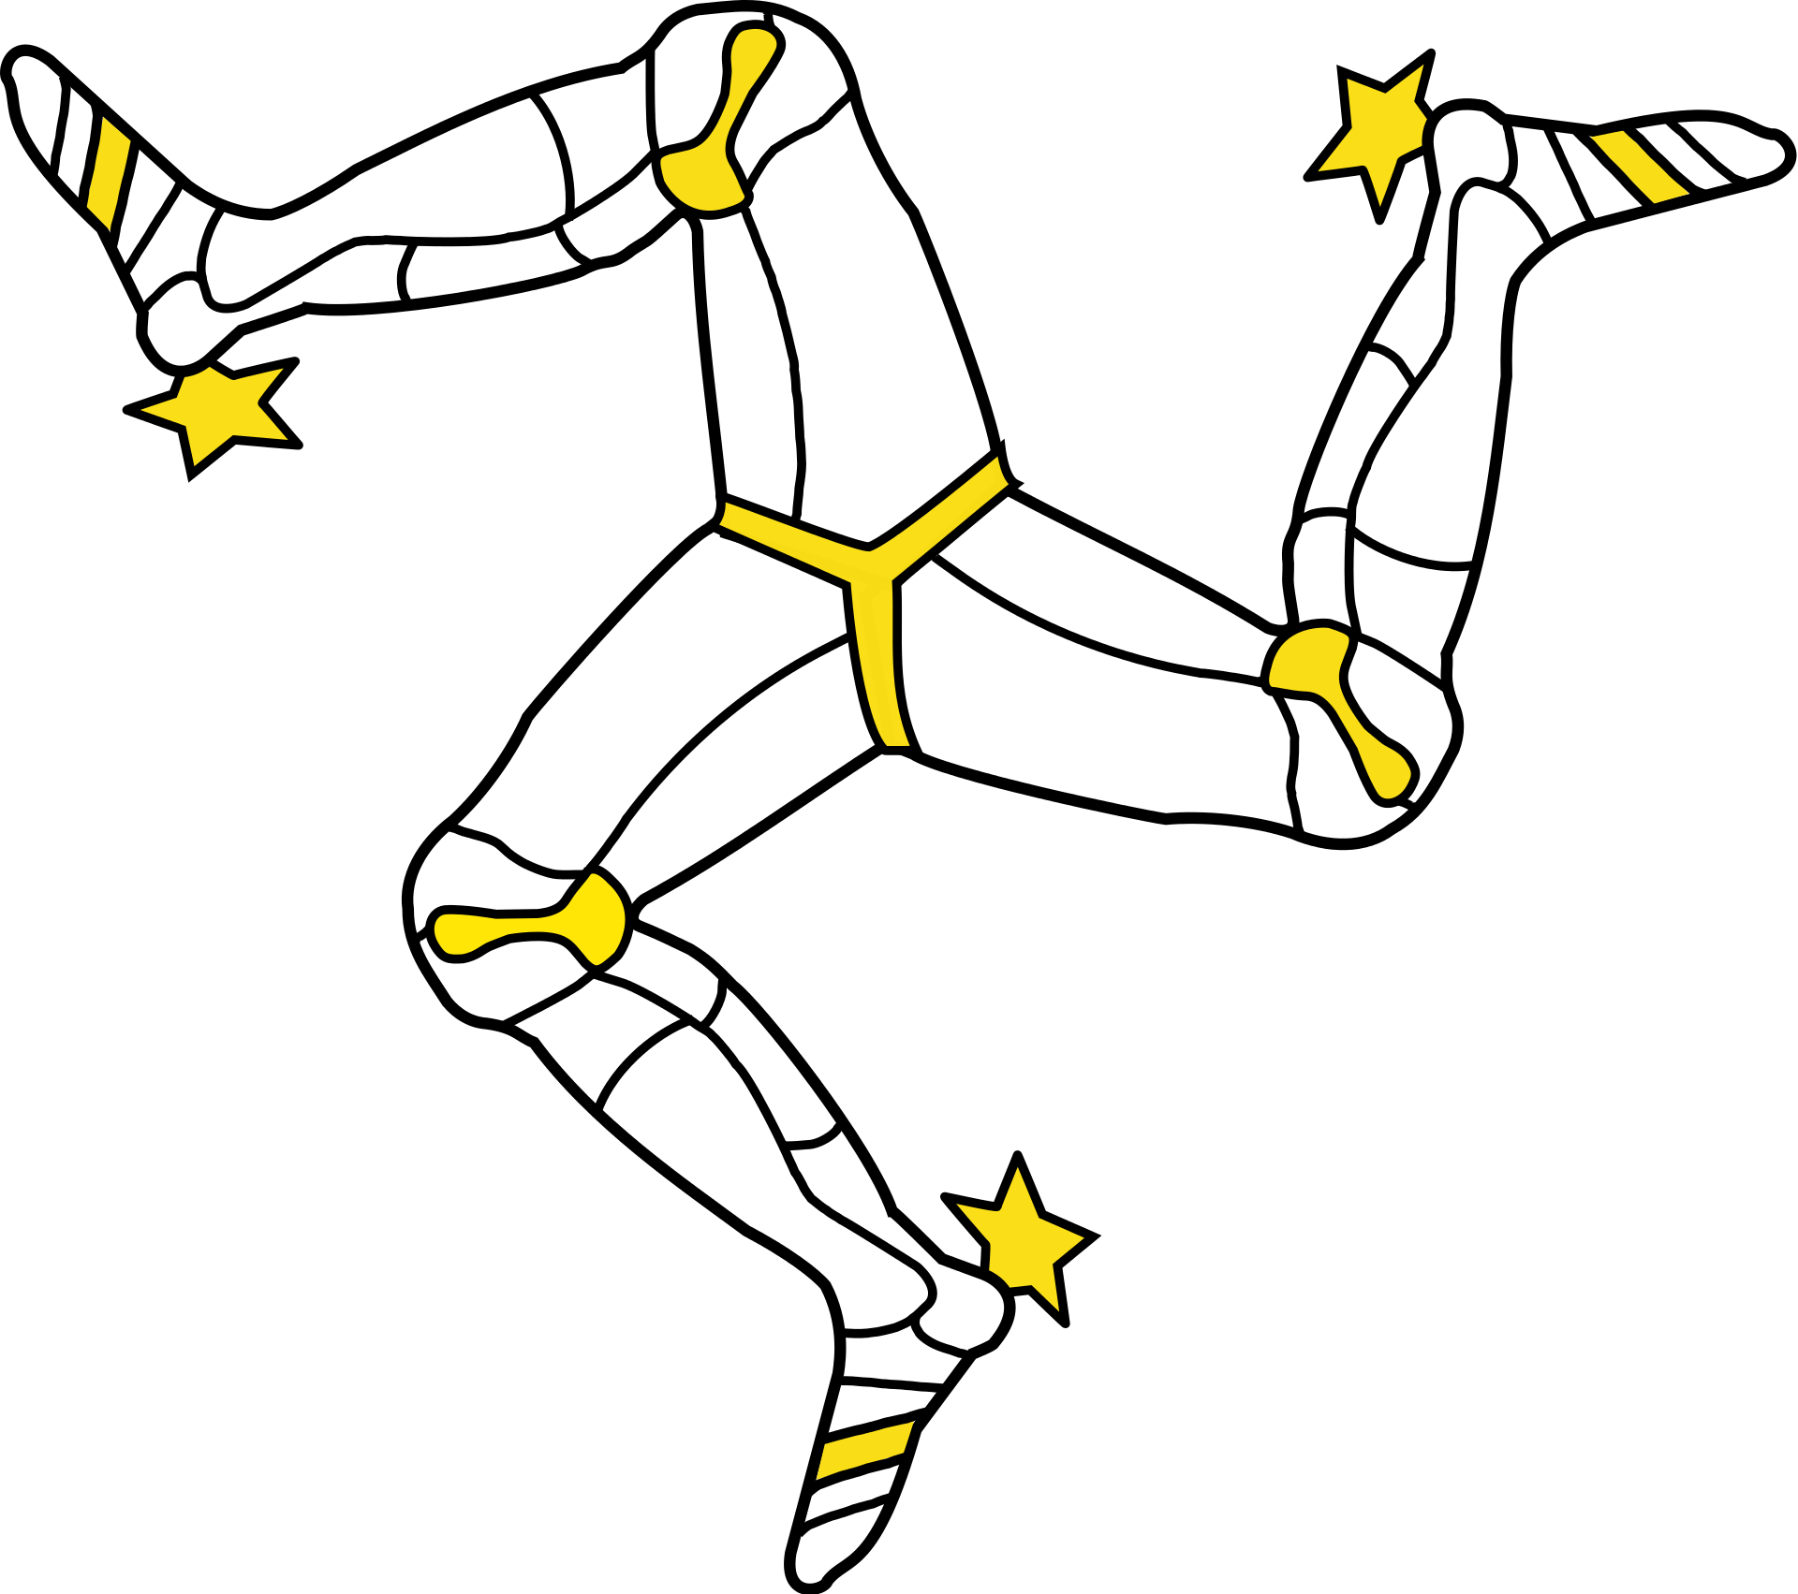


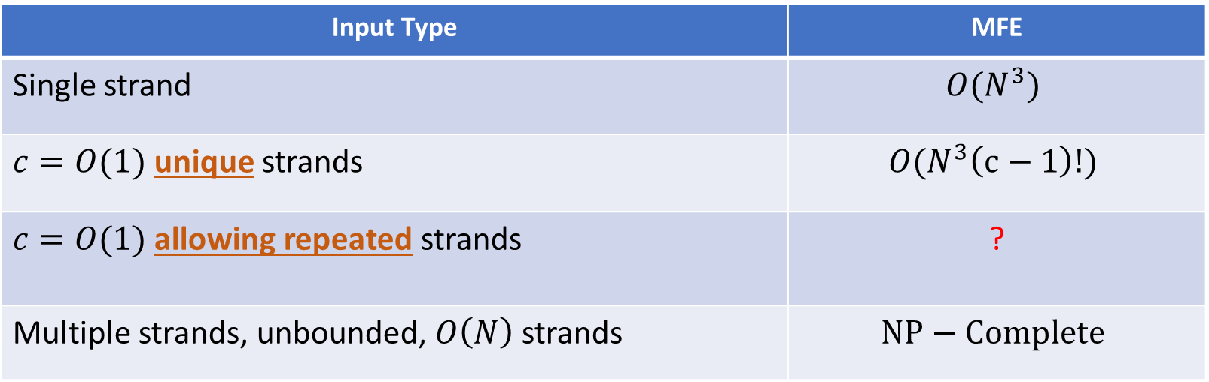

Computational complexity of Minimum Free Energy
Input Type | MFE
Single strand | $$O(N^{3})$$
$c=O(1)$ unique strands | $$O(N^{3}\left(c−1\right)!)$$
$c=O(1)$ allowing repeated strands | ?
Multiple strands, unbounded, $O\left(N\right)$ strands | $$NP−Complete$$
Nussinov et al. 1978
Dynamic
programming
algorithms
Dirks et al. 2007
Open problem for ≈ 𝟐𝟎 years
Condon, Hajiaghayi, Thachuk 2021
$N$bases, $c$ strands
Subproblems
Big problem
Local point of view
?
Global property

Slide 10


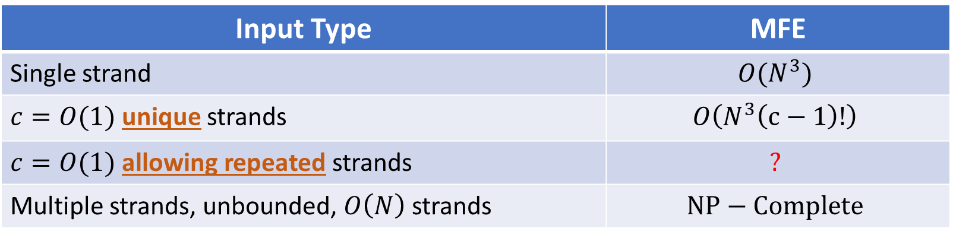




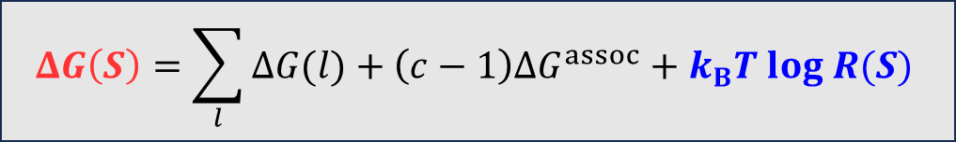
Current state of art
Input Type | MFE
Single strand | $$O(N^{3})$$
$c=O(1)$ unique strands | $$O\left(N^{3}\left(c−1\right)!\right)$$
$c=O(1)$ allowing repeated strands | $$?$$
Multiple strands, unbounded, $O\left(N\right)$ strands | $$NP−Complete$$
$N$bases, $c$ strands
$$\overline{ΔG}\left(S\right)=\sum_{l}{ΔG(l)}+(c−1) {ΔG}^{assoc}$$
$$snMFE= \min_{S∈Ω}{\overline{ΔG}\left(S\right)}$$
Symmetry naive energy function
Symmetry naive MFE
$$ΔG\left(S\right)=\sum_{l}{ΔG(l)}+\left(c−1\right){ΔG}^{assoc}+k_{B}T log R(S)$$
Goal
$$MFE= \min_{S∈Ω}{ΔG\left(S\right)}$$

Slide 11





Current state of art
Unfavorable
Symmetry naive energy landscape
Symmetry aware energy landscape
$$\overline{ΔG}\left(S\right)$$
$$ΔG\left(S\right)$$
Favorable
$k_{B}T log R(S)$
$$MFE$$
$$snMFE$$

Slide 12


If snMFE structure is Asymmetric $(R=1)$
Unfavorable
Symmetry naive energy landscape
Symmetry aware energy landscape
$$\overline{ΔG}\left(S\right)$$
$$ΔG\left(S\right)$$
Favorable
$$snMFE$$
$$MFE$$

Slide 13


If snMFE structure is Symmetric $(R>1)$
Unfavorable
Symmetry naive energy landscape
Symmetry aware energy landscape
$$\overline{ΔG}\left(S\right)$$
$$ΔG\left(S\right)$$
$$k_{B}T log R(S)$$
Favorable
$$MFE$$
$$snMFE$$

Slide 14








If snMFE structure is Symmetric $(R>1)$
Dirks et al. 2007 approach
Run the snMFE algorithm
Symmetry aware energy landscape
Is the snMFE structure $S$
asymmetric $(R=1)$?
Yes
DONE!
$$ΔG\left(S\right)$$
No
Backtrack all secondary structures in
$$snMFE+k_{B}T \log{R\left(S\right)}$$
$$Exponential$$
$$R\left(S\right)=2$$
$$k_{B}T log R(S)$$
$$k_{B}T log R(S)$$
$$snMFE$$
$$MFE$$
DONE!
Wuchty et al. 1999
$$snMFE$$

Slide 15

Our Approach
What if we could break symmetry with symmetry?

Slide 16



What if we could break symmetry with symmetry?
Slicing and swapping strategy
Sharing the same
Admissible pizza cut

Slide 17

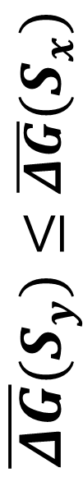




Unfavorable
$$S_{x}$$
Symmetric
$${\overline{ΔG}(S}_{y})≤\overline{ΔG}(S_{x})$$
$$S_{z}$$
Asymmetric
$S_{x}$ and $S_{y}$
Admissible pizza cut
$${\overline{ΔG}(S}_{y})≤\overline{ΔG}\left(S_{z}\right)=ΔG\left(S_{z}\right)≤\overline{ΔG}(S_{x})$$
$$\overline{ΔG}\left(S\right)$$
Favorable
$$S_{y}$$
Symmetric

Slide 18


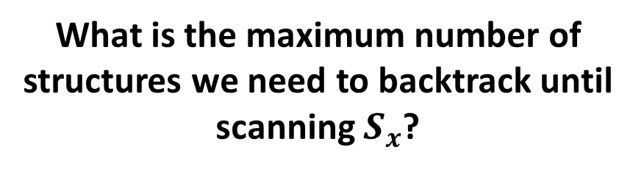




Unfavorable
Symmetry naive energy landscape
$$S_{x}$$
$S_{x}$ and $S_{y}$
Admissible pizza cut
$$\overline{ΔG}\left(S\right)$$
$$S_{z}$$
What is the maximum number of structures we need to backtrack until scanning $S_{x}$?
Favorable
$$S_{y}$$
$$snMFE$$

Slide 19


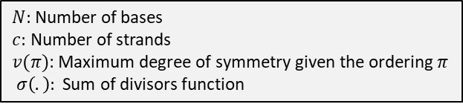



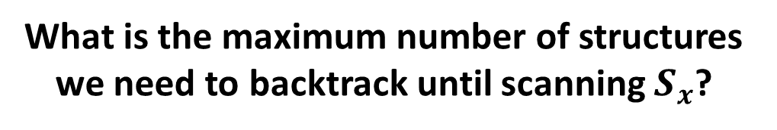
Unfavorable
What is the maximum number of structures we need to backtrack until scanning $S_{x}$?
$$S_{x}$$
In worst case
Upper bound $𝓤$
$${\overline{ΔG}(S}_{y})≤\overline{ΔG}\left(S_{z}\right)=ΔG\left(S_{z}\right)≤\overline{ΔG}(S_{x})$$
$$S_{z}$$
$$\overline{ΔG}\left(S\right)$$
$N:$ Number of bases
$c:$ Number of strands
$v(π)$: Maximum degree of symmetry given the ordering $π$
$σ\left(.\right):$ Sum of divisors function
Favorable
$$S_{y}$$

Slide 20
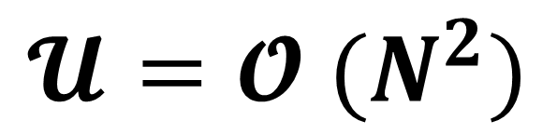
Unfavorable
Symmetry naive energy landscape
$$S_{x}$$
$$\overline{ΔG}\left(S\right)$$
$$S_{z}$$
$$𝓤=𝓞 (N^{2})$$
Favorable
$$S_{y}$$
$$snMFE$$

Slide 21




If snMFE structure is Symmetric $(R>1)$
Unfavorable
Symmetry naive energy landscape
Symmetry aware energy landscape
$$\overline{ΔG}\left(S\right)$$
$$ΔG\left(S\right)$$
$$Exponential$$
Favorable
$$𝓞 (N^{2})$$
$$MFE$$
$$snMFE$$

Slide 22

If snMFE structure is Symmetric $(R>1)$
Unfavorable
Symmetry naive energy landscape
Symmetry aware energy landscape
$$\overline{ΔG}\left(S\right)$$
$$ΔG\left(S\right)$$
Favorable
$$𝓞 (N^{2})$$
In practice
$$MFE$$
$$snMFE$$

Slide 23
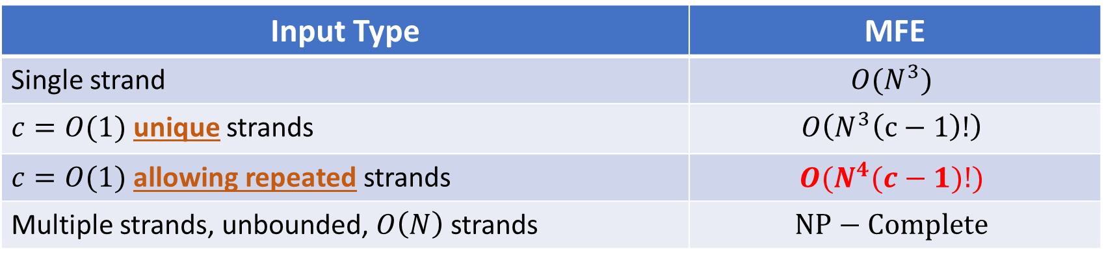

Computational complexity of MFE algorithms
Input Type | MFE
Single strand | $$O(N^{3})$$
$c=O(1)$ unique strands | $$O\left(N^{3}\left(c−1\right)!\right)$$
$c=O(1)$ allowing repeated strands | $$O(N^{4}(c−1)!)$$
Multiple strands, unbounded, $O\left(N\right)$ strands | $$NP−Complete$$
ICALP 2025
$N$bases, $c$ strands

Slide 24

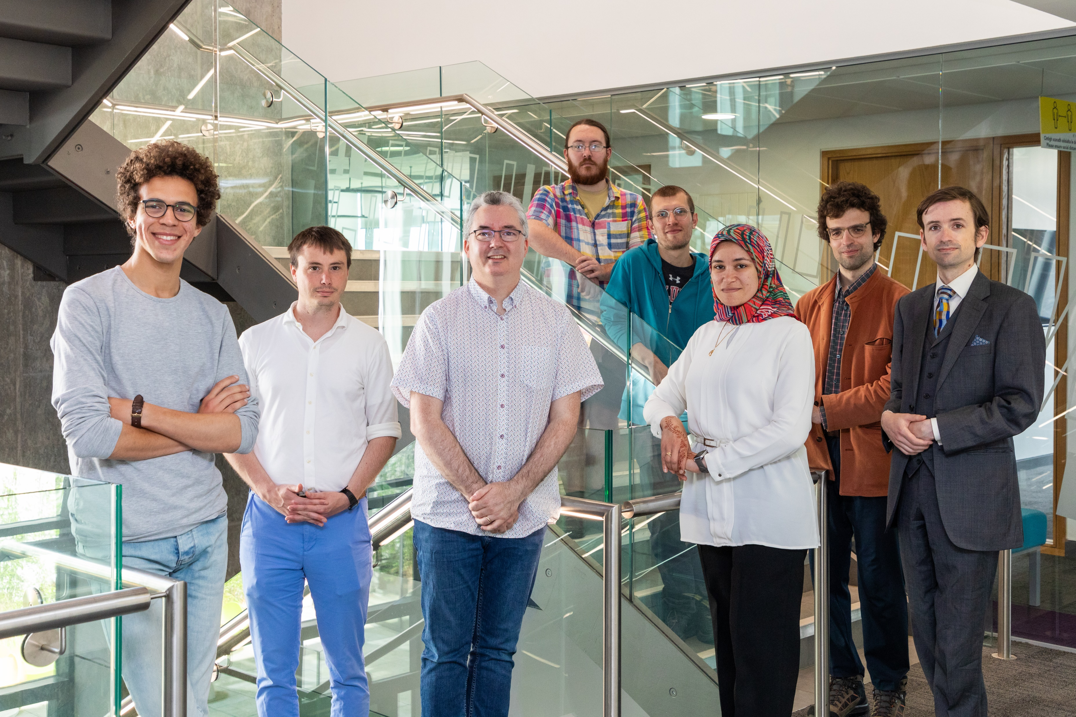

















Thanks
Constantine Evans
Anne Condon
Dave Doty
Erik Winfree
Niles Pierce
Mark Fornace
David Soloveichik
Matthew Patitz
Sergiu Ivanov
dna.hamilton.ie
shalabycave.com

