Slide 1
Minimum Free Energy, Partition Function & Kinetics Simulation Algorithms for a Multistranded Scaffolded DNA Computer
Ahmed Shalaby, Chris Thachuk, Damien Woods
Hamilton Institute, Computer Science
Maynooth University, Ireland

Slide 2
Thermodynamically favourable computation
Typical molecular computers are thermodynamically unfavourable (leak, errors, spurious nucleation, etc.)
Today: Thermodynamically favoured computation on our
Scaffolded DNA Computer
initial state
initial state
error path
correct path
error
output state
error correction
error state
output
What the system is designed to reach!
What the system thermodynamically tends towards
Stérin, Eshra, Woods (DNA28 Track B, In prep)
Abeer Eshra Poster 21, DNA29
Doty, Soloveichik et al. 2017
Wang, Thachuk et al. 2017

Slide 3
Scaffolded DNA Computer: strand-based model
A. Scaffolded DNA Computer
Strand$s$
$$k_{1}$$
$$k_{2}$$
$$k_{N}$$
compute
compute
$$L(s)$$
$$R(s)$$
. . .
. . .
. . .
...
position
$$M(s)$$
$$1$$
$$2$$
$$N$$
scaffold with $N$ domains
B. Key design concepts for thermodynamically favoured computation
strands compete for scaffold domain
$(1)$ algorithmic error ⟹ error correction by displacement (enthalpic gain)
strand binds
strand binds with error
displace
…
…
…
…
…
…
$(2)$strands in excess over scaffold
⟹ scaffold gets covered
$(3)$weak strand-strand binding
⟹ no off-scaffold structures

Slide 4
Scaffolded DNA Computer example: Bit-Copy
0
1
0
0
0
0
0
0
Input 1
$$1$$
$$2$$
$$3$$
$$4$$
1
1
1
1
1
1
Compute
$$1$$
$$2$$
$$3$$
$$4$$
$$2$$
$$4$$
Input domain
Input 0
$$1$$
$$3$$
Target configuration
GOAL
$$Pr⁡[$$
$$]$$
$$≫\sum_{c }{Pr⁡[}$$
$$]$$
$$c :is another configuration$$
…
At equilibrium

Slide 5
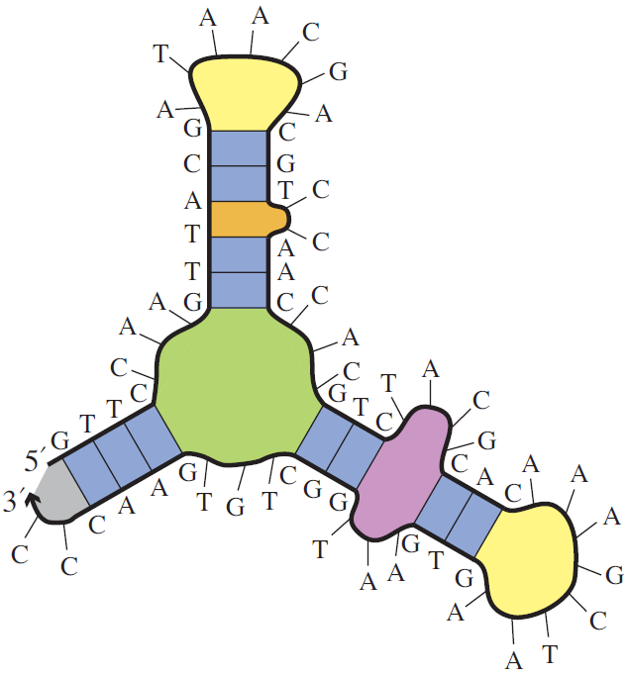
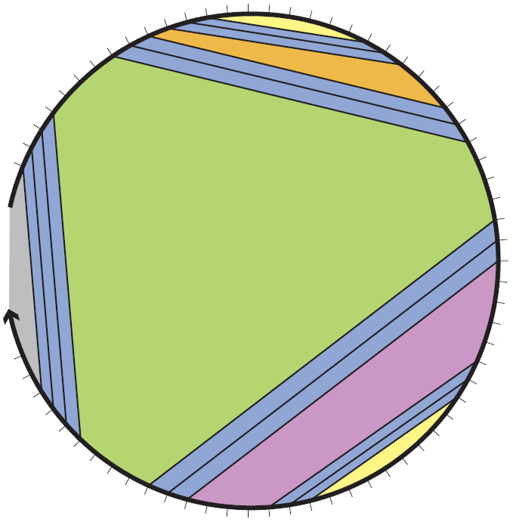
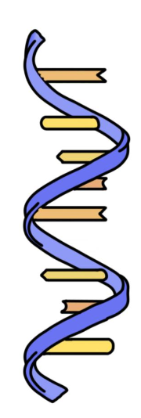
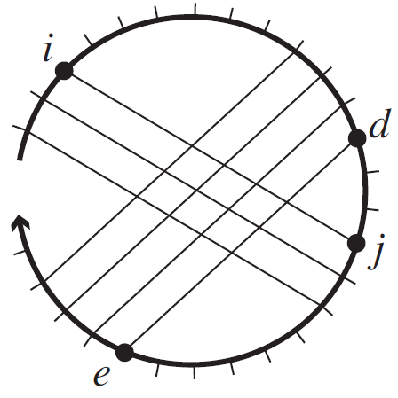
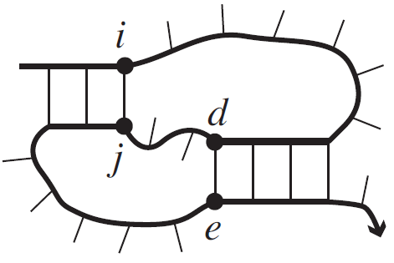
Secondary structure
Dirks et al. 2007
pseudoknot-free
Dirks et al. 2007
Single stranded DNA
Secondary structure
Polymer graph representation
$$NP−Hard$$
pseudoknotted
Dirks et al. 2007
Dirks et al. 2007

Slide 6
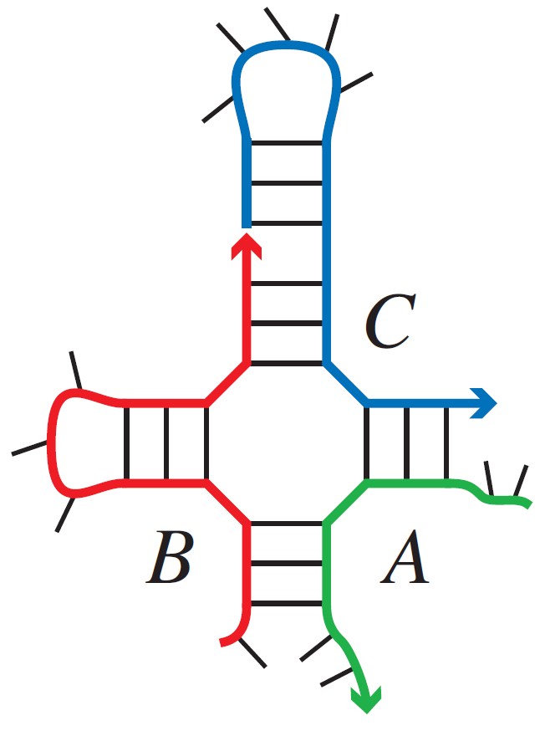
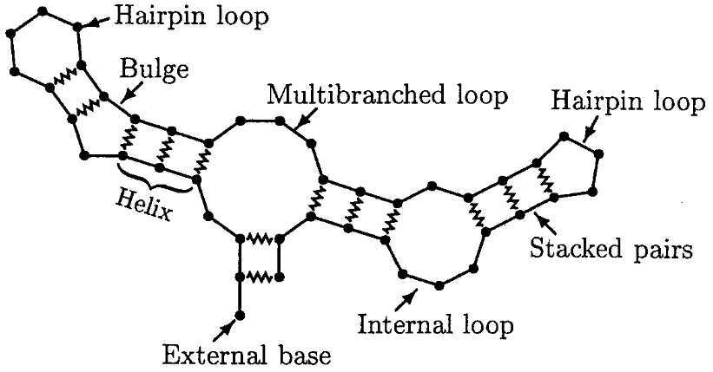
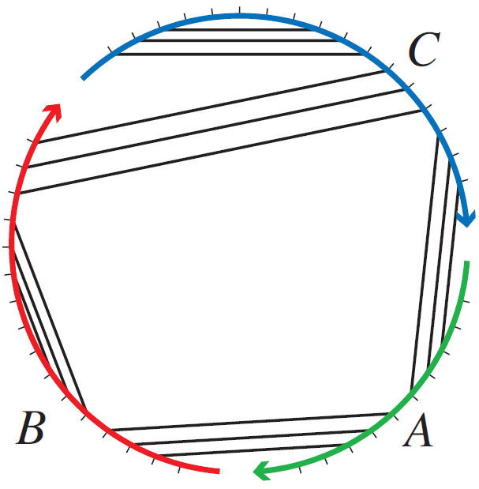
Energy models, Minimum Free Energy and Partition Function
Multi stranded system of $l$ strands
Single stranded system
Lyngsø and Pedersen 2000
Free energy
Loop energy
$$ΔG\left(S\right)= \sum_{l∈S}{ΔG\left(l\right)}$$
Free energy
Loop energy
Entropic cost
$$ΔG\left(S\right)= \sum_{l∈S}{ΔG\left(l\right)}+\left(l−1\right)∗∆G^{assoc}$$
Dirks et al. 2007
Free energy
Boltzmann weighted sum
$$Q=\sum_{S∈Ω}{e^{−ΔG\left(S\right)/k_{B}T}}$$
$$⇒$$
$$Pr⁡[S]=\frac{e^{−ΔG\left(S\right)/k_{B}T}}{Q}$$
$$MFE= \min_{S∈Ω}{ΔG\left(S\right)}$$
Minimum Free Energy
Partition Function
System secondary structures

Slide 7
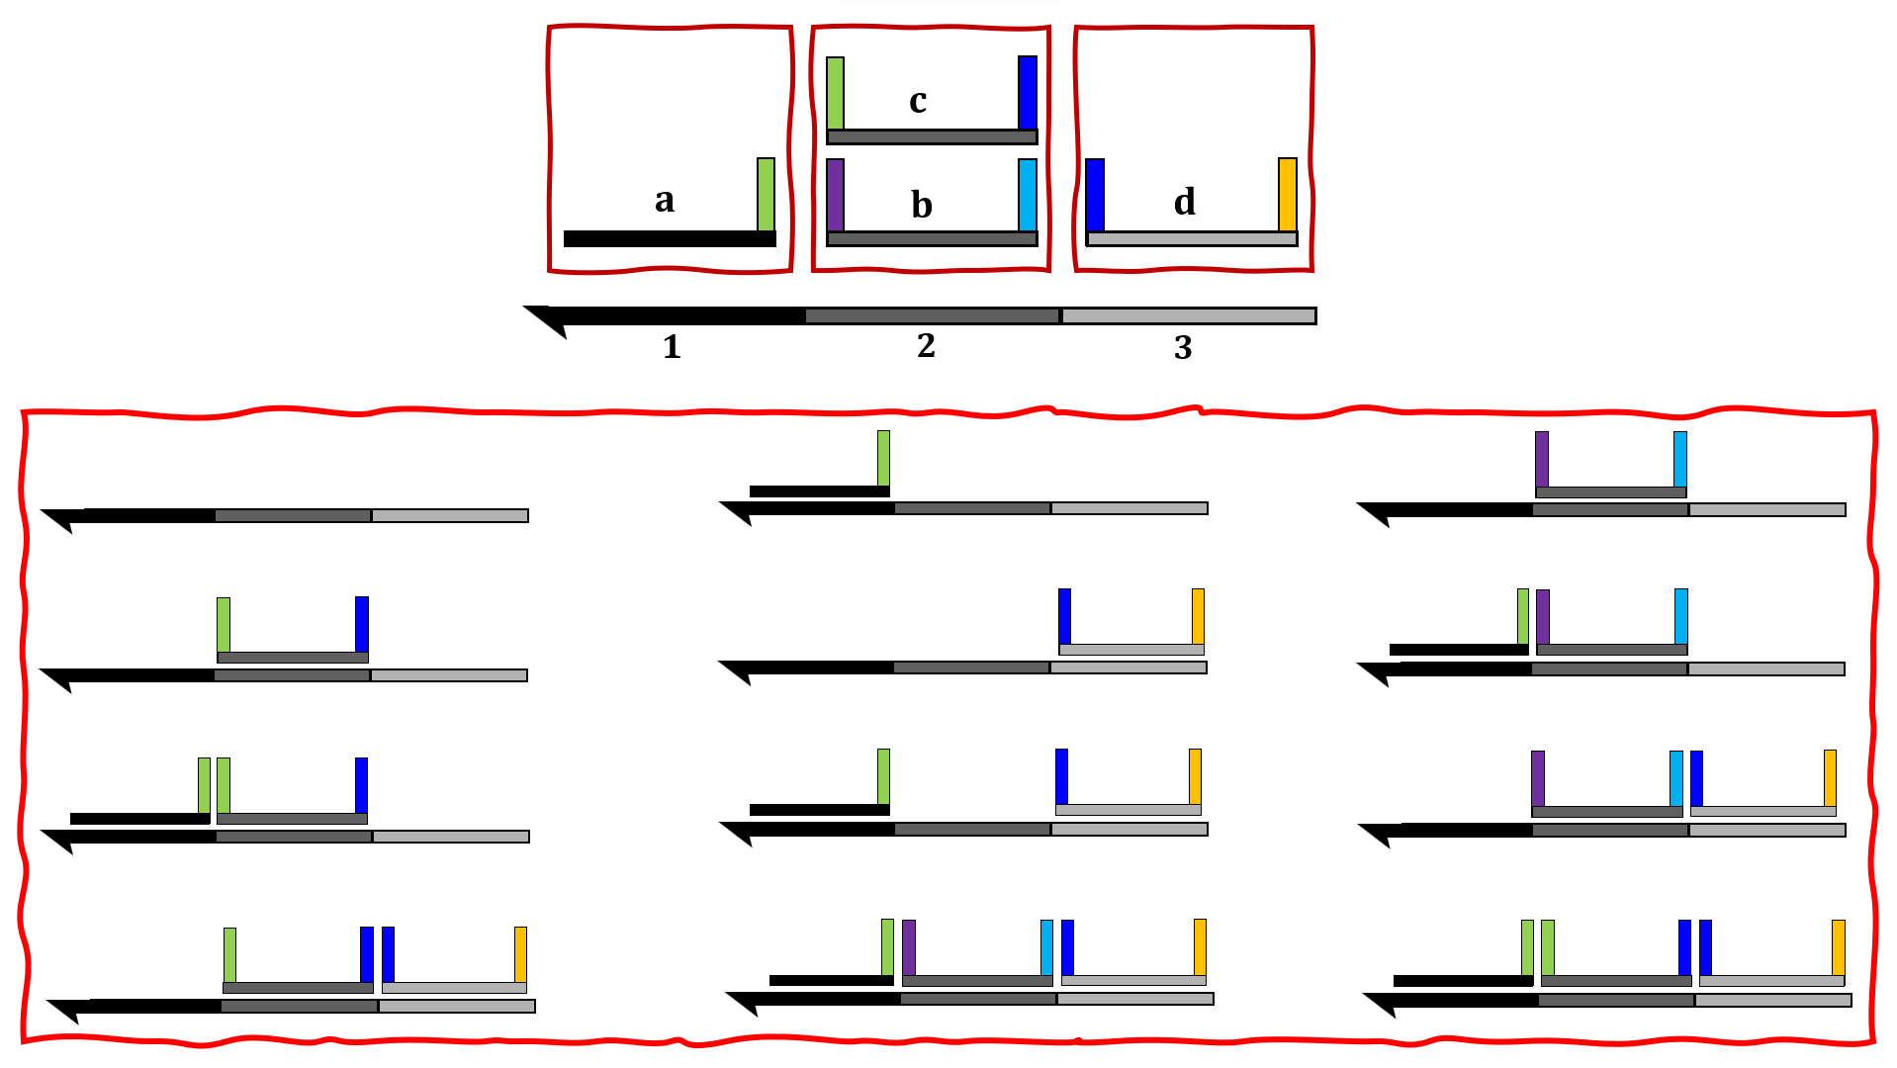
DOMAIN BASED ensemble of secondary structures for Scaffolded DNA Computer
Secondary structure
$⇕$
Scaffolded DNA Computer configuration
Scaffolded DNA Computer configuration space
$$Ω$$
How many different configurations we will have?
(Exponential in the # of scaffold domains)
$$\left|Ω\right|={(k+1)}^{N}$$

Slide 8
DOMAIN BASED energy model for the Scaffolded DNA Computer
Middle domain binding term
Toehold domain matching term
Entropic cost term
$$ΔG\left(X\right)= \sum_{s∈X}{ΔG\left(M(s)\right)}+\sum_{s_{i},s_{i+1} ∈ X}{ΔG\left(R\left(s_{i}\right),L\left(s_{i+1}\right)\right)}+l∗ΔG^{assoc}$$
$X$ is a configuration of size $l$
Configuration $A$ of size 2
GOAL
$$Pr⁡[$$
$$]$$
$$≫\sum_{c}{Pr⁡[c :is another configuration\text{ ]}}$$
At equilibrium
$$Ω$$
$$MFE=\min_{X∈Ω}{\{ΔG\left(X\right)\}}$$
$$MFE$$
$$Pr[target] =\frac{e^{− ΔG\left(target\right) /k_{B}T}}{Q}$$
$$Q=\sum_{X∈Ω}{e^{−ΔG\left(X\right)/k_{B}T}}$$

Slide 9
Computational complexity of Minimum Free Energy and the Partition Function
Input Type | MFE | Partition Function
Single Strand | $$O(n^{3})$$ | $$O(n^{3})$$
Multiple Strands, Bounded $(≤s)$ | $$?$$ | $$O\left(n^{3}\right)\left(s−1\right)!$$
Multiple Strands, Unbounded | $$NP−Complete$$ | $$?$$
Nussinov et al.
McCaskill
NUPACK
Condon et al.
$n$bases, $s$ strands
GOAL
At equilibrium
$$Pr⁡[$$
$$]$$
$$\sum_{c }{Pr⁡[}$$
$$≫$$
$$]$$
$$c :is another configuration$$
Efficiently

Slide 10
$$Ω$$
Is there recursive way to build these classes?
c
$${Ω }_{ε}$$
a
c
$${Ω }_{c}$$
b
d
$${Ω }_{a}$$
b
c
a
c
a
$$1$$
$$2$$
d
$$\left|Ω\right|={(k+1)}^{N} =9$$
$${Ω }_{b}$$
$$Q=\sum_{X∈Ω}{e^{−ΔG\left(X\right)/k_{B}T}}$$
a
d
$${Ω }_{d}$$
b
b
d

Slide 11
0
1
$$k_{1}$$
. . .
1
1
$$k_{2}$$
...
2
1
$$k_{1}$$
1
$$k_{1}$$
…
…

Slide 12
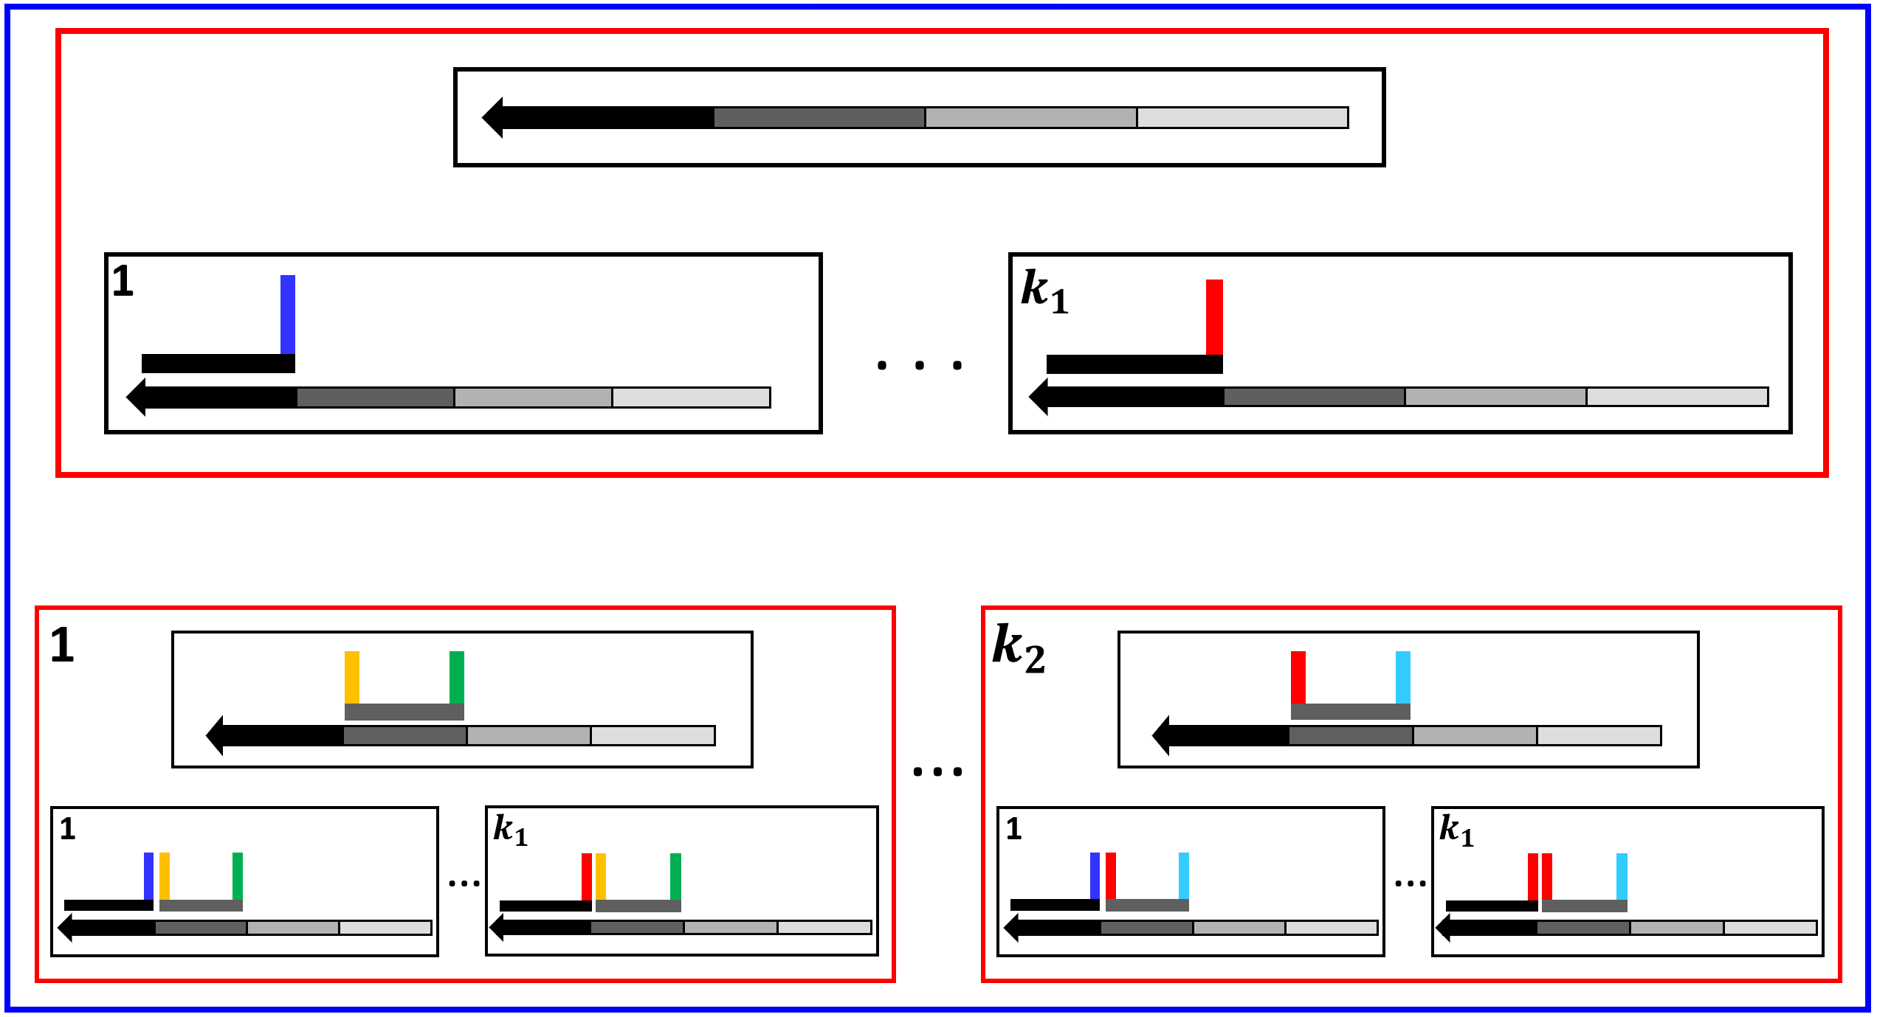
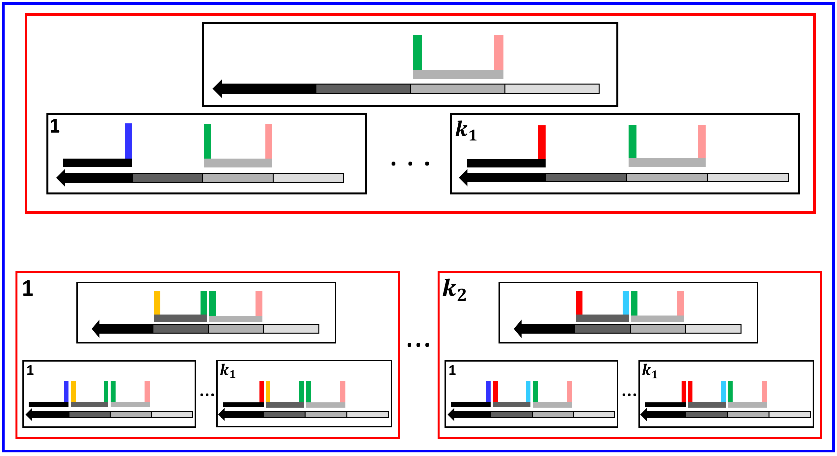
0
Layer = Domain
1
$$b$$
There is a 1-1 correspondence between each class of higher layers and a sub-class of any class in the current layer.
Class
2
$$a$$
$$Ω_{a}$$
$$a$$
$$a$$
$$Ω_{a}$$
$$Ω_{s}$$
$$s$$
Class
$$s$$
$$b$$
$$s$$
$$Ω_{a⟷s}$$
$${⊂Ω}_{s}$$
3
. . .
. . .
1
$$k_{3}$$
Sub-class
$$a$$
$$s$$
$$s$$
$$a$$
$$s$$
$$a$$
$$s$$
$$s$$
$$s$$
$$Ω_{a⟷s}$$

Slide 13
0
1
$$b$$
Class
2
$$Ω_{a}$$
$$a$$
Adjacent domain
=
Direct neighbour
$$a$$
$$a$$
$$Ω_{s}$$
$$s$$
Class
. . .
$$s$$
$$b$$
$$s$$
. . .
3
1
$$k_{3}$$
Sub-class
$$a$$
$$s$$
$$s$$
$$a$$
$$s$$
$$a$$
$$s$$
$$s$$
$$s$$
$$Ω_{a⟷s}$$

Slide 14
Can we use this recursive construction to propagate information through this hierarchy?
1 - Propagate information from only the previous layer (toehold matching possibility).
Class
Class $Ω_{a}$ Domain 2
Sub-class
$Ω_{a⟷s}$ Domain 3
1
1
$$a$$
$$a$$
$$s$$
1
$$k_{1}$$
1
$$k_{1}$$
$$a$$
…
$$a$$
$$a$$
$$s$$
…
$$a$$
$$s$$
Information given:$Q\left(Ω_{a}\right)$
Information needed: $Q\left(Ω_{a⟷s}\right)$
Middle domain binding and the entropic cost term
Toehold matching possibility term
$$Q\left(Ω_{a⟷s}\right)= . . . =e^{\frac{−∆G(M(s))+∆G^{assoc}}{k_{B}T}}∗{ e}^{\frac{−∆G(R\left(a\right), L\left(s\right))}{k_{B}T}}∗Q\left(Ω_{a}\right)$$

Slide 15
0
Class
1
$$b$$
Non-adjacent domain
$$Ω_{b}$$
2
$$a$$
$$a$$
$$a$$
Sub-class
$$s$$
$$Ω_{b⟷s}$$
. . .
$$s$$
$$b$$
$$s$$
. . .
3
1
$$k_{3}$$
Class
$$a$$
$$s$$
$$s$$
$$a$$
$$s$$
$$a$$
$$s$$
$$s$$
$$s$$
$$Ω_{s}$$

Slide 16
Can we use this recursive construction to propagate information through this hierarchy ?
2 - Propagate information from all other prior layers (No toehold matching possibility).
Class
Sub-class
Class $Ω_{b}$ Domain 1
$Ω_{b⟷s}$ Domain 3
$$b$$
$$b$$
$$s$$
Information given:$Q\left(Ω_{b}\right)$
Information needed: $Q\left(Ω_{b⟷s}\right)$
Middle domain binding and the entropic cost term
$$Q\left(Ω_{b⟷s}\right)= . . . =e^{\frac{−∆G(M(s))+∆G^{assoc}}{k_{B}T}}∗Q\left(Ω_{b}\right)$$

Slide 17
Middle domain binding
and the entropic cost
0
$$\sum_{b}{ }$$
$$Q\left(Ω_{b⟷s}\right)=e^{\frac{−∆G(M(s))+∆G^{assoc}}{k_{B}T}}∗Q\left(Ω_{b}\right)$$
1
$$+$$
Toehold matching possibility
$$\sum_{a}{ }$$
$$Q\left(Ω_{a⟷s}\right)=e^{\frac{−∆G(M(s))+∆G^{assoc}}{k_{B}T}}∗{ e}^{\frac{−∆G(R\left(a\right),L\left(s\right))}{k_{B}T}}∗Q\left(Ω_{a}\right)$$
2
Class
. . .
. . .
$$Ω_{s}$$
3

Slide 18
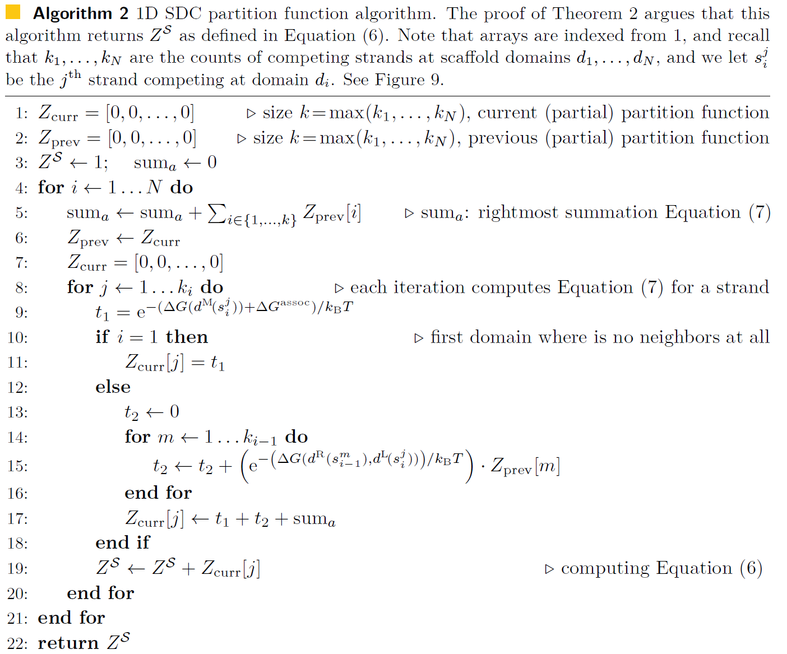
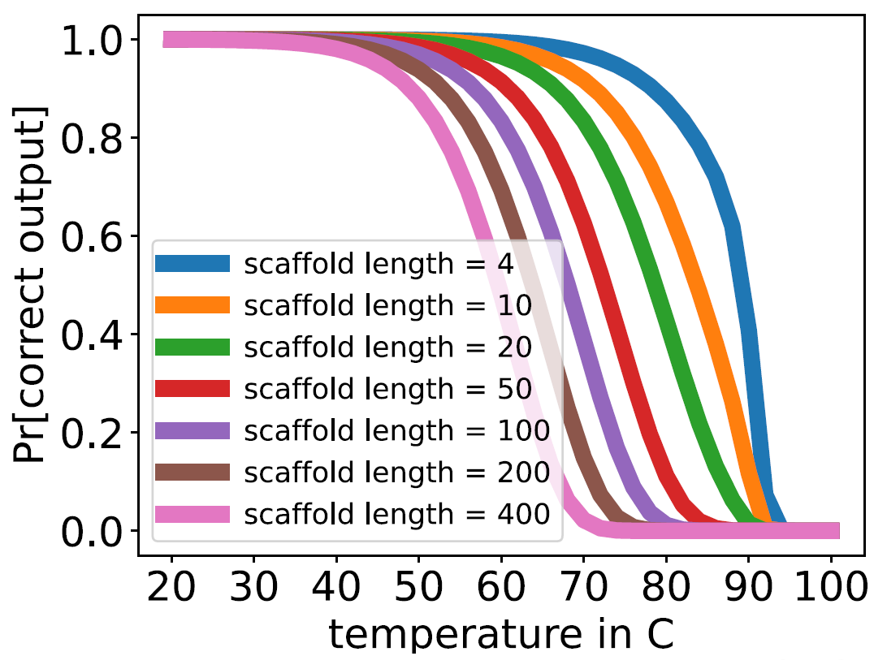
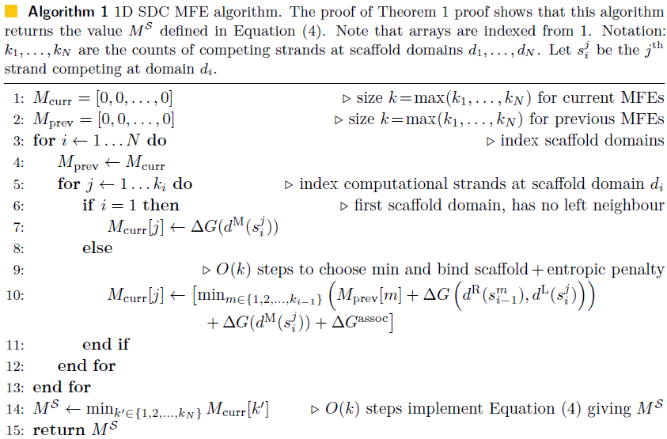
$$Q\left(Ω_{s}\right)=e^{\frac{−∆G(M(s))+∆G^{assoc}}{k_{B}T}}∗\left[\sum_{\begin{aligned}s^{′}∈{LD}_{s} \\ \end{aligned}}{\left({ e}^{\frac{−∆G\left(R\left(s^{′}\right), L\left(s\right)\right)}{k_{B}T}}∗Q\left(Ω_{s^{′}}\right)\right)}+1+\sum_{\begin{aligned}s^{′}≺s \\ s^{′}∉{LD}_{s}\end{aligned}}{Q\left(Ω_{p′}\right)}\right]$$
$$Q =1+\sum_{s∈T}{Q(Ω_{s})}$$
Benefits of Domain Based models !!
Previous: 1 simulation of length 13
Now: 280 simulations in 20 min [800 strands]

Slide 19
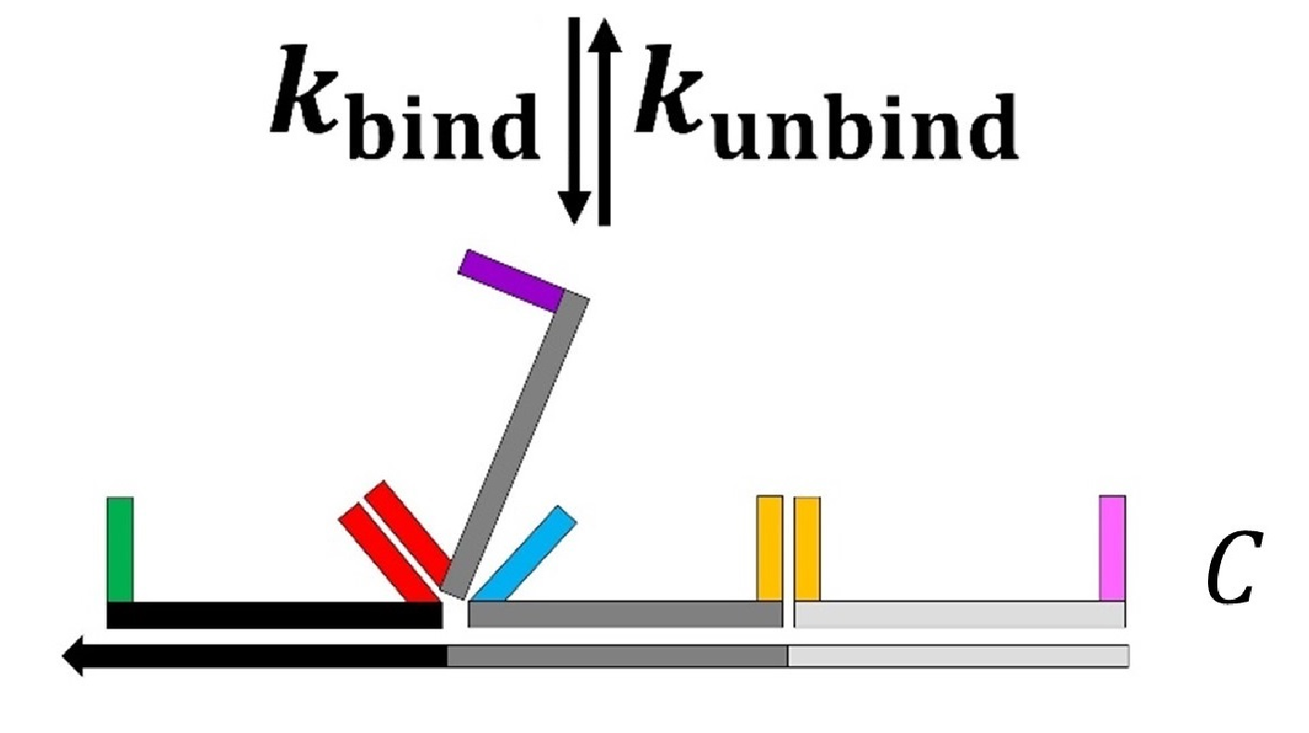
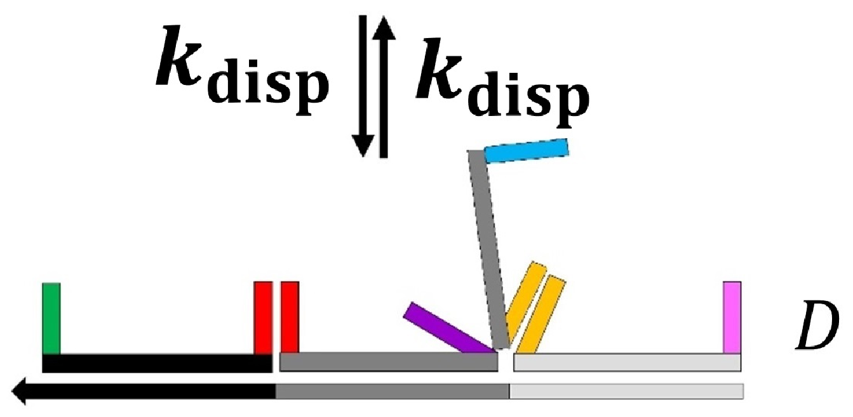
Kinetic model for Scaffolded DNA computer
The kinetic model for Scaffolded DNA Computer is a continuous-time Markov chain (CTMC) that satisfies detailed balance.
$$1$$
$$2$$
$$3$$
$$4$$
$$. . .$$
GOAL
Understanding system kinetics.
Ability to propose some ideas that may help in speeding up the system.

Slide 20
Possible kinetic scenario with the Scaffolded DNA computer
. . .
4
5
. . .
3
4
. . .
2
3
. . .
3
4
4
5
Random walks
. . .

Slide 21
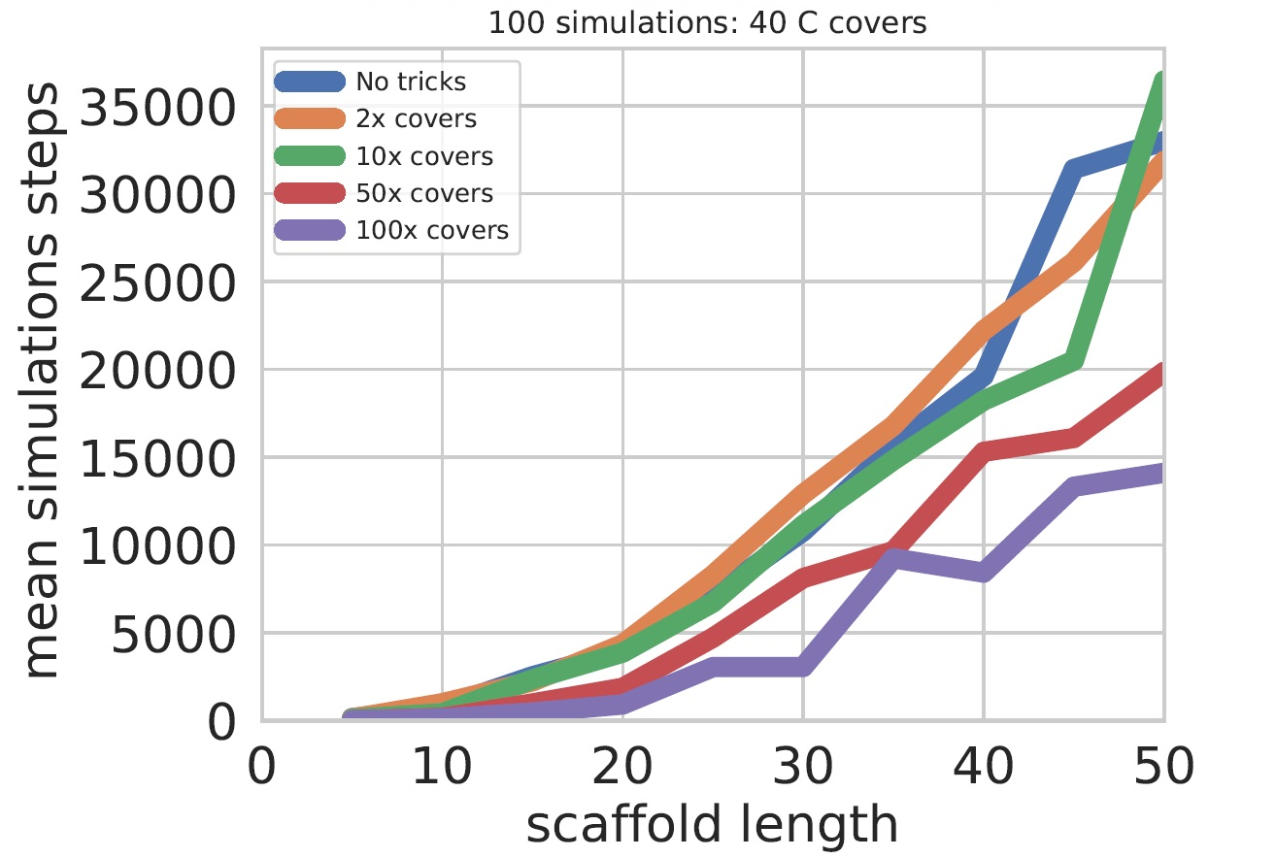
Proposal 1: Covers
Scaffold with covers (here at the second, third, fourth, and sixth scaffold domains)
. . .
...
$$1$$
$$2$$
$$N$$

Slide 22
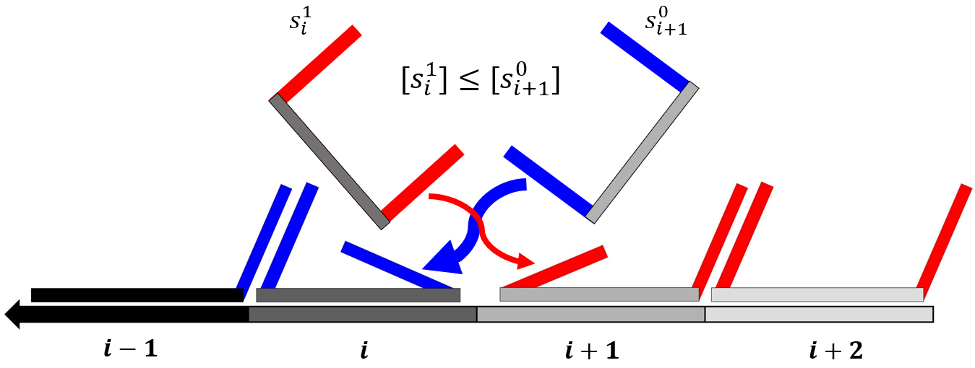
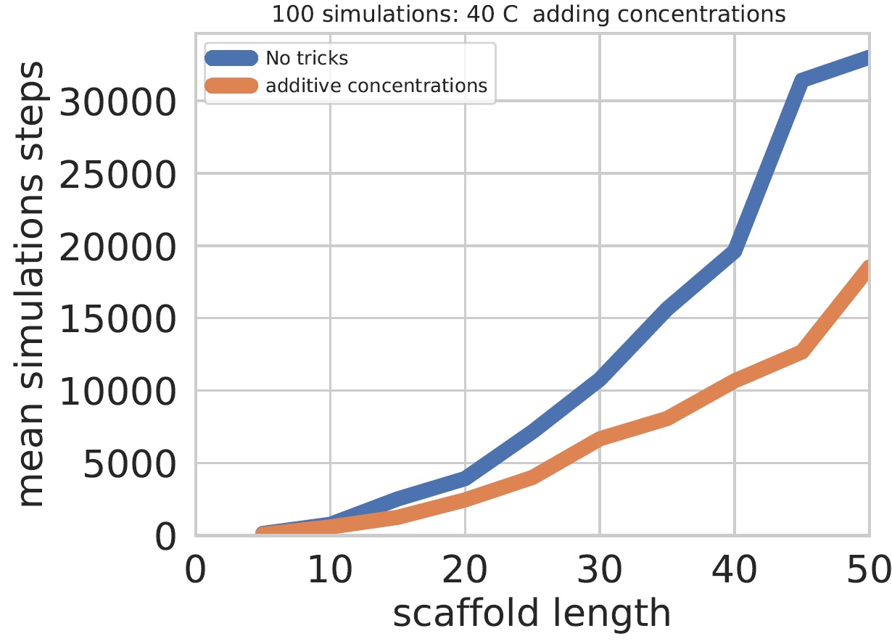
Proposal 2: Monotonically increasing competing strands concentrations along the scaffold
Lower concentration
higher concentration
$$1x$$
$$2x$$
$$Nx$$
$$⇓$$
$$⇓$$
$$⇓$$
. . .
...
$$1$$
$$2$$
$$N$$

Slide 23
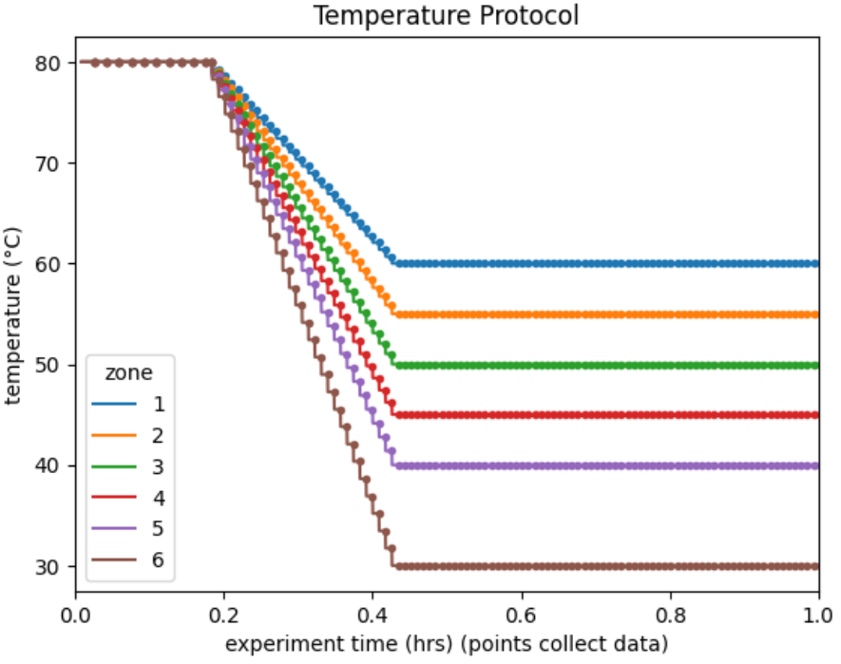
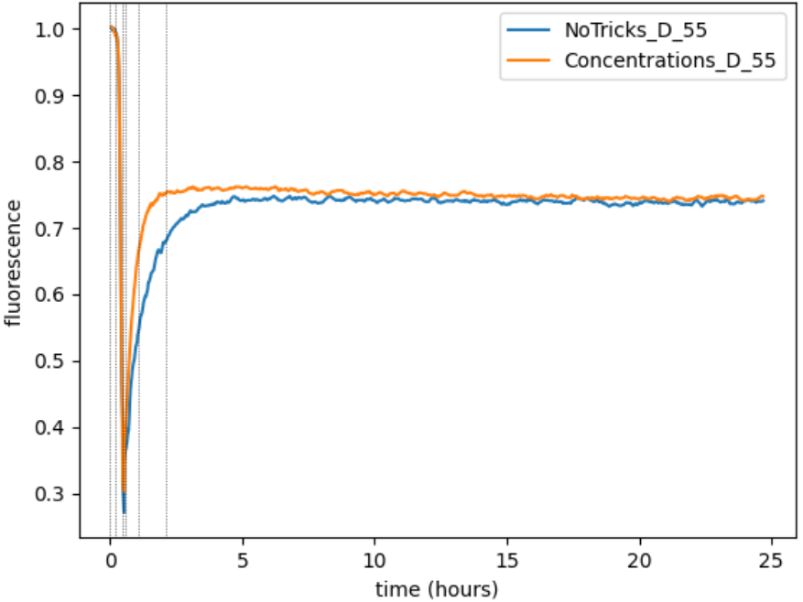
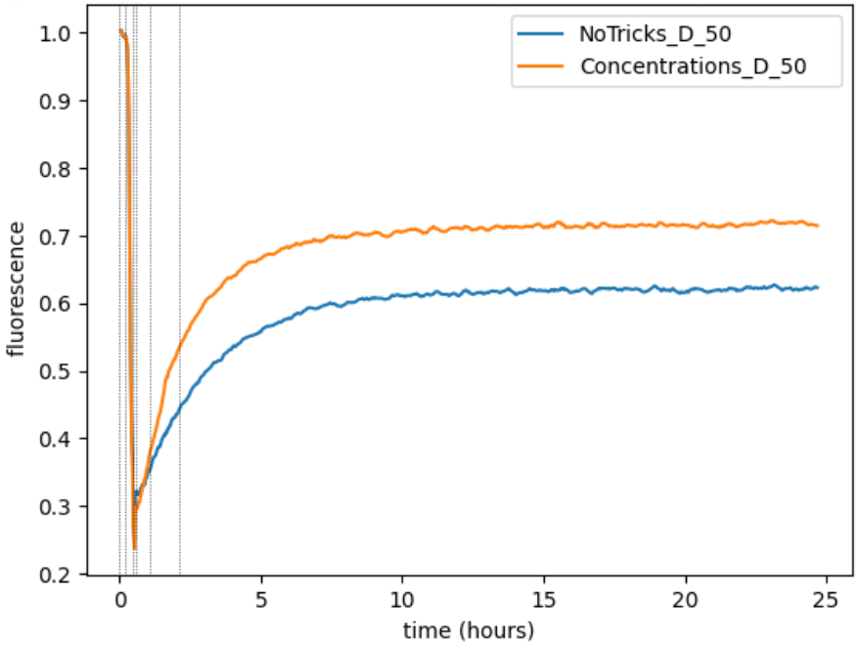
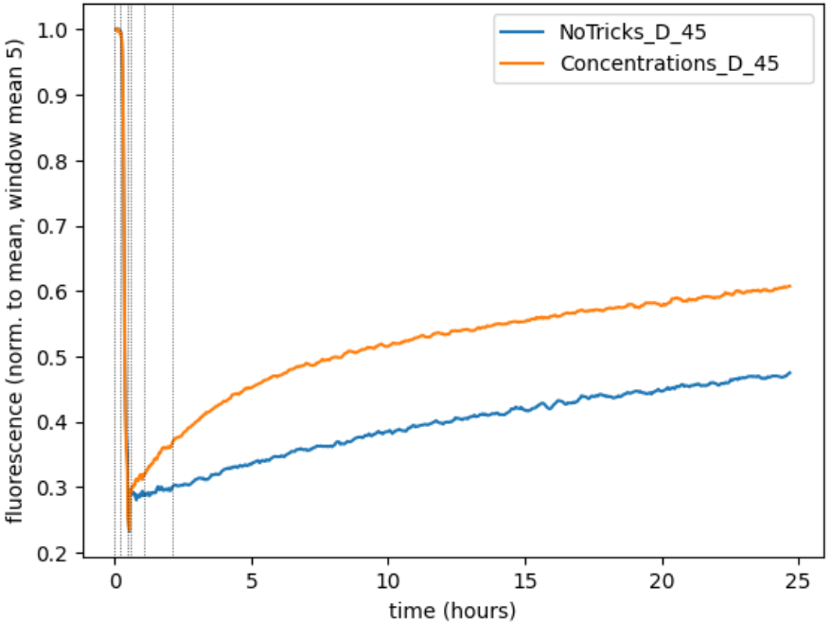
Concentration trick experiment [LATE INPUT] with concentrations [1x, 1x, 3x, 5x]
$$1x$$
$$3x$$
$$5x$$
$$1x$$
$$\overline{B}$$
$$\overline{D}$$
$$\overline{C}$$
Q
$$\overline{A}$$
$$\overline{B}$$
$$\overline{D}$$
$$\overline{C}$$
F
$$\overline{E}$$
$$A$$
$$B$$
$$C$$
$$D$$
$$E$$

Slide 24
Conclusions
DONE
Our polynomial time algorithms for MFE and Partition Function give some evidence that Scaffolded DNA Computer is thermodynamically favourable.
The Scaffolded DNA Computer kinetic simulator confirms our intuition about the tricks that we think it will speed up the system.
Our preliminary experiments are promising with respect to the proposed tricks.
In progress
Future Work
Extending the work to the 2D case of "Algorithmic DNA Origami".
Experimentally testing our tricks with bigger systems.
Looking for other fast thermodynamic prediction algorithms for other engineered multistranded and/or pseudoknotted systems?
DNA strand displacement circuits
DNA tile-based self-assembly systems
DNA origami systems

Slide 25
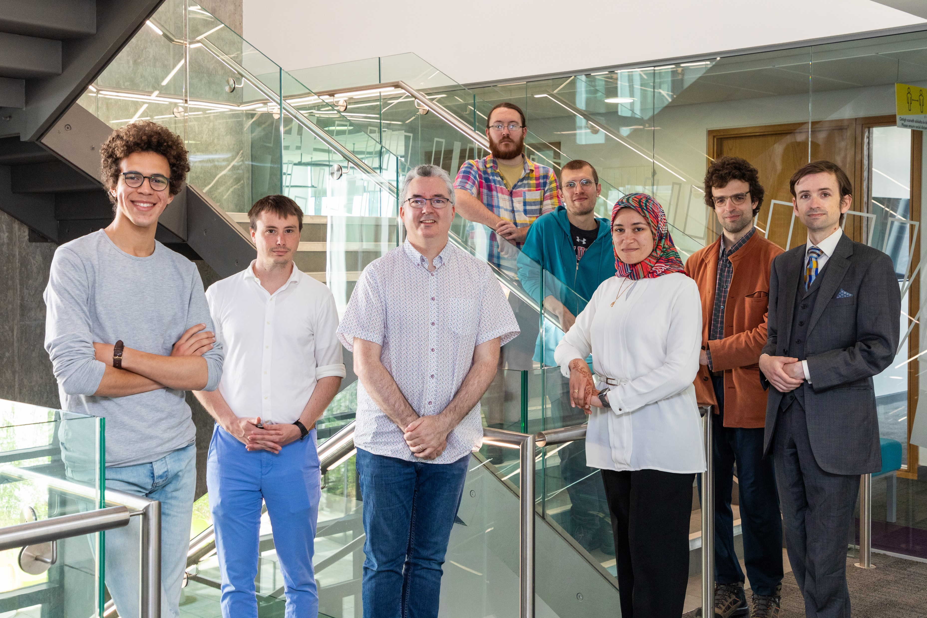
Thanks
Cai Wood➔22
Abeer Eshra➔21
dna.hamilton.ie
We're hiring!
Postdoc, PhD
Acknowledgments: Dave Doty, David Soloveichik, Eric Winfree and Boya Wang.

