Slide 1
It’s not about DNA, It’s all about Pizza
Ahmed Shalaby
2nd year PhD
Supervisor: Damien Woods
CS workshop [19/06/2024]

Slide 2
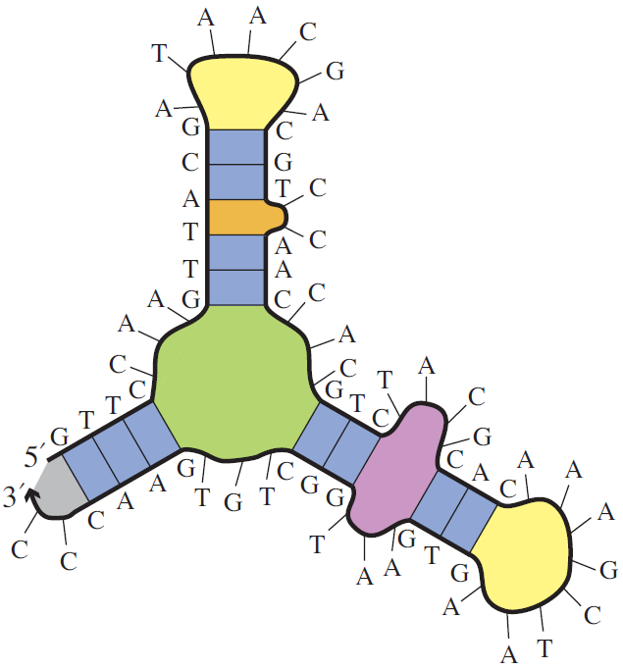
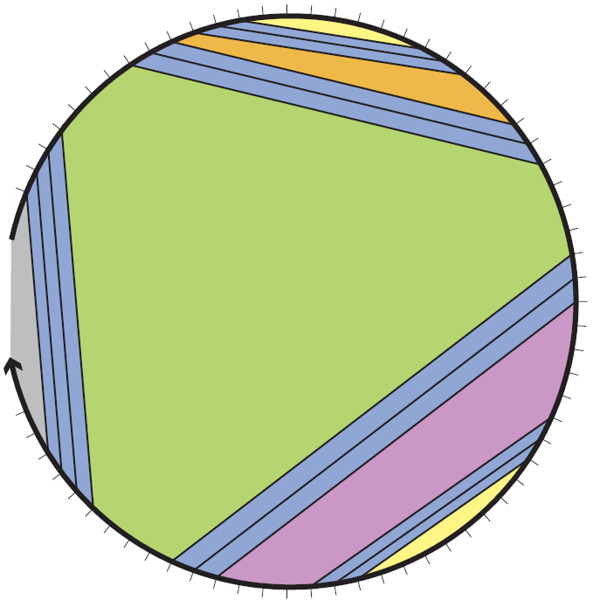
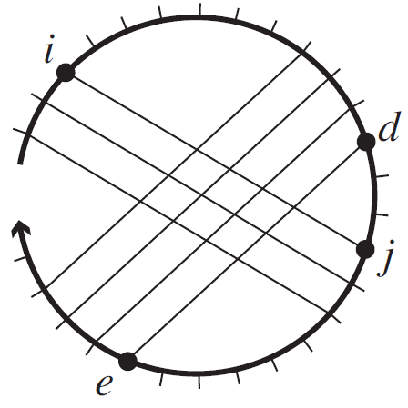
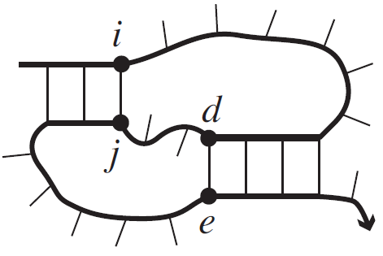
Secondary structure
Dirks et al. 2007
pseudoknot-free
A
T
T
C
Dirks et al. 2007
G
G
Single stranded DNA
Secondary structure
Polymer graph representation
$$NP−Complete$$
pseudoknotted
Dirks et al. 2007
Dirks et al. 2007

Slide 3
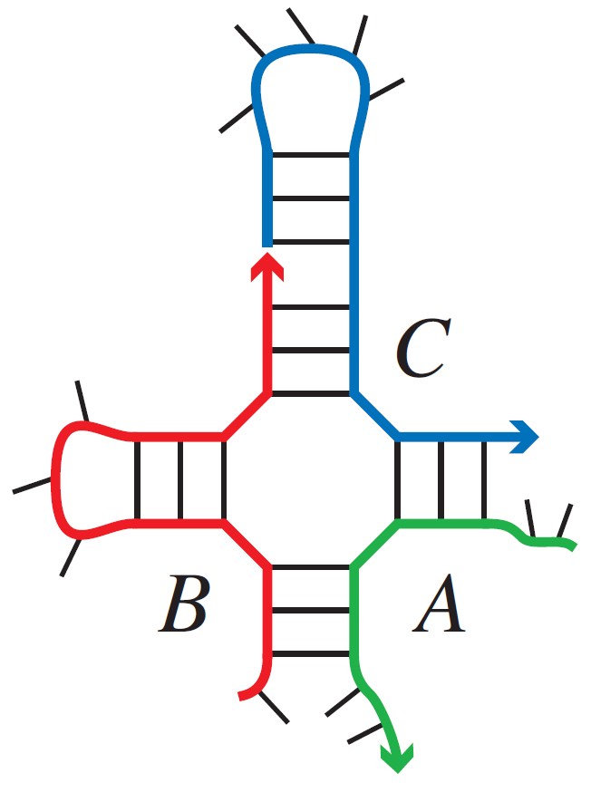
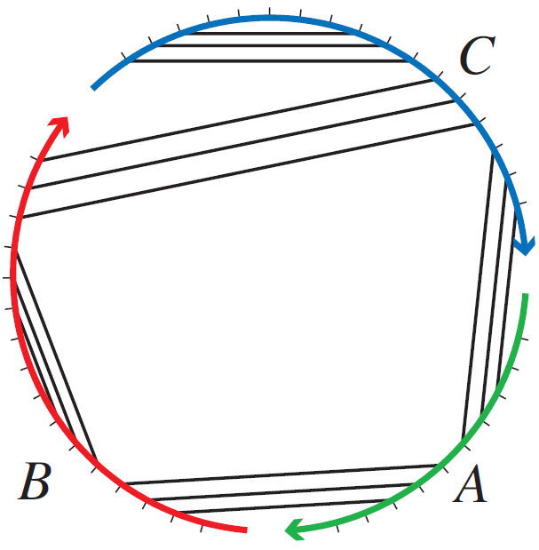
Energy models, Minimum Free Energy and Partition Function
Single stranded system
Multi stranded system of $s$ strands
$$ΔG\left(S\right)$$
Energy model
Capture the free energy
of secondary structure
Free energy
$$MFE= \min_{S∈Ω}{ΔG\left(S\right)}$$
Minimum Free Energy
System secondary structures

Slide 4
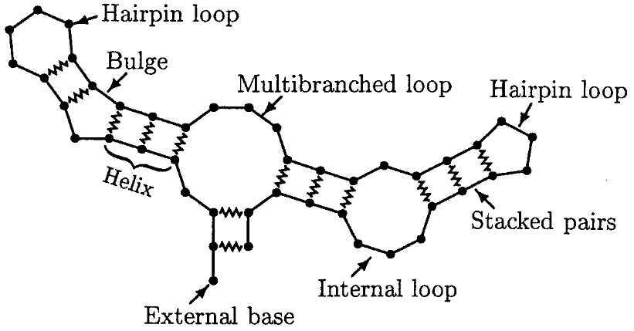
Energy model: Loop model
c = 3 strands
unique strands
$$ΔG\left(S\right)=\sum_{l ∈ S}{ΔG(l)}$$
$$ΔG\left(S\right)=\sum_{l}{ΔG(l)}+(c−1) ΔG^{assoc}$$
$$\min_{S∈Ω}{ΔG(S)}$$
$Ω:$ the set of all secondary structures

Slide 5
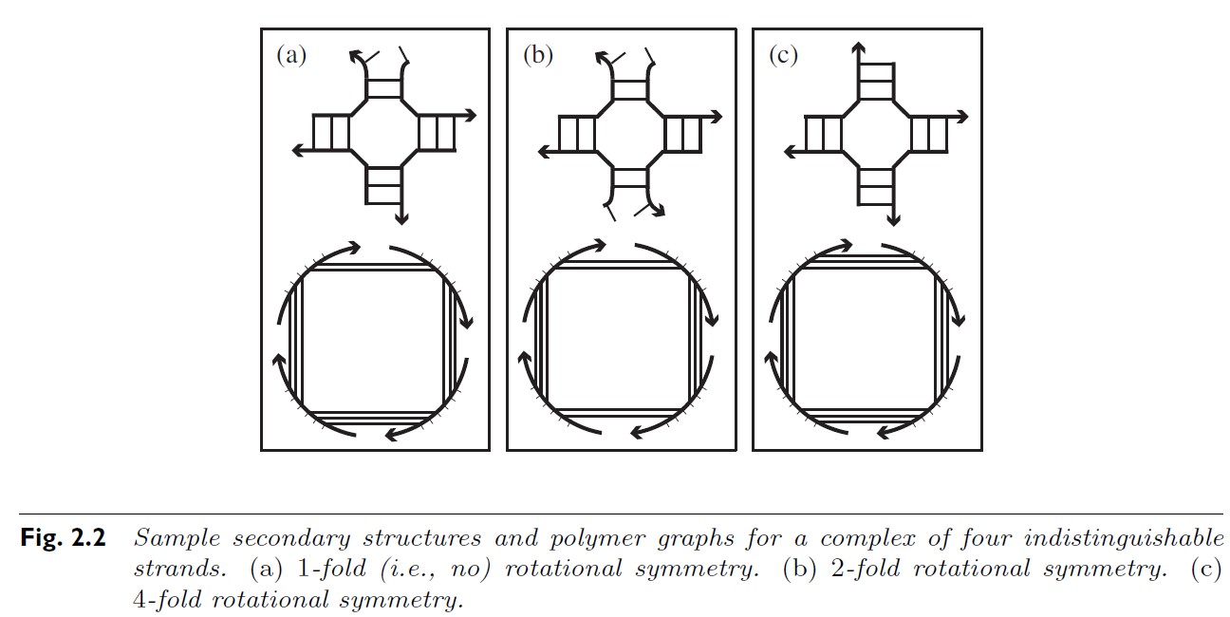
Energy model: Loop model (allowing repeats)
Free energy
Loop energy
Entropic association cost
Symmetry penalty
$$ΔG\left(S\right)= \sum_{l∈S}{ΔG\left(l\right)}+\left(c−1\right)∗∆G^{assoc}+k_{B}T∗logR$$
$$−$$
$$+$$
$$+$$
c$=4$ strands
$$\min_{S∈Ω}{ΔG(S)}$$
1
2
4
$Ω:$ the set of all connected structures
$R:$ degree of rotational symmetry

Slide 6
Computational complexity of Minimum Free Energy algorithms
Input Type | MFE
Single Strand | $$O(N^{3})$$
Multiple unique Strands, Bounded $(≤c)$ | $$O\left(N^{3}\left(c−1\right)!\right)$$
Multiple Strands allowing repeats, Bounded $(≤c)$ | $$?$$
Multiple Strands, Unbounded | $$NP−Complete$$
$N$bases, $c$ strands
Open problem for $≈20$ years

Slide 7
Why symmetry makes it difficult?
Input Type | MFE
Single Strand (Loop model) | $$O(N^{3})$$
Multiple unique Strands, Bounded $(≤c)$ | $$O\left(N^{3}\left(c−1\right)!\right)$$
Multiple Strands, Bounded $(≤c)$ | $$?$$
Dynamic
programming
algorithms
$N$bases, $c$ strands
All of these are dynamic programming algorithms
Subproblems
Big problem

Slide 8
All of these are dynamic programming algorithms
Subproblems
Big problem
Local point of view
?
Global property

Slide 9
Possible approach
Input Type | MFE
Single Strand (Loop model) | $$O(N^{3})$$
Multiple unique Strands, Bounded $(≤c)$ | $$O\left(N^{3}\left(c−1\right)!\right)$$
Multiple Strands, Bounded $(≤c)$ | $$?$$
$N$bases, $c$ strands
$$ΔG\left(S\right)=\sum_{l}{ΔG(l)}+\left(c−1\right){ΔG}^{assoc}+k_{B}T∗logR$$
$$ΔG′\left(S\right)=\sum_{l}{ΔG(l)}+(c−1) {ΔG}^{assoc}$$
Ignore symmetry

Slide 10
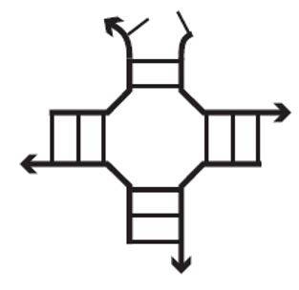
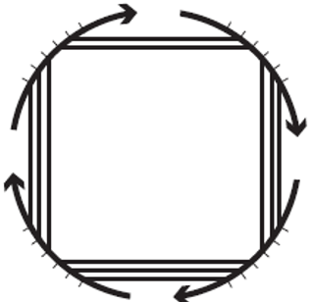
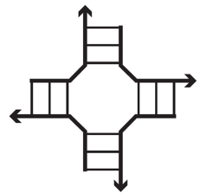
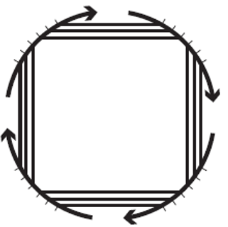
Let’s ignore the symmetry for a while
$$ΔG′\left(S\right)$$

Slide 11
$$Ω$$
$$ΔG′\left(S\right)$$

Slide 12
$$Ω$$
$$ΔG′\left(S\right)$$

Slide 13
$$Ω$$
$$1$$
MFE is asymmetric
$$ΔG′\left(S\right)$$

Slide 14
$$Ω$$
$$2$$
MFE is symmetric
$$ΔG′\left(S\right)$$

Slide 15
$$Ω$$
$$2$$
MFE is symmetric
$$ΔG′\left(S\right)$$
$$k_{B}T∗log R$$

Slide 16
$$Ω$$
$$2$$
MFE is symmetric
$$ΔG′\left(S\right)$$
$$Expoential$$

Slide 17
Our solution

Slide 19
$$S_{x}$$
Symmetric
$$ΔG′\left(S\right)$$
$$X$$
$S_{x}$ and $S_{y}$
Admissible cut
$${ΔG′(S}_{y})≤ΔG′(S_{x})$$
$$S_{z}$$
Asymmetric
$${ΔG′(S}_{y})≤G\left(S_{z}\right)≤ΔG′(S_{x})$$
$$S_{y}$$
Symmetric

Slide 20
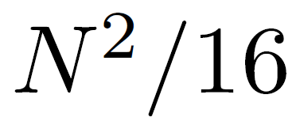
$$S_{x}$$
Upper bound
Symmetric
$$+$$
$$X$$
$$S_{z}$$
$S_{x}$ and $S_{y}$
Admissible cut
Asymmetric
Adjusting the backtracking algorithm to go through energy levels sequentially starting from the MFE level.
$$S_{y}$$
Symmetric

Slide 21
$$Ω$$
$$ΔG′\left(S\right)$$
$$Polynomial$$

Slide 22
$$Ω$$
$$ΔG′\left(S\right)$$
$$Polynomial$$

Slide 23
Computational complexity of Minimum Free Energy algorithms
Input Type | MFE
Single Strand (Loop model) | $$O(N^{3})$$
Multiple unique Strands, Bounded $(≤c)$ | $$O\left(N^{3}\left(c−1\right)!\right)$$
Multiple Strands, Bounded $(≤c)$ | $$O\left(N^{4}\left(c−1\right)!\right)$$
Multiple Strands, Unbounded | $$NP−Complete$$
$N$bases, $c$ strands

Slide 24
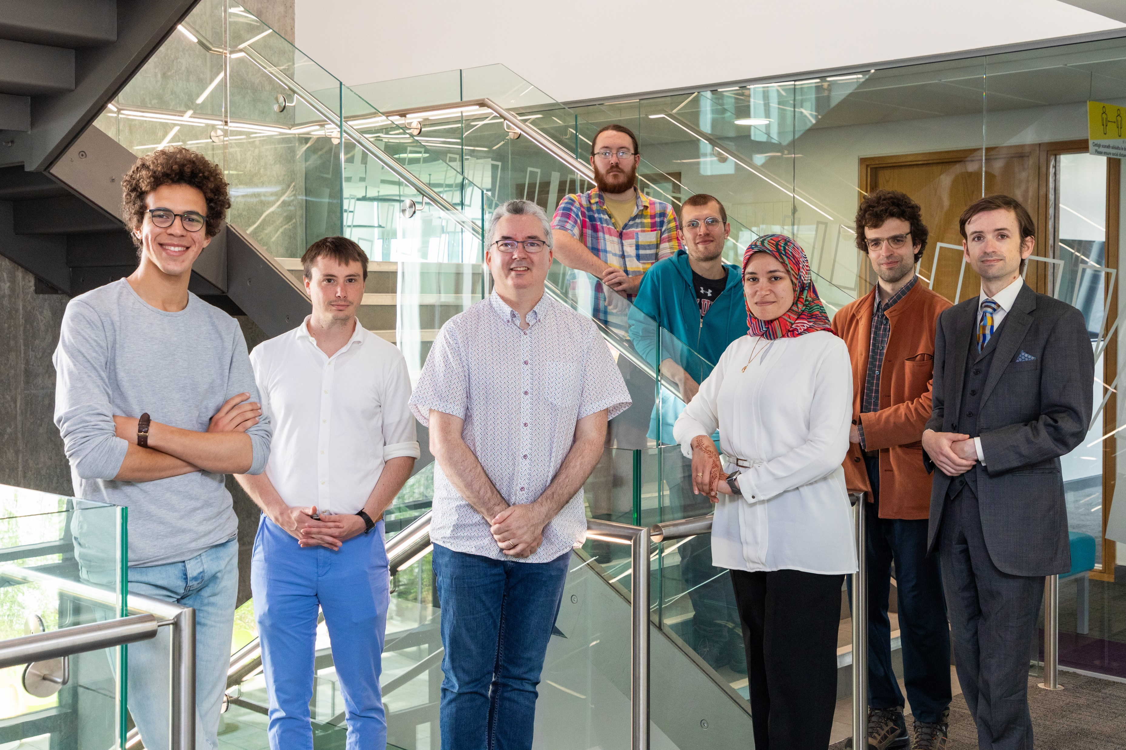
Thanks
dna.hamilton.ie/shalaby

